Slide 1
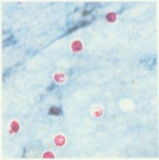
Cryptosporidium parvum

Slide 2
Introduction
Cryptosporidium is associated with infection in persons with immunodeficiency such as those with AIDS .
Also it occurs in conditions which reduce normal immune response (e.g. treatment with immunosuppressive drugs ) .

Slide 3
cryptosporidium species infect humans and wide range of animals , infection may be zoonotic from infected animal to human .

Slide 4
Transmission
Transmitted by ingestion of infective oocysts from contaminated water , food or hands .

Slide 5
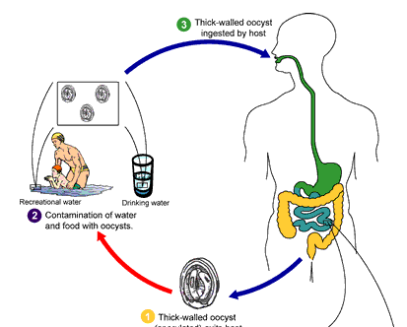
Life cycle

Slide 6
Clinical features
Fatal diarrhea in immunocompromised patients .
Gastroenteritis in immunocompetent persons .

Slide 7
Lab diagnosis
Specimen : stool ( watery with offensive odor)
Diagnostic stage : oocyst
Modified ZN stain

Slide 9
Control
Health education
Providing pure water supply
Improve sanitation
Personal hygiene

