Slide 1
Light microscope
Mosab Nouraldein mohammed
Musab.noor13@gmail.com

Slide 2
Microscope = mickros “ small” + scope “too see”

Slide 3
Definition
Is an optical instrument used to see objects that are too small for the naked eye

Slide 4
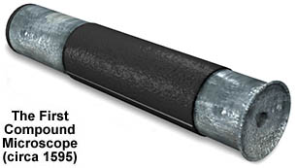
History of the Microscope
1590 –first compound microscope

Slide 5
History of the Microscope
1655 – Robert Hooke used a compound microscope to observe pores in cork
  He called them “cells”

Slide 6
History of the Microscope
Antoine van Leeuwenhoek
  1st to see single-celled organisms in pond water

Slide 7
Microscope Vocabulary
Magnification: increase of an object’s apparent size
Resolution: power to show details clearly
Both are needed to see a clear image

Slide 8
Types of Microscopes
Light Microscopy
Use of any kind of microscope that uses visible light to observe specimens
Types of light microscopy
  Compound light microscopy
  Darkfield microscopy
  Phase-contrast microscopy
  Fluorescence microscopy
  Confocal microscopy
Electronic Microscopes

Slide 9
The Compound Light Microscope
In a compound microscope, the image from the objective lens is magnified again by the ocular lens
Total magnification is product of the magnification of its ocular and its objective lenses
Total magnification = objective lens × ocular lens
Resolution is the ability of the lenses to distinguish two points

Slide 10
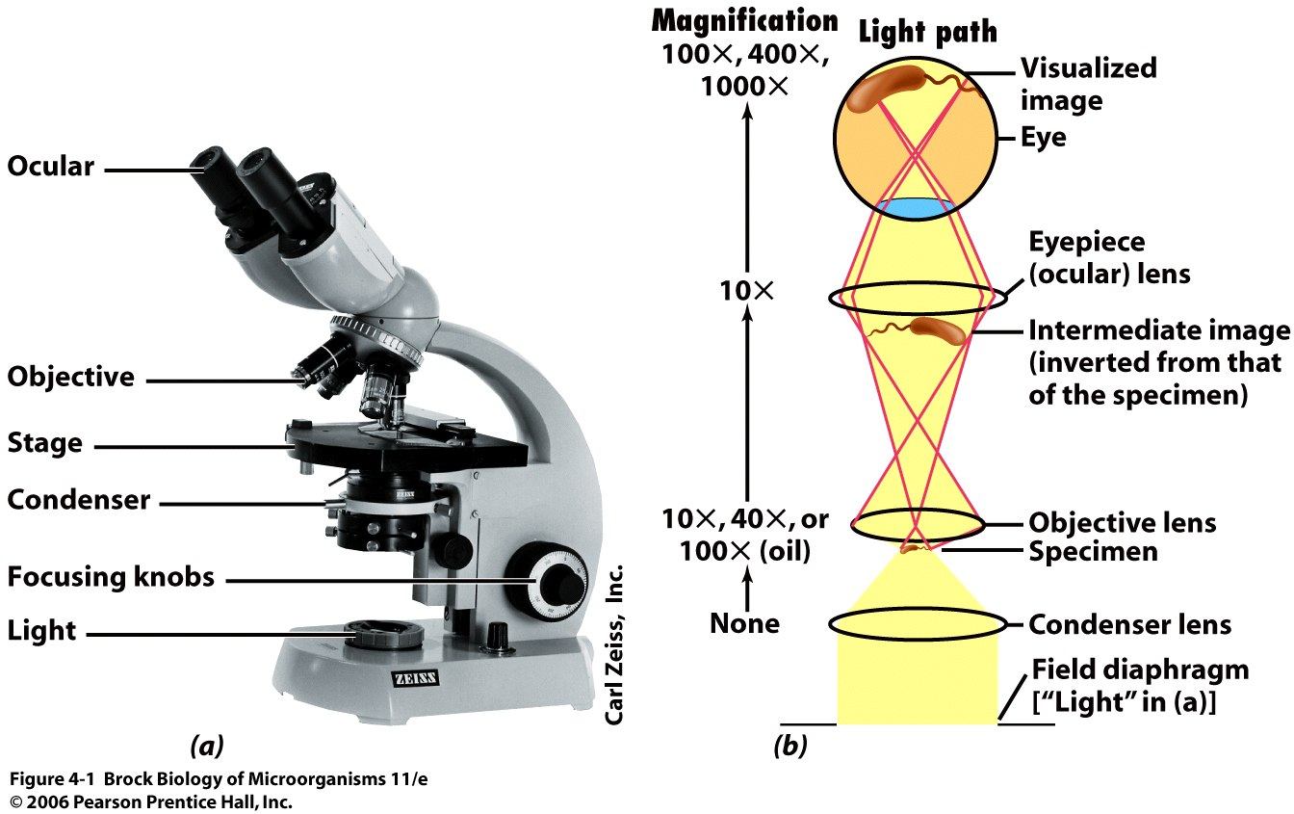

Slide 11
Ocular lens ( eye piece):
The lens at the top that you look through .
They are usually 10x or 15x power

Slide 12
Arm :
Supports the tube and connect it to the base

Slide 13
Revolving nosepiece :
It holds two or more objectives lenses and can be rotated .

Slide 14
Objective lenses :
Usually you find 3 or 4 objectives lenses on a microscope .They almost always consist of 4x, 10x, 40, 100x powers .
When coupled with 10x ( most common ) eye lens , we get total magnifications of 40 x, 100x, 400x and 1000x .

Slide 15
The shortest objective lens is lowest power , the longest one is the lens with greatest power .
Lenses are color coded :
Red : 4x
Yellow : 10x ( low power objective)
Blue : 40x ( high power objective)
White : 100x

Slide 16
Stage :
The platform where you place your slides

Slide 17
Stage clips :
Hold the slide in place on the stage

Slide 18
Diaphragm:
Control the amount of light going through the specimen

Slide 19
Light source :
Makes the specimen easier to see.

Slide 20
Base :
The bottom of the microscope ,used for support

Slide 21
Steps to Use:
Rotate the low power objective into place and make sure the stage is all the way down.
Place slide on stage making sure object to be viewed is centered over the hole in the stage. Use the stage clips to hold the slide in place.
Turn light on.
Focus first with the coarse adjustment knob. Once in focus on low power, turn the nosepiece until the next higher lens is in place.
Use FINE adjustment knob ONLY and focus the object.

Slide 22
Microscope Care
Always carry with 2 hands
Never touch the lenses with your fingers.
Only use lens paper for cleaning
Keep objects clear of desk and cords
When you are finished with your "scope", rotate the nosepiece so that it's on the low power objective, roll the stage down to lowest level, rubber band the cord, then replace the dust cover.

