Slide 1
Hard tick

Slide 2
classification
Class : Arachnida
Order : Metastigmata
Family : Ixodidae
Genus: Ixodes
Species: I.ricinus
I.persulcatus

Slide 3
Distribution
World wide , mostly in temperate regions.

Slide 4
External morphology
Dorsoventerally flattened and oval in shape
Female is larger than male
Females need more blood meals than male because they are need blood to produce their eggs.
Capitulum is projected forward and can be seen from dorsal view.
Palp is club-shaped they have a dorsal plate called shield or scutum
They have four pairs of legs which are six-segmented

Slide 5
Anus is located ventrally in the posterior third of the body
Genital opening is present about the base of the second or the third pair of legs .

Slide 6
egg
Laying thousands of eggs (1000-8000)
Small and spherical
eggs are laid in gelatinous mass
Eggs hatch after 2-3 weeks or up to several months.

Slide 7
larva
Six legged larva
Referred to as seed tick
Remain inactive for few days , then become active and seeking their blood meal.
It attracted to the host by many factors, odor, warmth, vibration and movement
The host seeking behavior of larva and also nymph is called questing .

Slide 8
Nymph
Eight legged
Have questing behavior
There is only one nymphal stage ( soft ticks have several nymphal stages).

Slide 9
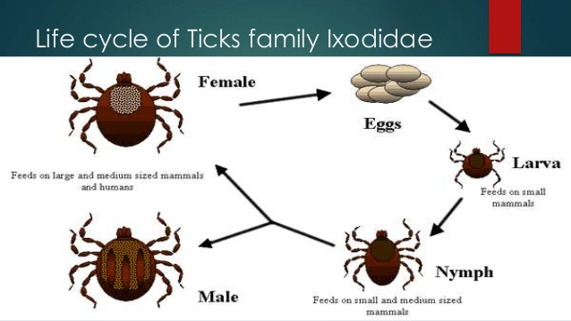
Life cycle

Slide 10
Feeding habits
Both male , female adults, nymphal and larval stages are hematophagous.
The newy formed adult may remains more or less inactive for about seven days.

Slide 11
Source of nutreints
Feeds on wide variety of mammals, cattle, dogs, human,…

Slide 12
Breeding areas
Under the leaves ,stones ,…etc

Slide 13
Resting areas
They remains on their host for longer period of time ,sucking blood , then they drop off.
They rest under leaves , stones ,..etc

Slide 14
Medical importance
Tick paralysis
Arbovirus
Rickettsia

