Slide 1
Paragonimus westermani
Mosab Nouraldein

Slide 2
Common names
Lung fluke , oriental lung fluke, Japanese lung fluke.

Slide 3
Disease
Paragonimus westermani is the causative agent of Paragonimiasis

Slide 4
Geographical distribution
  Paragonimus westermani is distributed in southeast Asia and Japan

Slide 5
Transmission
Primarily through consumption of raw, salted, or partially cooked freshwater crabs or crayfish (crawfish) containing inmetacercariae.

Slide 6
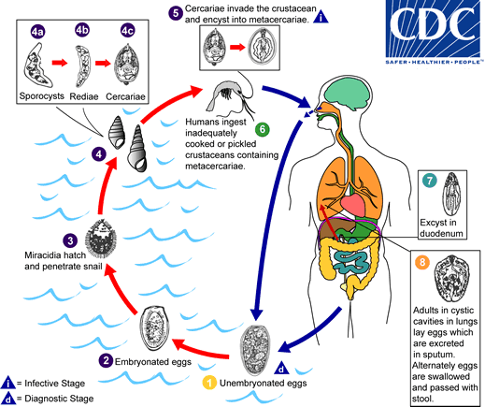
Life cycle

Slide 7
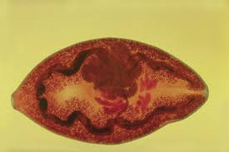
Adult stage

Slide 8
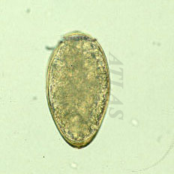
Egg

Slide 9
Pathology
Incubation Period:
  Variable; approximately 7-12 weeks after ingestion of metacercaria

Slide 10
Clinical features :
  Acute phase
    diarrhea, abdominal pain, fever, cough, hepatosplenomegaly, pulmonary abnormalities, and eosinophilia

Slide 11
  Chronic phase,
    pulmonary manifestations include dry cough, rusty-colored or blooded sputum on exertion, and chest pain
    extrapulmonary disease is not uncommon, with flukes found in such sites as the CNS, subcutaneous tissues, intestinal wall, peritoneal cavity, liver, lymph nodes and genitourinary tract

Slide 12
Lab diagnosis
  Microscopic exam- identification of Paragonimus eggs in stool or sputum.
  Serology

Slide 13
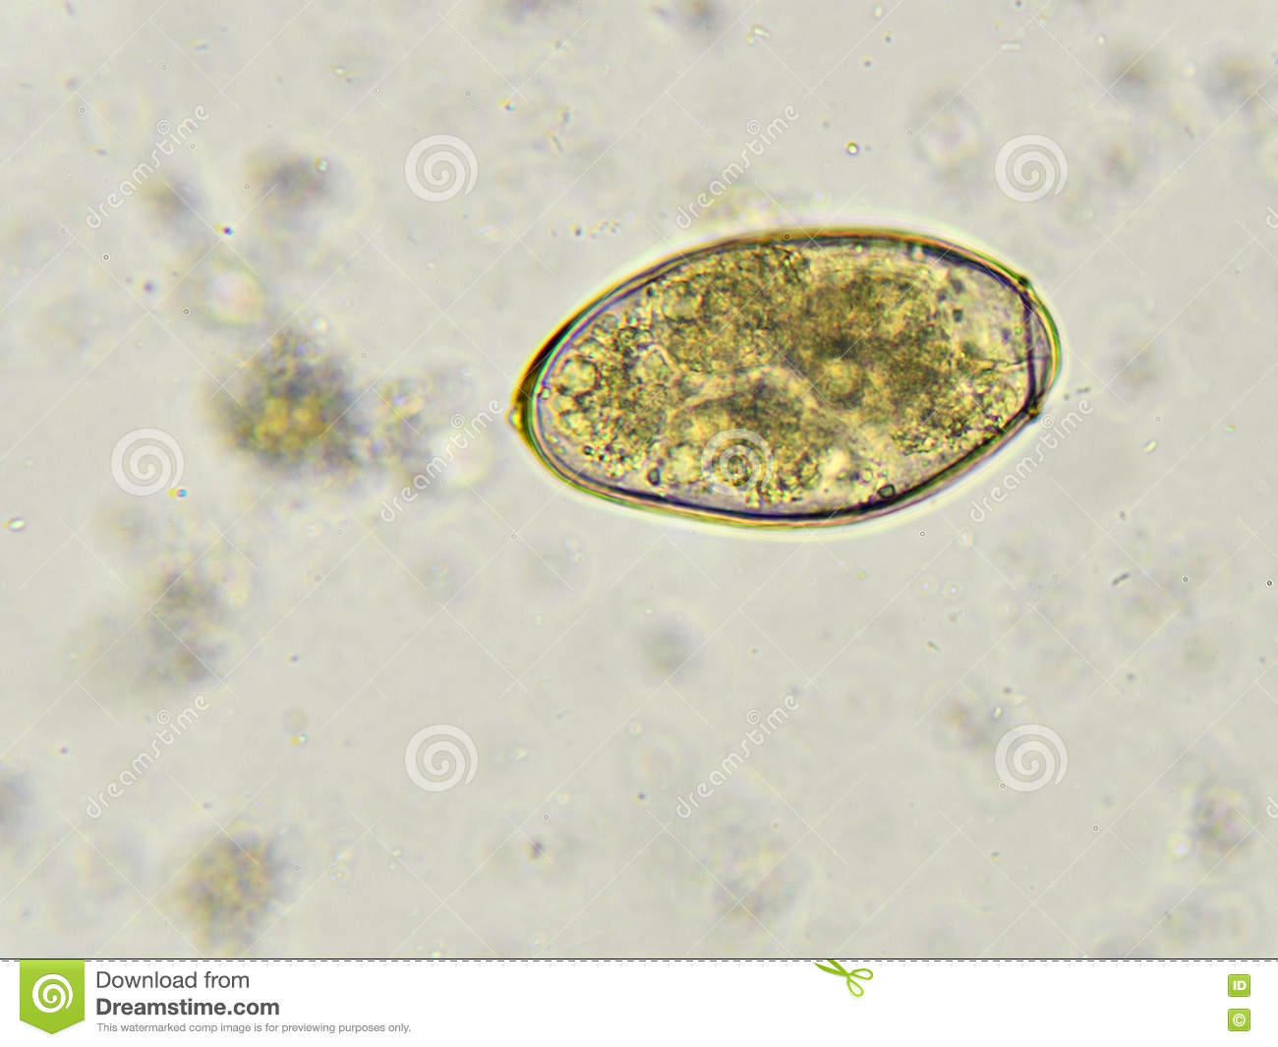
Diagnostic stage : egg

Slide 14
Control
Health education
Treatment of patients
Avoid eating of raw or under cooked –fish
Snail control .

Slide 15
Treatment
  Praziquantel is the drug of choice for treatment of Pargonimasis

