Slide 1
Class insecta

Slide 2
They have segmented body composed of :
Head
Thorax
Abdomen
One pair of antennae
Three pairs of legs
Wings in some species.

Slide 3
Bilateral symmetry

Slide 4
Body segments
Head:
Compound eyes
Visual elements grouped on each side of the head.
May be found in the upper part of the head and the sight of view is 360C.

Slide 5
Antennae:
Segmented appendages located in the lateral side of the head it is sensitive to the out side environment.
Many of the hairs on the antennae are sensitive to air borne chemical in very small concentrations, they are distant chemo-receptors.

Slide 6
Palps:
Shorter than antennae, segmented appendages located near the mouth.
It detect the presence of chemicals in greater concentration in contact with them.
They are contact chemo-receptor.

Slide 7
The mouth part:
Labium : lower lip which forms floor of the mouth.
Labrum: upper lip which forms roof of the mouth
Mandible : pair of upper jaws
Maxillae: pair of lower jaws
Hypophyrnax: Tongue –shaped structure lies between labrum and labium connected to salivary duct.

Slide 8
Types of mouth:
Sucking mouth type:
Present in the adult insects of class Hexapoda ( insect).
Chewing mouth type:
This type is present in the adult stages are larval stages of class insects.
Sucking ,chewing mouth type:
Combination of sucking and chewing types.

Slide 9
Thorax :
It is the center of locomotion , the wings and the jointed legs are connected to the thorax.
Composed of three parts :
Prothorax
Mesothorax
metathorax

Slide 10
Abdomen:
Contains between 8-11 segments , the end of the abdomen containing two projections called cerci for sensation.

Slide 11
`
The jointed leg:
Divided into many parts:
Coxa : the first part of the leg
Trochanter: connected to the coxa through small join.
Femur: largest part of the jointed leg it support the movement force of jointed leg.
Tibia: rod-like part , it is long and narrow , jointed to the femur through small joint.

Slide 12
Tarsus: 5 tarsal segments jointed to the tibia.
Claw: is connected to the tarsal segments, is used for holding and adhesion .
Arolium : delicate hair covered , between claws.

Slide 13
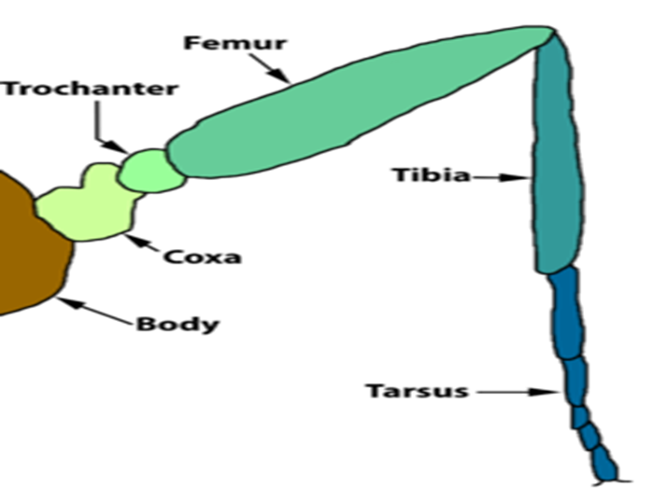

Slide 14
Arthropods are classified according to the number of legs into:
Hexapoda (insect) : contain 6 legs
Arachnida: has 8 jointed legs
Crustacea : has 12 jointed legs
Myriapoda : many jointed legs ,centipedes and millipede.

