Slide 1
Importance of medical parasitologist
motivational presentation /
Mosab Nouraldein

Slide 2
Objectives of the departments
To provide community with :
Researchers : solving problems
Teachers : learning
Laboratories technologists : diagnosing

Slide 3
What's parasitology ?
A branch of biology which deals with those organisms ,plant or animal which have become dependent one other living creatures. .

Slide 4
Global infections with parasites
The burden of parasitic diseases often rests on communities in the tropics and subtropics ,but parasitic infections also affect people in developed countries .

Slide 5
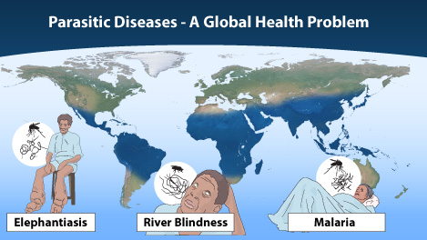
Its globally

Slide 6
Main parasitic diseases
Malaria : fever , anaememia, jaundice ,hypoglycemia
Giardiasis : malabsprption
Toxoplasmosis : abortion
Leishmaniasis : pancytopenia
schistosomiasis: bladder cancer
Hook worm infections : IDA
Onchocerciasis :Blindness

Slide 7
Techniques in parasitology lab
Wet mount
Staining techniques
Concentration techniques
Invitrocultivation
Invivocutivation
Immunochromatography tests
Immunofluorescence methods
Immunoblotting techniques
ELISA
PCR

Slide 8
Global warming
its an increase in the earth’s average atmospheric temperature that cause corresponding changes in climate and that may result from green house effect.

Slide 9
Parasite and the weather
Most parasites occur in tropic and subtropics so when temperature rise in other areas parasitic infections will increase in that area (i.e.Europe) .

Slide 10
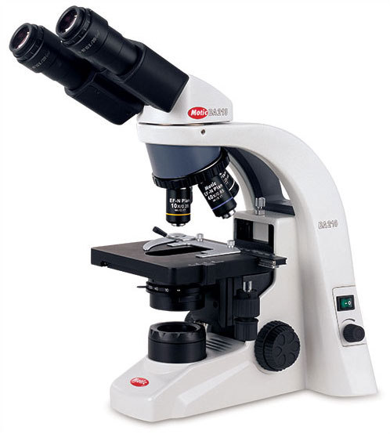
Instruments in parasitology lab microscope

Slide 11

Cont
Centrifuge

Slide 12
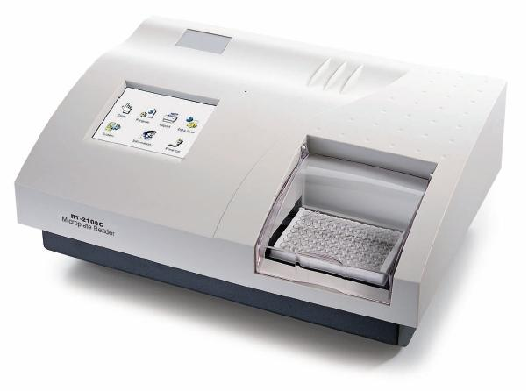
cont
ELISA machine

Slide 13
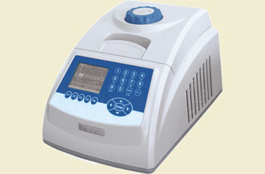
cont
PCR machine

Slide 14


Slide 15
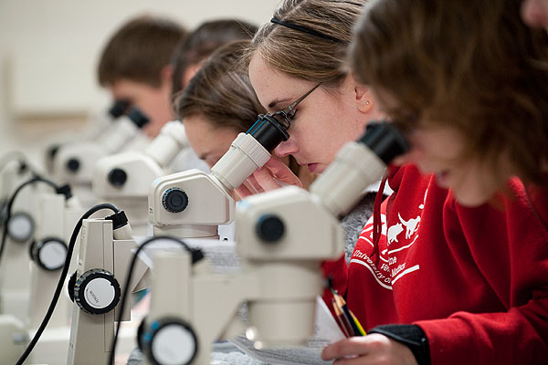
The winners of tomorrow

Slide 16

Thank you

