Slide 1
Introduction to medical helminthology
Mosab Nouraldein

Slide 2
Helminthology is the study of parasitic worms
Worms : multicellular microorganisms

Slide 3
Helminthes either to be
Platyhelminthes (flat worms)
Nemathelminthes (round worms)

Slide 4
Platyhelminthes are classified into :
Trematoda (trematodes) and Cestoda (cestodes)

Slide 5
General characters of trematodes (flukes)
Unsegmented ,flat leaf-like worms.
Attach to their host by means of suckers
Oral sucker: surround the mouth
Ventral sucker: present on the ventral surface.

Slide 6
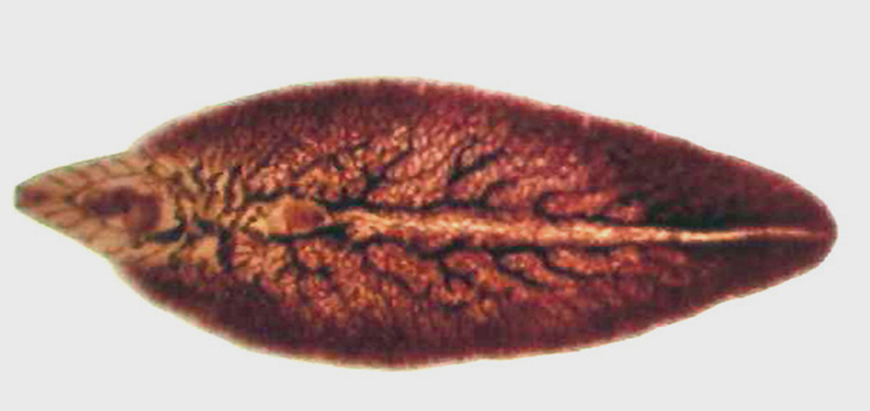
Leaf like

Slide 7
No body cavity
Digestive system consist of mouth and esophagus which divides to form two intestinal caeca. There is no anus.

Slide 8
Excretory system is composed of excretory cells called flame cells , collecting tubules and excretory pore.

Slide 9
Trematodes are hermaphrodite except schistosomes.
Hermaphrodite: male and female reproductive organs in the same individual.

Slide 10
Most eggs of trematodes are operculated except egg of Schistosoma species

Slide 11
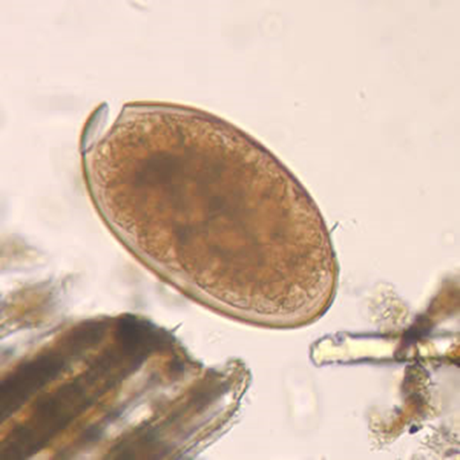
Operculated egg

