Slide 1
house fly
(Musca domestica)

Slide 2
Classification:
Class: insecta
Order: Diptera
Suborder: Brachycera
Family: Muscidae
Genus: Musca
Species : Musca domestica

Slide 3
The house fly( Musca domestica) , is a well known cosmopolitan pest of both home and farm.
This species is always found in association with humans or the activities of humans.

Slide 4
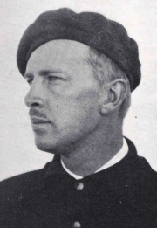
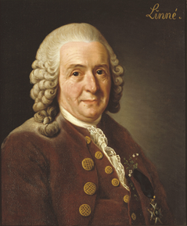
history
The housefly was first described as Musca domestica in 1758 by the Swedish botanist and zoologist Carl Linnaeus and continues to be classified under that name. A more detailed description was given in 1776 by the Danish entomologist Johan Christian Fabricius

Slide 5
Distribution
This common fly originated on the steppes of central Asia, but now occurs on all inhabited continents, in all climates from tropical to temperate, and in a variety of environments ranging from rural to urban. It is commonly associated with animal feces, so it is abundant almost anywhere people live.

Slide 6
Life cycle
The house fly has a complete metamorphosis with distinct egg, larval or maggot, pupal and adult stages. The house fly overwinters in either the larval or pupal stage in protected locations. Warm summer conditions are generally optimum for the development of the house fly, and it can complete its life cycle in as little as seven to ten days. However, under suboptimal conditions the life cycle may require up to two months. As many as 10 to 12 generations may occur annually in temperate regions, while more than 20 generations may occur in subtropical and tropical regions.

Slide 7
Morphology
House fly(adult stage)
Small size 6-9mm in length.
Chitin colour is varying from pale gray to deep gray.

Slide 8
Head :
Oval in shape
Contain pair of brown to purple compound eyes.
Female dichoptic eyes
Male holoptic eyes
Antennae containing 3 segments

Slide 9
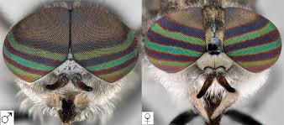
Compound eyes

Slide 10
Mouth part has ability to extend (sponging) , contains a ring of teeth which is called pre-oral teeth and it is rich of small tube used for sucking the fluids and small particles.
Have no mandibles or maxillae.

Slide 11
thorax
The dorsal thorax has four boardish dorsal longitudinal strips.
The jointed legs containing pair of claws and a pair of fleshly pad-like structure called empodium or pulvilli, which is covered by adhesive glandular hair( used to adhere to smooth surfaces and transmission of diseases mechanically).

Slide 12
The abdomen:
Contain 8 segments , only 4 segments can be seen.
Short hair at posterior part.
It move like telescope tube.
Female insect can be extended to deposit eggs.

Slide 13
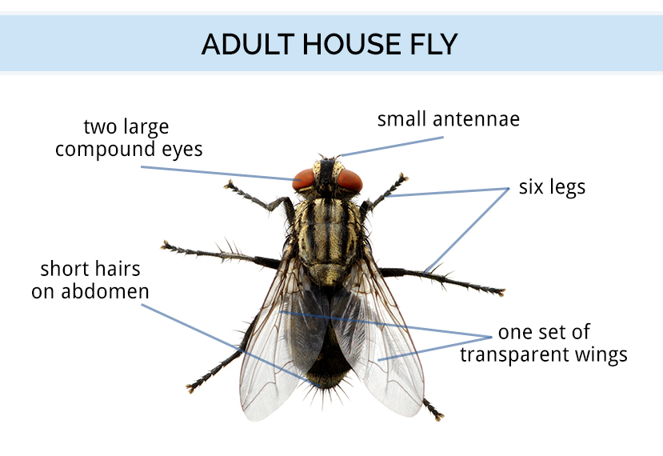
ADULT

Slide 14
Usually female is larger than male
Also the male legs are longer than legs of the females
Adults lives 15 to 25 days ,but may live up to 60 days . Without food they only live for 2 to 3 days.
They require food before they will copulate, and copulation is completed in as few as two minutes or as long as 15 minutes. Oviposition commences four to 20 days after copulation.
Female flies need access to suitable food (protein) to allow them to produce eggs

Slide 15
The flies are inactive at night , they have diurnal activity.

Slide 16
Egg
1mm in length
White color
Banana shape
Concave dorsally
Female lays 75-150 eggs( laying masses of eggs)
Hatch within 6-12 hours
Can not resist desiccation
Die over 40C and under 15C.

Slide 17
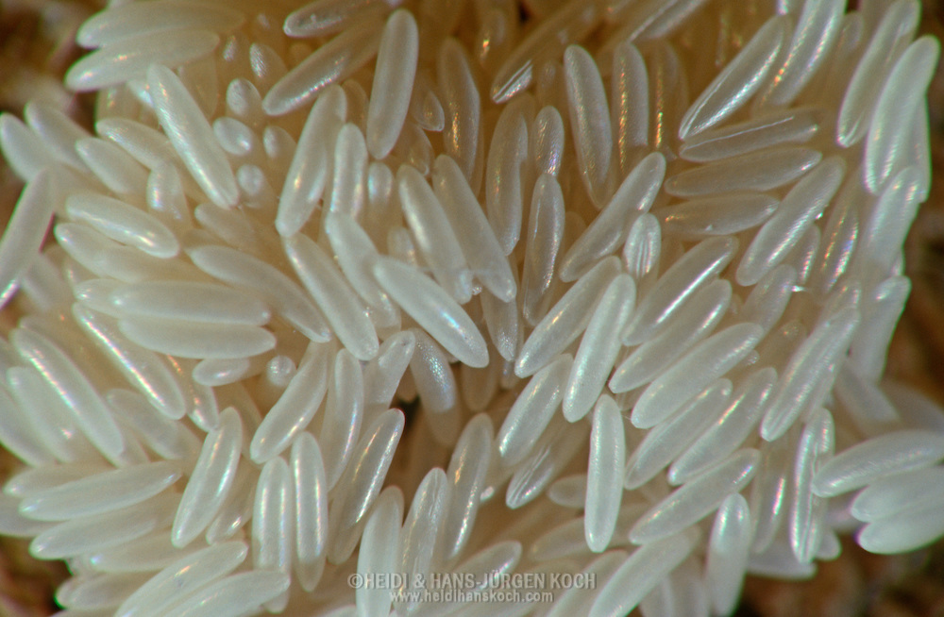
EGG

Slide 18
The number of eggs produced is a function of female size which, itself, is principally a result of larval nutrition. Maximum egg production occurs at intermediate temperatures, 25 to 30°C.
Often, several flies will deposit their eggs in close proximity, leading to large masses of larvae and pupae.
Eggs must remain moist or they will not hatch.

Slide 19
LARVAE
It is called maggots.
Have small head, thorax and posterior part is board and larger than anterior part.
Larval body contains 12 segment.
There are three larval instar .
Mature larva mainly found in wet places .

Slide 20
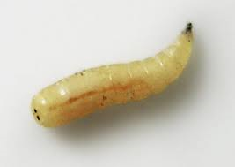

Slide 21
Maggots immediately begin feeding on and developing in the material in which the egg was laid
Early instar larvae are 3 to 9 mm long, typical creamy whitish in color, cylindrical but pointed toward the head.
The larva goes through three instars and a full-grown maggot, 7 to 12 mm long, has a greasy, cream-colored appearance.

Slide 22
The optimal temperature for larval development is 35 to 38°C.
larval survival is greatest at 17 to 32°C. Larvae complete their development in four to 13 days at optimal temperatures.
but require 14 to 30 days at temperatures of 12 to 17°C.

Slide 23
Pupa
Larva migrate to dry place and pupate under the soil.
Pupa have a barrel shape .
After about 6 days and depending on temperature the adult house fly developed.

Slide 24
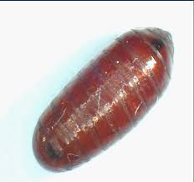

Slide 25
Pupae complete their development in two to six days at 32 to 37°C, but require 17 to 27 days at about 14°C.
The emerging fly escapes from the pupal case through the use of an alternately swelling and shrinking sac, called the ptilinum, on the front of its head which it uses like a pneumatic hammer to break through the case.

Slide 26
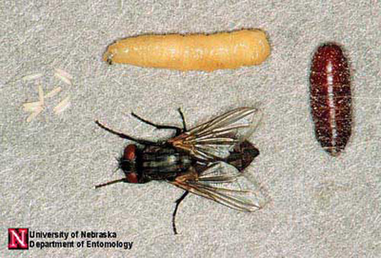
LIFE CYCLE

Slide 27
Feeding habits
Omnivorous(eating everything).
Diurnal activity.

Slide 28
Breeding sites
Wet and contaminated areas containing animal or human waste

Slide 29
Medical importance
Nuisance
Irritant
Mechanical vectors for many pathogens.

Slide 30
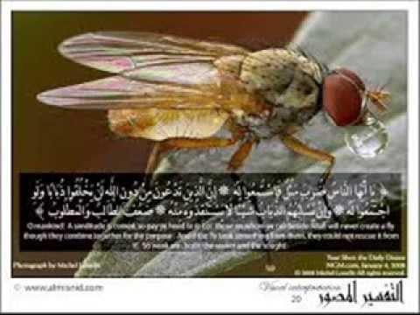

Slide 31
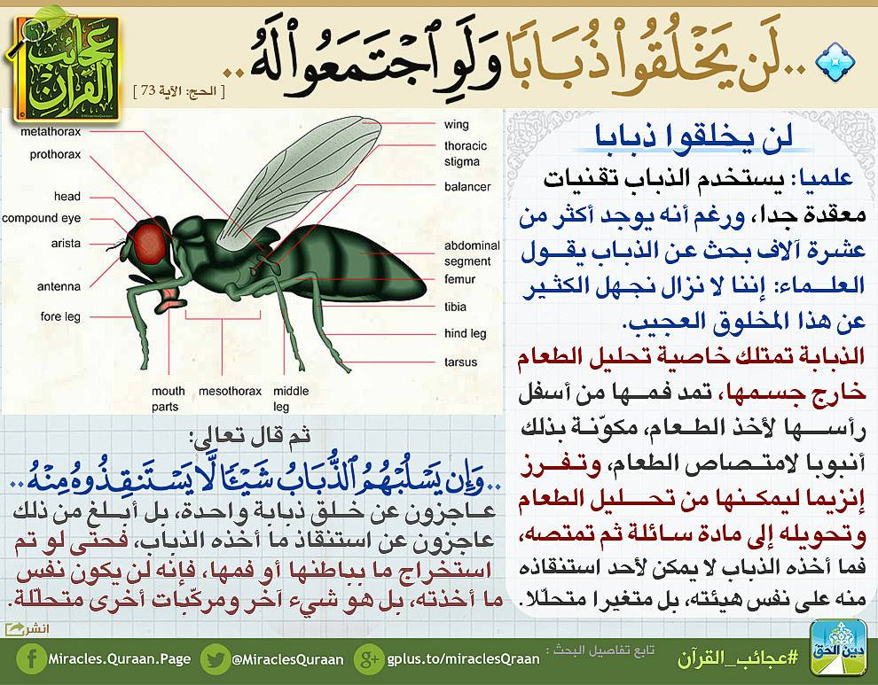

Slide 32


