Slide 1
Colorimetery & spectrophotometry
Mosab Nouraldein

Slide 2
Introduction
Color : the property by an object of producing different sensations on the eye as a result of the way the object reflects or emits light .

Slide 3

Importance of color
It can helps to facilitate and fulfill some very basic human needs .( it can specify necessary objects ( animal , vegetable or even traffic road signs) .

Slide 4
Color formation
Color = light source + object properties + eye + brain
visible light range from 400 -700 nm .
The human eye is most sensitive at 555nm

Slide 5
Colorimetery
Is use of human eye to determine the concentration of colored species .
spectrophotometry
Is the use of instruments to determine the concentration of colored species .

Slide 6
Colorimetery
Visual observation : because colorimetery is based on inspection of materials with the naked eye its necessary to know the aspects of visible light .
Visible light: is the narrow range of electromagnetic waves with the wavelength of 400-700 nm .

Slide 7
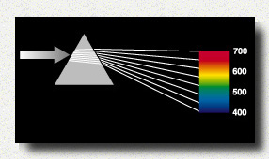
Visible light

Slide 8
Visual colorimetery
Intensity :
Intensity of color depends on the thickness of the absorbing layer (pathlength)
And the concentration of the colored solution .

Slide 9
Spectrophotometry
Spectrophotometer : an instrument that measures the amount of light absorbed , or the intensity of color at a given wavelength .
The intensity of color can be given a numerical value by
comparing the amount of light prior to passing it through
the sample and after passing through the sample.
These quantitative measurements of light absorbed are the
Transmittance and the Absorbance.

Slide 10
Beers and Lambert law
The absorbance of light is directly proportional to the thickness of the media through which the light is being transmitted multiplied by the concentration of absorbing chromophore .
Chromophore: an atom whose presence is responsible for the color of a compound .

Slide 11
A=ξ b c , where :
A , is the absorbance
ξ , is molar extinction coefficient
b, is the thickness of the solution
c, is the concentration

Slide 12
Transmittance is Related to Absorbance
Transmittance is given by the equation:
T = I/I_{o}
where I is the intensity of the light after it has gone
through the sample & I_{o} is the initial light intensity.
Absorbance is related to the %T:
A = -logT = -log(I/ I_{o})

Slide 13
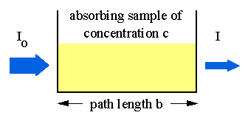

Slide 14
Essential parts of colorimeter
Light source ( low voltage filament lamp)
An adjustable aperture
A set of colored filters
A cuvette to hold the working solution
A detector to measure the transmitted light
A meter to display from the detector .

Slide 15
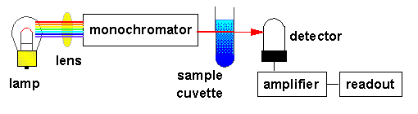
Components of simple spectrophotometer
The lamp emits all colors of light (i.e., white light).
The monochromator selects one wavelength and that wavelength is sent through the sample.
The detector detects the wavelength of light that has passed through the sample.
The amplifier increases the signal so that it is easier to
  read against the background noise.

