Slide 1
Strongyloides stercoralis
Mosab Nouraldein

Slide 2
Common names
Dwarf thread worm
Military worm

Slide 3
History
Strongyloides stercoralis was known as the “military worm” as it was first found by Lois Normand in 1876 in the feces of French soldier.

Slide 4
Distribution
Hot and humid tropical areas ( south East Asia, Sub Saharan Africa, South America ) .

Slide 5
Habitat
Adult female reside in human small intestine ( duodenum, jejunum )
whereas the free ­living female worms multiply in the environment.
Male worms are always free­ living

Slide 6
Modes of transmission
Penetration of skin by Filariform larvae, larvae releases hydrolytic enzymes that helps in penetration .
Internal autoinfection
Transmammary

Slide 7
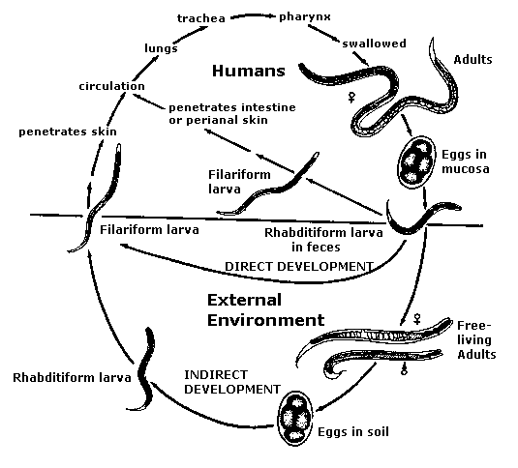
Life cycle

Slide 8
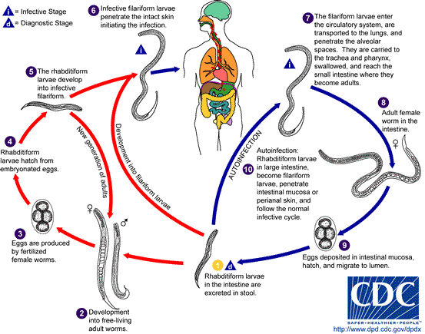

Slide 9
Free and parasitic adult female
Parasitic female:
2.2 mm
cylindrical esophagus
Free living female:
1 mm
Rhabditiform esophagus

Slide 10
Adult male:
- 0.7 mm
- Rhabditiform. esophagus
- posterior end curved ventrally

Slide 11
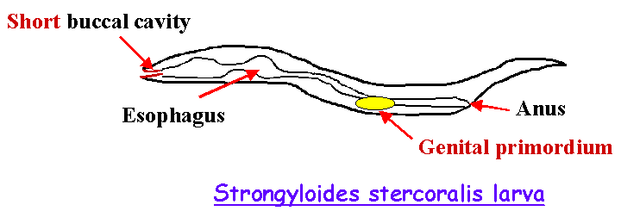

Slide 12
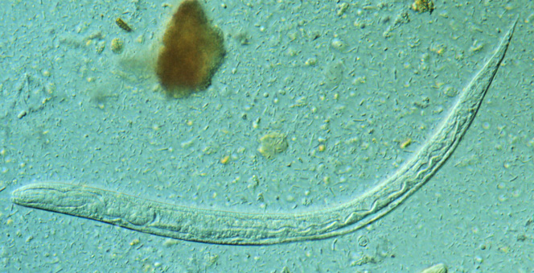
Rhabditiform larvae

Slide 13
Rhabditiform larva:
- 200 µm
- short buccal cavity
- Rhabditiform esophagus (1/3 body length)

Slide 14
Parthogenesis
Is a natural form of asexual reproduction in which growth and development of embryos occur without fertilization

Slide 15
It has 2 cycles :
Parasitic life cycle (direct)
Free living cycle

Slide 16
Diagnostic stage : Rhabditiform larvae
Infective stage : Filariform larvae

Slide 17
Clinical features
Light infection is asymptomatic
Intestinal symptoms :
upper Abdominal pain
diarrhea
malabsorption
Vomiting
Steatorrhea

Slide 18
Weight loss
Constipation
Pulmonary symptoms:
Cough
Loffler's syndrome

Slide 19
Loeffler’s syndrome :
It is a condition characterized by accumulation of Eosinophils in the lung in response to parasitic infection

Slide 20
Lab diagnosis
Specimen : Stool , duodenal aspirate , sputum
Diagnostic methods :
Wet mount
Formal ether centrifugation concentration technique
Entero capsule ( string)
Water emergence technique

Slide 21
Stool culture techniques :
Harada Mori filter paper tube method
Petridish (slant culture) technique
Charcoal culture method
Agar Plate technique

Slide 22
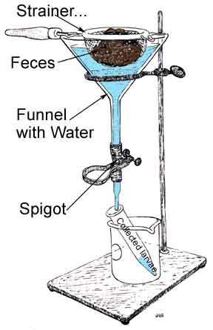
Baermann funnel technique

Slide 23
Baermanns apparatus

Slide 24
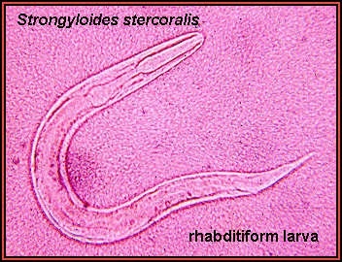

Rhabditiform larvae

Slide 25
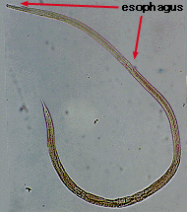
Adult female

Slide 26
ELISA
PCR

Slide 27
Prevention& Control
Treatment of patients
Health education
Avoid using of untreated human feces as fertilizer

Slide 28
Quiz
Define the following :
Loeffler syndrome ?
Parthogenesis ?
Geohelminthes ?
Mention the diagnostic methods to dwarf thread worm?
Mention two causative agents of eosinophilic pneumonia?

