Slide 1

Fasciola hepatica
(Liver fluke)
Mosab Nouraldein

Slide 2
Disease
It infect the liver of various mammals ,including human and caused disease known as Fasciolosis.

Slide 3
Distribution
It is distributed world wide .

Slide 4
Mode of transmission
Food borne infection ,through ingestion of infective stage (metacercaria) encysted on aquatic plant .

Slide 5
Life cycle
Fasciola hepatic has an indirect life cycle which require 2 host :
Intermediate host :
An amphibious freshwater lymnaeid snail known as Galba truncatula.
Definitive host :
Sheep, cattle or human .

Slide 6
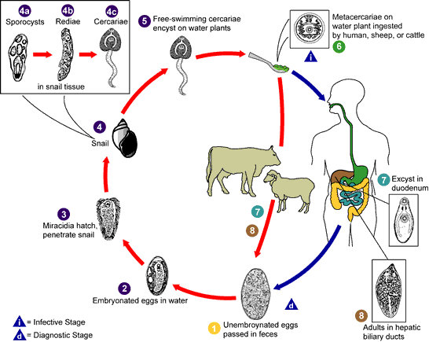
life cycle

Slide 7
Signs and symptoms
Acute phase symptoms :
Fever , nausea ,hepatomegaly , skin rashes and extreme abdominal pain .
Chronic phase symptoms :
Jaundice , anemia.
In cattle and sheep it cause persistent diarrhea ,chronic weigh loss ,reduced milk production and finally death .

Slide 8
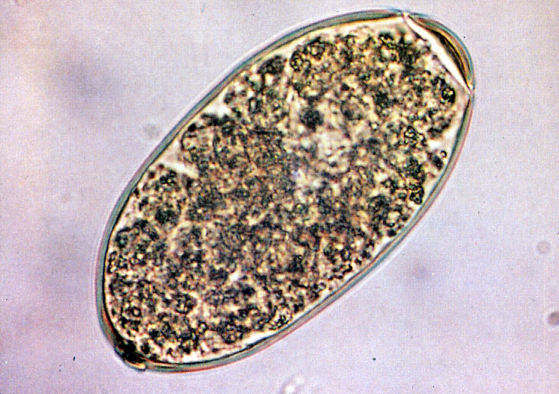
Laboratory diagnosis
Specimen :
Stool sample
Diagnostic stage : Fasciola hepatica egg
technique

Slide 9
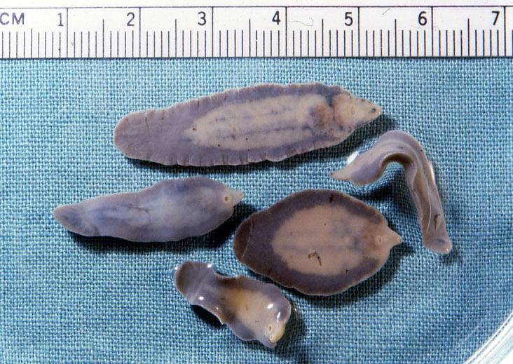
Adult :

Slide 10
Diagnostic techniques :
Wet mount
Concentration techniques
ELISA
Immunoblotting technique
Molecular techniques

Slide 11
Fasciolopsis buski
(intestinal flukes)

Slide 12
Disease
It infect pigs and human caused the disease known as Fasciolopsiasis .

Slide 13
Distribution
Its widely distributed in southern and southeastern Asia .

Slide 14
Mode of transmission
Food borne infection ,through ingestion of infective stage (metacercaria) encysted on aquatic plant .

Slide 15
Life cycle
It has indirect life cycle( need more than one host) .
Intermediate host :
Snail of the genera Segmentina and Hippeutis .
Definitive host :
Pigs and human

Slide 16
Life cycle

Slide 17
Signs and symptoms
Mostly its asymptomatic
However in certain cases patient may suffered from abdominal pain and diarrhea , in heavy infection it may lead to intestinal obstruction , allergic reaction and swelling of the face and legs also anemia may occur .

Slide 18
Laboratory diagnosis
Specimen : stool
Diagnostic stage :Fasciolopsis buski egg

Slide 19
Diagnostic techniques
Wet mount
Concentration techniques
ELISA
Immunoblotting techniques
Molecular techniques

Slide 20
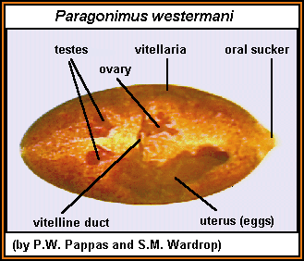
Paragonimus westermani
(Lung fluke)

Slide 21
Disease
Paragonimus westermani cause sub-acute to chronic inflammatory disease of the lung known as parogonimiasis .

Slide 22
Distribution
Most common in eastern Asia and South America .

Slide 23
Mode of transmission
Food borne disease through eating of crabs that contain encysted metacercaria

Slide 24
Life cycle
Its an indirect life cycle (require 3 hosts)
2 are intermediate hosts ( freshwater snail of the genus semisulcospira and crabs) and the 3rd is human .

Slide 25
Life cycle

Slide 26
Signs and symptoms
Bad cough , bronchitis and blood in sputum (hemoptysis) .

Slide 27

Laboratory diagnosis
Specimen : sputum (rusty colored)
Diagnostic stage : Paragonimus westermani egg

Slide 28
Diagnostic techniques
Wet preparation
ELISA
Radiological methods (e.g. Chest X-ray ) .

