Slide 1
Medical heminthology tutorial
Mosab Nouraldein
email: musab.noor13@gmail.com

Slide 2
Section one (MCQs)
Choose the best answer

Slide 3
1) Nematodes also known as:
A)Flat worm
B)Round worm
C)Tape worm

Slide 4
2) Nematodes also known as:
A) Thread worm
B)Segmented worm
C) Platyhelminth

Slide 5
3)Oviparous means:
A) Larva production
B) Egg production
C) Hermaphrodite

Slide 6
4) Viviparous means:
A) Hermaphrodite
B) Egg production
C) Larva production

Slide 7
5) The largest intestinal nematode:
A) Ascaris lumbricoides
B) Strongyloides stercoralis
B) Enterobius vermicularis

Slide 8
6)The common name of E.vermicularis
A) pig worm
B) beef worm
C) pin worm

Slide 9
7) NIH swab used to diagnose:
A) Ascariasis
B) Trichiuriasis
C) Enterobiasis

Slide 10
8)String test used to detect :
A) strongyloides stercoralis
B) Enterobius vermiculars
C) Ascaris lumbricoides

Slide 11
9) Barrel shape ovum:
A) Trichuris trichiura
B) Enterobius vermicularis
C) Ascaris lumbricoides

Slide 12
10) Unsheathed microfilariae:
A) Brugia species
B) Onchocerca volvulus
C) Wuchereria bancrofti

Slide 13
11) non-periodic microfilariae:
A) Wuchereria bancrofti
B) Brugia species
C) Onchocerca volvulus

Slide 14
12) Whip worm is a common name of:
A) Ascaris lumbricoides
B) Enterobius vermicularis
C) Trichiuris trichiura

Slide 15
13)Enterobius vermicularis is a:
A) pig worm
B) beef worm
C) pin worm

Slide 16
14) Skin snip is used to diagnose:
A) lymphatic filariasis
B) onchocerciasis
C) Ascariasis

Slide 17
15) Have NO nuclei at the tip of tail:
A) Wuchereria bancrofti
B) brugia species
C) Onchocerca volvulus

Slide 18
Section two
Identify the followings

Slide 19
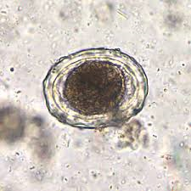
1) Identify

Slide 20
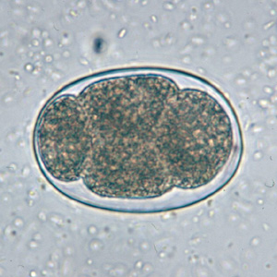
2) Identify

Slide 21
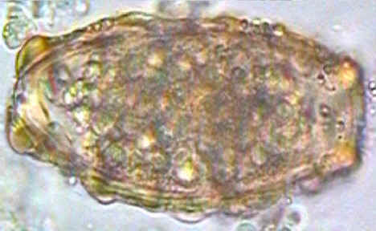
3) Identify ?

Slide 22
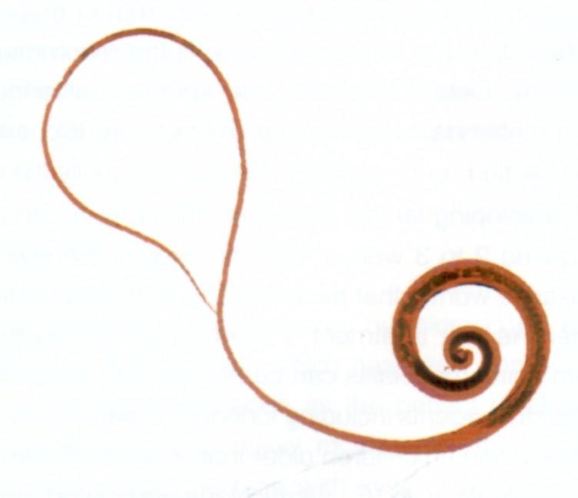
4) Identify ?

Slide 23
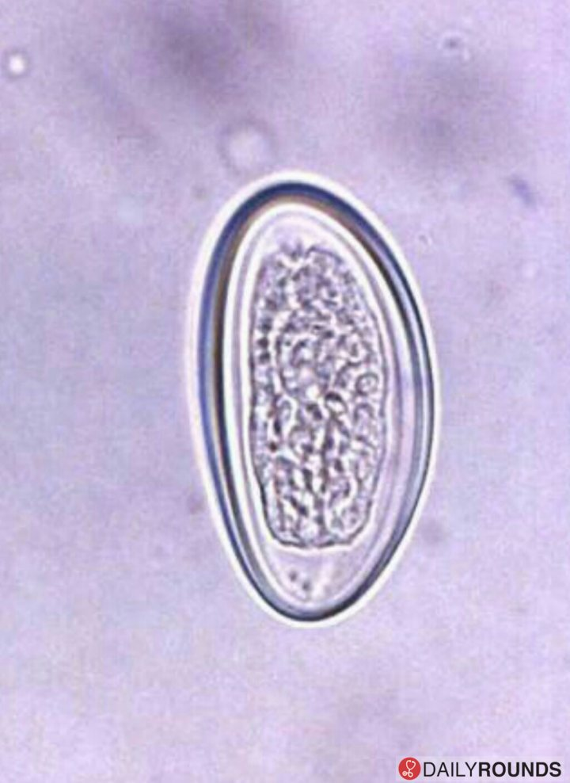
5) Identify ?

Slide 24
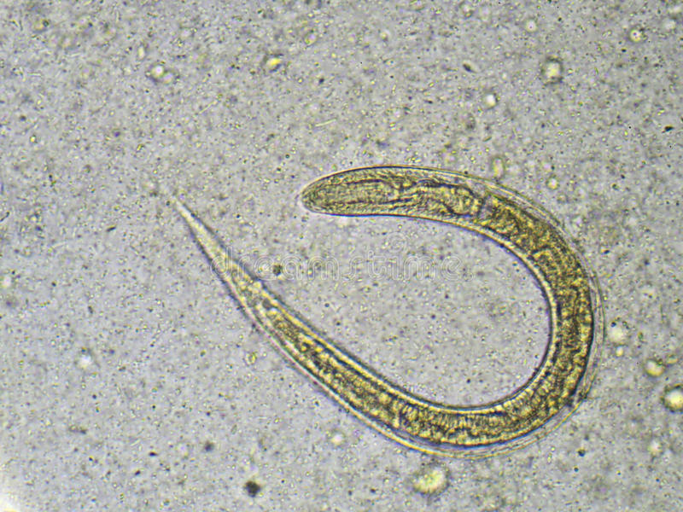
6) Identify ?

Slide 25
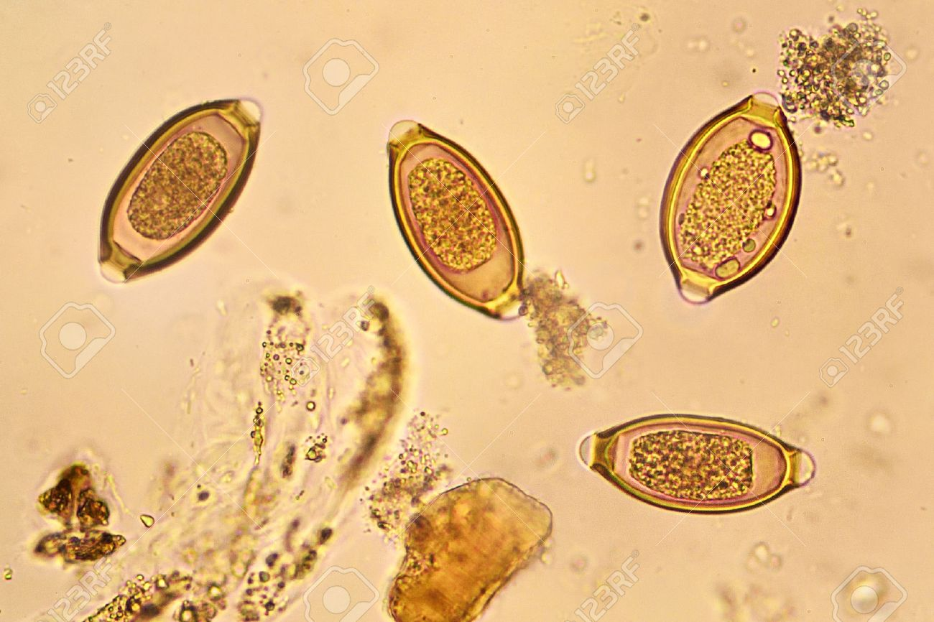
7) Identify ?

Slide 26
Section three
Define :
A) periodicity?
B) viviparous?
C) oviparous?
D) molting?
E) Parathogen?

Slide 27
Section four
Solve the problems

Slide 28
A) 4 year old child with insomnia and pre-anal itch.
Mention the possible parasitic cause?
Enumerate the modes of transmission of that parasite?

Slide 29
B)45 years old male suffering from IDA and excrete black colored feces.
IDA: iron deficiency anemia
What is the possible parasitic cause?
Enumerate the species of that parasite?

Slide 30
C) 5 years old patient with lower abdominal pain , fever, rectal prolapse.
What is the possible parasitic cause of this condition ?

Slide 31
Section five
Enumerate the methods used to classify the round worm ?

Slide 32

GOOD LUCK

