Slide 1
TRICHIURIS TRICHIURA
(WHIP WORM)
MOSAB NOURALDEIN MOHAMMED

Slide 2
HISTORY
It was first described by Linnaeus in 1771

Slide 3
Distribution
World wide , mostly in warm and moist climate .

Slide 4
Children are commonly affected .
Global prevalence in human is approximately 795 millions .

Slide 5
Habitat
It resides in the large intestine of man ( mainly caecum and appendix)

Slide 6
Mode of transmission
Human ( usually children) acquire infection by ingestion of contaminated food and water containing Embryonated egg .

Slide 7
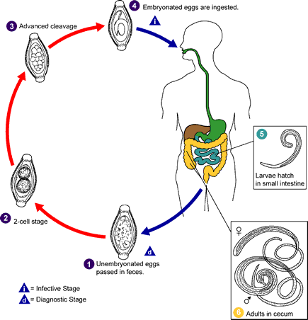
Life cycle

Slide 8
Egg hatch out in the intestine releasing the second stage larva , migrate to large intestine where they undergo moltings to transform into adult worms.
Within 2-3 months , the female worms following fertilization start laying unembryonated eggs.
Each female worm can lay 14.000-20.000 eggs per day for 1-3 years .

Slide 9
Unembryonated eggs passed in the feces are not infective . It takes about 28 days to become Embryonated ( it undergoes two molts to produce second stage larva within the egg shell ) .
Embryonation occurs at 25C in warm and moist condition .

Slide 10
Direct life cycle
Definitive host : human
Infective stage : Embryonated egg
Diagnostic stage : unembryonated egg

Slide 11
Clinical features
Mostly its asymptomatic
In case of heavy infection it causes :
Abdominal pain
Dysentery
Rectal prolapse
Iron deficiency anemia , due to blood loss

Slide 12
Growth retardation and impaired cognitive function .

Slide 13
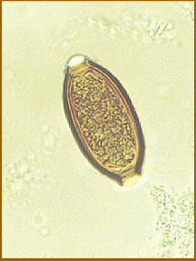
Laboratory diagnosis
Stool examinations:
Wet preparation
Saturated sodium chloride flotation technique

Slide 14
Egg
Barrel shape
Surrounded by a shell
Bear mucus plug at both the poles (bipolar plug)
Elongate
Unembryonated , when freshly passed
Yellowish to brown

Slide 15
Adult worm
Its whip shaped , anterior three-fifth is thin ,hair like coiled ,and posterior two-fifth is short and thick .
Female is larger then male

Slide 16
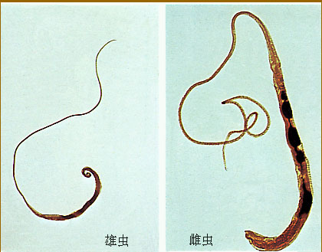

Slide 17
Prevention & control
Health education
Treat the patients
Avoiding uses of human feces as fertilizer .

