Slide 1
Soft tick

Slide 2
classification
Class :Arachnida
Order: metastigmata
Family :Argisade
Genus :Argas
Species :Argas persicus
Genus :Ornithodors
Species: Ornithodors moubata complex

Slide 3
distribution
Common in dry areas

Slide 4
External morphology
Dorsoventerally flattened
Have a tough integument
Wrinkled
Simple eye may be present or not depending on species
Have no scutum
The capitulum or (false head) is situated ventrally, so is not visible dorsally
The mouth part composed of four –segmented leg-like palps (pedipalps)

Slide 5
Have four pairs of well developed legs.
The anus is present about on third from the posterior margin
The genital opening is just behind the base of the capitulum.
The spiracles (stigmata) are situated in front of the coxae of the hind legs
Male and female are extremely similar but they are differ in in the shape of genital pore and the male is more conspicuous.

Slide 6
egg
After blood meal female lay several small egg batch( 4-6 batches) each one contain about 15-100 spherical eggs. Occasionally can produce larger eggs , and each batch may contain 200-300 eggs.
Adult ticks may live several years ,so female may lay thousands of eggs during her life time.
Eggs are deposited near the resting place of the adult
Eggs hatch usually within one to four weeks
Eggs may remain viable for many months under adverse climate conditions, because the are coated with protective waxy secretion from the gene’s region.

Slide 7
Gene region: is located in front of the mid gut and during the oviposition is extruded from small opening above the capitulum and secrete waxy substances that coat the eggs and enable them to resist dessication.

Slide 8
Larva
Six –legged
Very active, searches for the host to take its blood meal
The capitulum is projected from the body and is visible from above
Blood feeding from the host may takes from several minutes minutes to several hours. But larva of Ornithodors moubata differ from most other Argasid larval ticks in that they do not take blood meals but remain within their egg shells after hatching , moulting to produce first instar nymph which crawl from egg shells to seek their blood meal.

Slide 9
Nymph
Eight legged
They are 4-5 or up to 8 instar larva in some species
Each instar nymphal stage needs blood meal
Blood feeding usually occur during night.

Slide 10
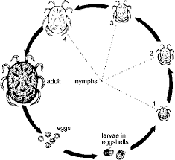
Life cycle

Slide 11
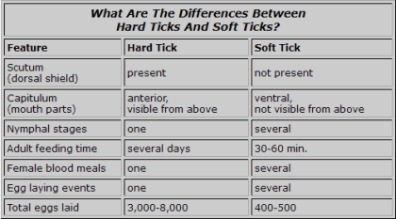

Slide 12
Feeding habits
Both male and females are hematophagous
They take their blood meals from several host , so they are known as (many host) or multi-host) ticks.
Blood meal is essential for maturation of the ovaries and egg laying.

Slide 13
Source of nutrients
Both male and female feed on blood of man and a large variety of domestic and wild mammals.

Slide 14
Breeding areas
Eggs are deposited near the resting places of the adult ticks.(e.g. in cracks in the walls).

Slide 15
Resting areas
They are found around the host settlement especially in village huts.

Slide 16
Medical importance
Tick borne relapsing fever
Q-fever

