Slide 1
Malaria
Microscopy

Slide 2
Malaria microscopy means to examine thin and thick blood smear microscopically , using x100 objective’s ( oil immersion lens).

Slide 3
Firstly
Selection of sample :
Capillary blood
Venous blood ( EDTA anticoagulated blood) :
Take appropriate volume of blood.
Gently, Mix blood with anticoagulant.

Slide 4
Prepare blood smear
Label with patient name or lab number and also the date of smear preparation.
Allow to dry at room temperature

Slide 5
Thick smear
Needs more blood ( 3 drops)
Need more time to dry
Not need fixation
Used to detect the stage of plasmodium
More sensitive than thin smear
Nucleus of WBCs and parasite are only present

Slide 6
Thin blood smear
Need one drop of blood
Dry rapidly
Need fixation with absolute methanol
Morphology of RBCs is preserved
Used to identify the plasmodium species
More specific than thick blood smear
RBCs ,WBCs, Platelets and parasite are present .

Slide 7
Fixation of thin blood film
By absolute methanol (methyl alcohol)

Slide 8
Staining
By Giemsa stain 10% or 3% .
stock Giemsa stain composed from:
Giemsa powder 3.8 gram
Glycerol 250 ml
Absolute methanol 250ml

Slide 9
working Giemsa stain
Prepared according to the law of :
RV/O
R: required concentration (10 or 3%)
V: required volume
O : original concentration (100%)

Slide 10
Each slide require 3 ml of working Giemsa stain .

Slide 11
RBCS & plasmodium infection
Plasmodium falciparum infect all RBCS
Plasmodium vivax infect young RBCs
Plasmodium malariae infect aged RBCs

Slide 12
Plasmodium and RBCs morphology
Normal shape and size in Plasmodium falciparum
Normal or smaller than normal in plasmodium malaria
Enlarge in plasmodium vivax
Enlarge and may take ovale shape in Plasmodium ovale.

Slide 13
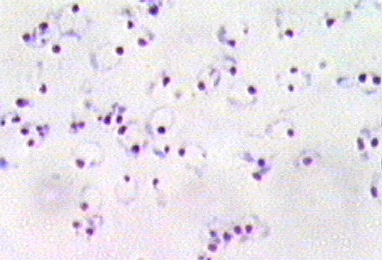
Early trophozoite of Plasmodium falciparum
Hyperparasitemia

Slide 14
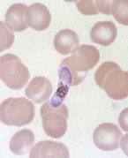
Gametocyte of plasmodium falciparum
Crescent shape
Banana shape
Sausage shape

Slide 15
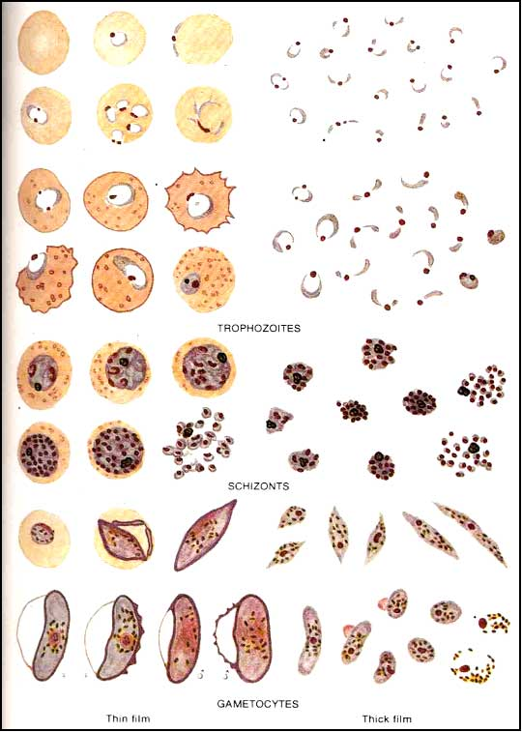
Plasmodium falciparum - stages

Slide 16
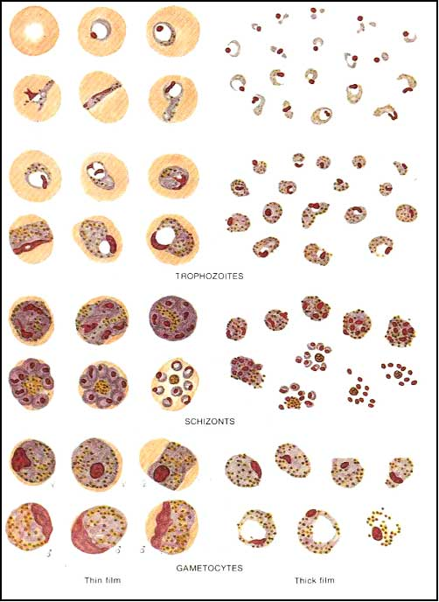
Plasmodium malariae

Slide 17

Rosette form – schizont

Slide 18
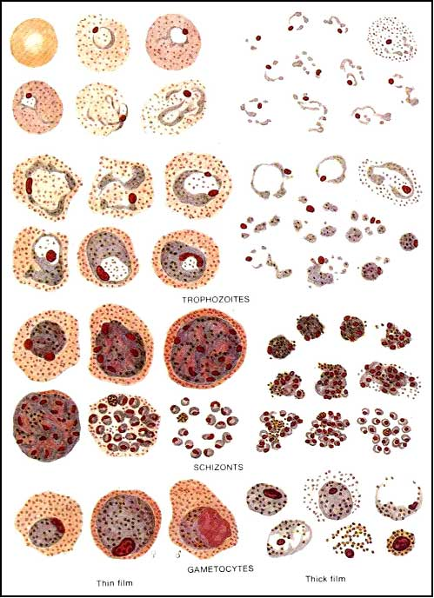
Plasmodium vivax

Slide 19
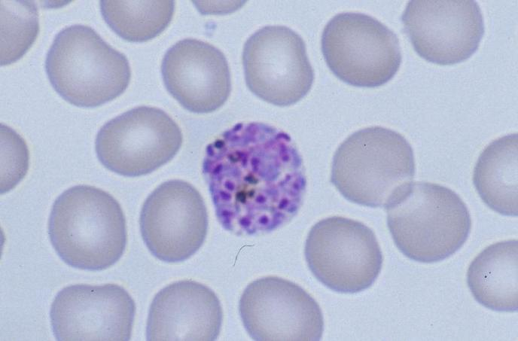
Schizont of plasmodium vivax

Slide 20
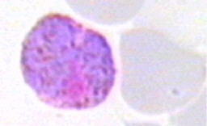
Gametocyte – plasmodium vivax

Slide 21
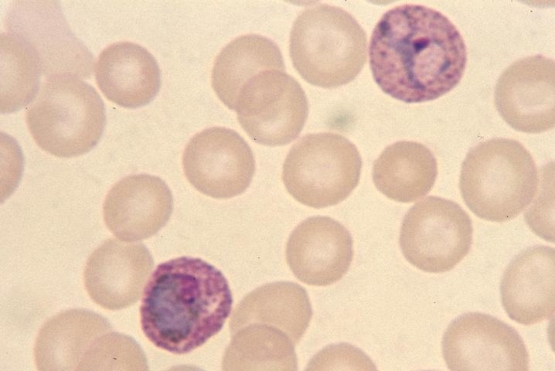
Late trophozoite of plasmodium vivax

Slide 22
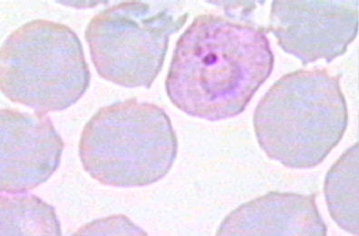
Trophozoite of plasmodium vivax

Slide 23
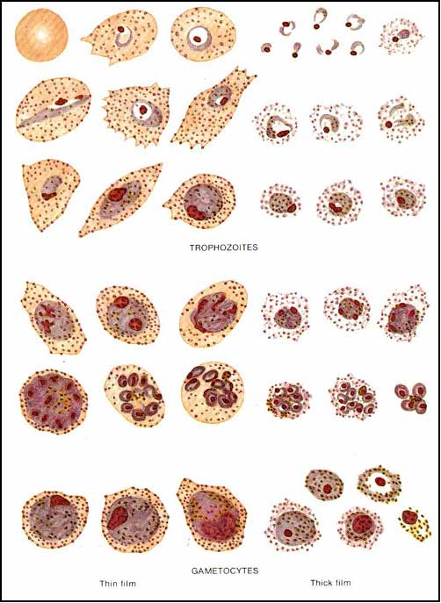
Plasmodium ovale

Slide 24
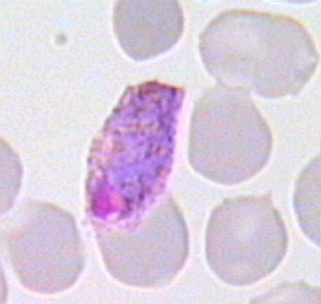
Gametocyte of plasmodium ovale

Slide 25
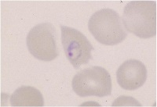
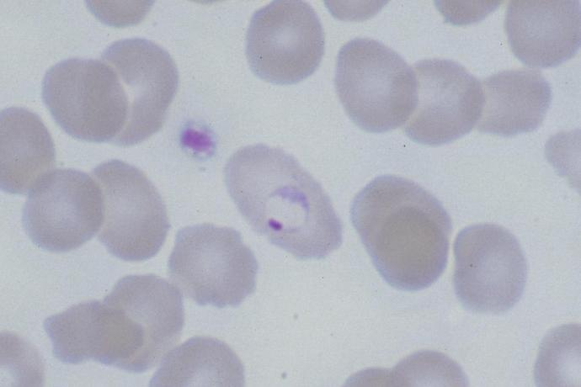
Trophozoite of plasmodium ovale

Slide 26
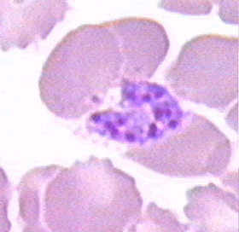
Schizont of plasmodium ovale

