Slide 1
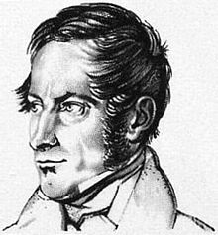
Hymenolepsis nana
Hymenolepsis nana
Mosab Nouraldein

Slide 2
History
Von Siebold identified H.nana as human parasite in 1852 .

Slide 3
Epidemiology
H.nana is widely distributed in countries with warm climates (Africa ,south America and southeast Asia .

Slide 4
Transmission
Fecal Oral Route (FOR) .
Transmission is by ingesting eggs in food or drink or from contaminated hands.
The eggs are infective when passed in the feces .
Internal autoinfection also occur .

Slide 5
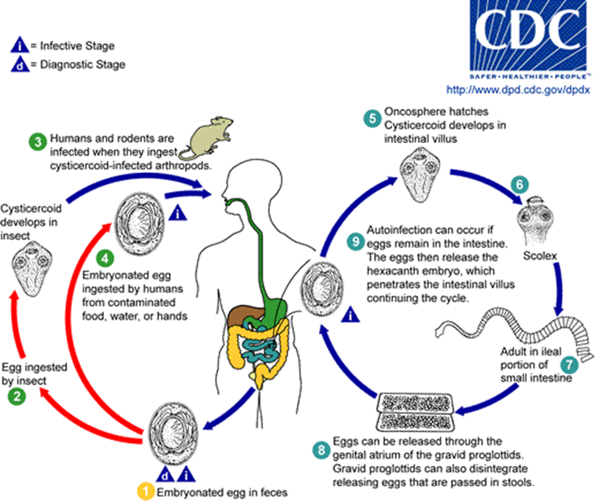
Life cycle

Slide 6
Clinical presentation
Mostly its asymptomatic .
Heavy infection can cause weakness, headache, anorexia ,diarrhea and abdominal pain .

Slide 7
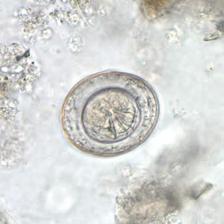
Lab diagnosis
Finding the eggs of H.nana in faces( directly or by concentration technique

Slide 8
Egg morphology
Colorless
Oval or round
Hooklets are present in the embryo (3 pairs of hooklets ) .
Has a polar filaments ( thread like structures at each end of the egg ) .

Slide 9
Control
Practicing personnel hygiene.
Providing latrines .
Avoiding eating uncooked food .
Treating the infected persons by Praziquantel .

Slide 10
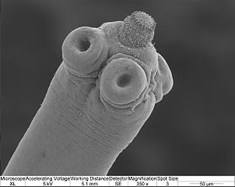
SCOLEX

