Slide 1
Malaria parasite

Slide 2
Malaria is a vector borne disease, transmitted by females of Anopheles mosquitoes .
Causative agent : Plasmodium species
40% of world population lives in endemic area

Slide 3
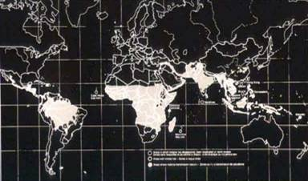
Distribution of malaria

Slide 4
History
Evidence of patient died of malaria were found from Egyptian mummies of more than 3000 years old
The name malaria was derived from the ancient false belief that “ disease is spread by air pollution through stagnant and marshy lands”
Mal = bad , aria: air
Malaria = bad air

Slide 5
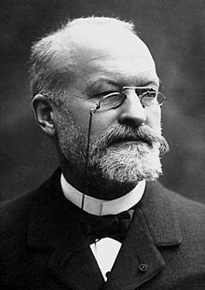
French army surgeon Charles Alphonse Laveran (1880) , was the first to discover the causative agent of malaria (Plasmodium) , in the red blood cell of a patient in Algeria .
Golgi described the asexual cycle of the parasite in RBCs.
Ronald Ross in 1897 described the sexual cycle of the parasite in female anopheles mosquito in India .

Slide 6
Causative agent of malaria
Plasmodium falciparum
Plasmodium vivax
Plasmodium malariae
Plasmodium ovale
Plasmodium knowlesi ( usually affect monkey but also can affect human)

Slide 7
Mode of transmission
By the bites of infected female of Anopheles mosquito
Blood transfusion
Transplacental transmission

Slide 8
Life cycle
Indirect life cycle
To complete their life cycle Plasmodium require two host :
Vertebrate host ( human)
Invertebrate host ( female of Anopheles mosquito)

Slide 9
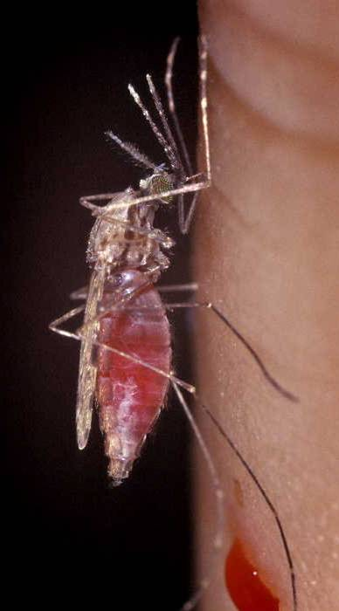
Female Anopheles mosquito
Act as definitive host in which sexual reproduction (sporogony) takes place .
Male of Anopheles mosquito feeds on nectar and fruit juices .
Females need human blood to produce their eggs , it needs a least two blood meals before laying eggs.

Slide 10
Human
Intermediate host in which asexual reproduction takes place (Schizogony)

Slide 11
Human cycle ( asexual cycle)
Infective stage :
Sporozoites are the infective stage of the parasite .
They are present in the salivary gland of female Anopheles mosquito .
When plasmodium species is transmitted by blood transfusion or through placenta , merozoites act as infective stage.

Slide 12
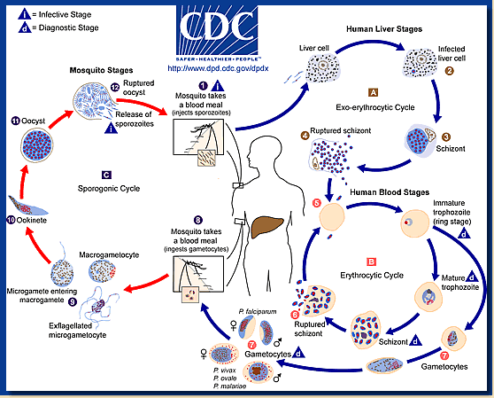
Life cycle (sexual & asexual)

Slide 13
Inborn malaria resistance :
Thalassaemia
Sickle cell trait
HB C
HB E
Glucose 6phosphaste dehydrogenase deficiency
Ovalocytosis
Duffy negative (lack Duffy receptor in RBCs)

Slide 14
Immunity against malaria
Natural :
Naturally present in the host and is not dependent on any previous infection .
Alterations in the structure of hemoglobin or in certain enzymes have been found to provide protection against malaria .
Macrophages : which is activated by interferon –gamma produced by natural killer cells
NK cells produce IL-8 that play important role in recruitment and activation of dendritic cells and macrophages .

Slide 15
Acquired immunity :
Cell mediated immunity :
CD4 are essential for immune protection against asexual blood stages .
CD8 are essential for immune protection against pre-erythrocytic stages of malaria parasite .

Slide 16
Humoral immunity :
IgM, IgG & IgE are involved .

Slide 17
Mechanism of evasion :
intracellular habitat
Antigenic diversity
Immune-suppression ( the parasitized RBCs with deposited hemozoin inside , inhibit the maturation of dendritic cell which is one of APCs ) .

