Slide 1
Medical entomology
Mosab Nouraldein

Slide 2
The origin of the word entomology
The word entomology derived from Greek entomon (= insect ) , logia ( =logy )

Slide 3
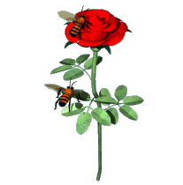
Introduction to medical entomology

Slide 4
History
TAXONOMY :
DRIVED FROM GREEK WORD TAXIS(=AGRREMENT) & NOMOS(=LAW)

Slide 5
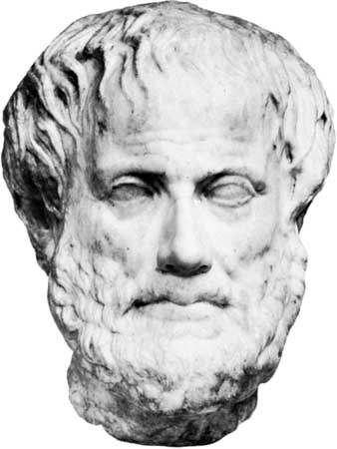
Aristotle:
Classified insects into winged ( Petra) & unwinged (Apetra).

Slide 6
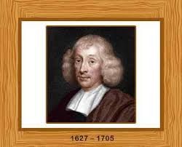
John Ray
Established high classification categories

Slide 7
Kingdom
Phylum
Class
Order
Family
Genus
Species

Slide 8
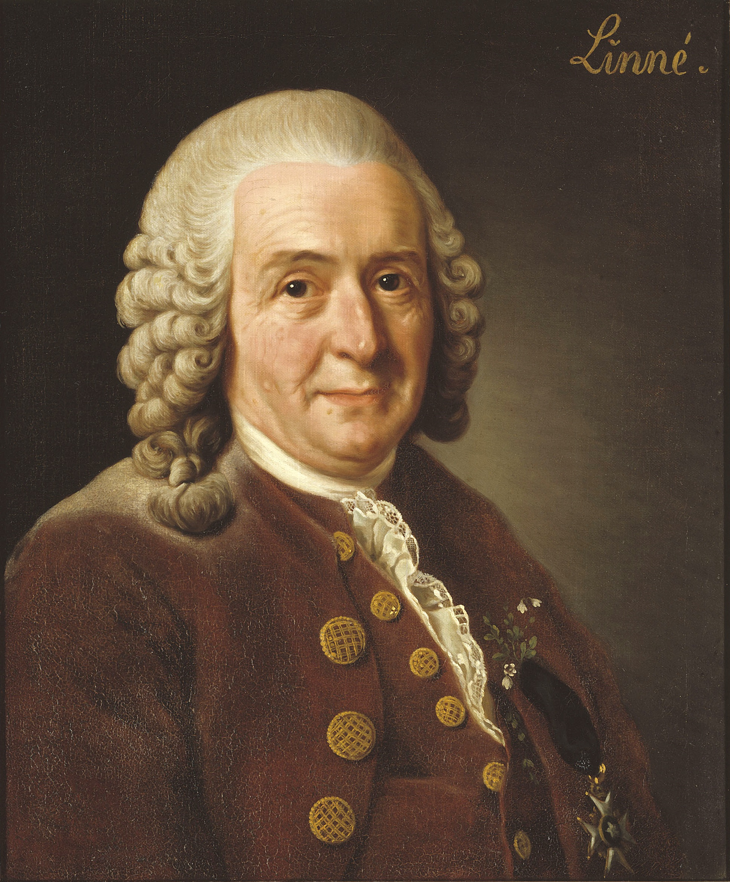
Carlos Linnaeus
Created binomial nomenclature .
Named organism according to genus and species

Slide 9
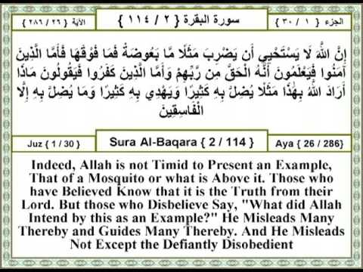

Slide 10
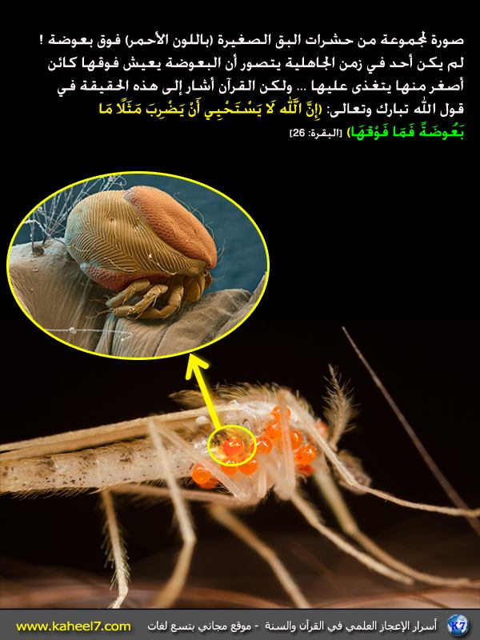

Slide 11
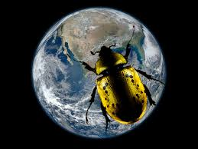
Entomology
Entomology is the study of arthropods , the most abundant form of animal life on earth.

Slide 12
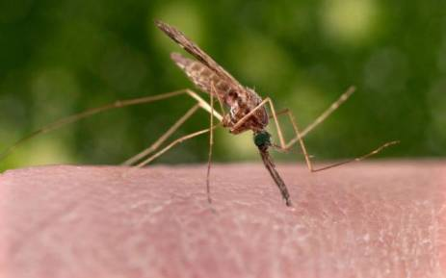
Medical entomology
Is the branch of science that deals with arthropods that cause disease or that serve as vectors (carrier) of organisms that cause disease in humans.

Slide 13
Arthropods s have incredibly diverse morphological, physiological, and behavioral adaptations to their surroundings which makes the study of arthropods an exciting subject.

Slide 14
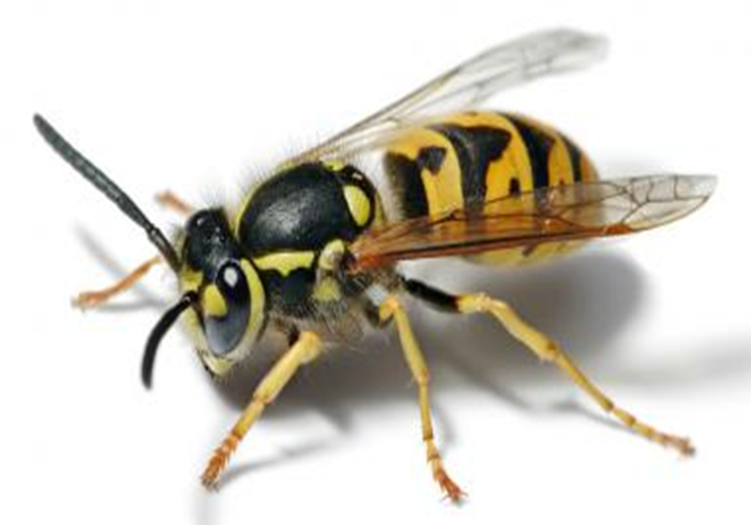
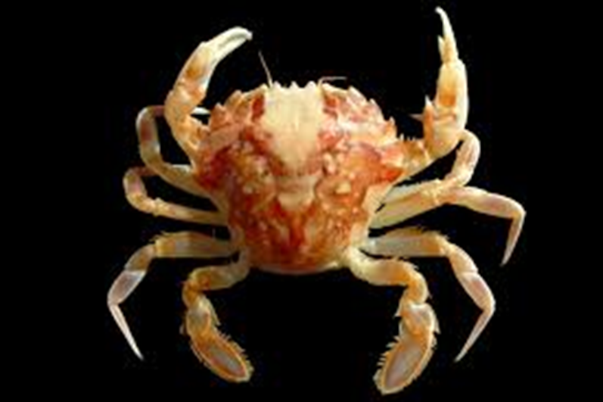

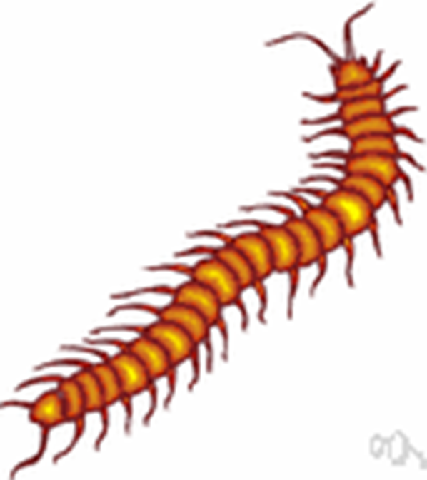

Slide 15
Their abundance, short life cycle, reproductive potential and small size allow scientific experiments to be set up.

Slide 16
Despite their small size, the sheer numbers or biomass of insects means that they have a significant impact on the environment and therefore upon our lives.

Slide 17
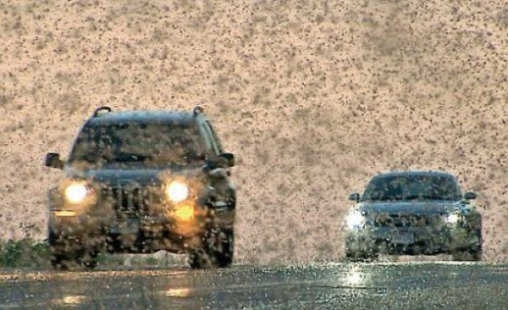

Slide 18
Although most arthropods have never adapted to a truly marine environment, they inhabit almost all terrestrial and aquatic environments. Some have adapted to live with us (cockroaches) while others live on us (lice).

Slide 19
Arthropods
An Arthropods is a derived from Greek word ( Arthron: joint, pod: foot) , JOINTED LEG.

Slide 20
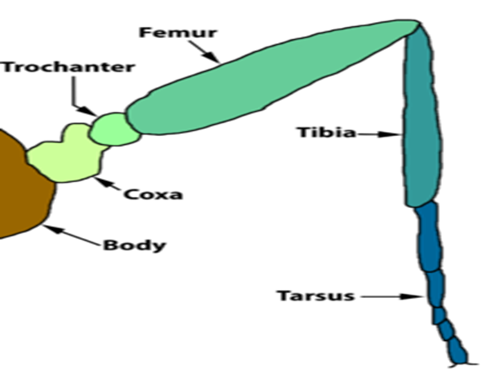

Slide 21
Features of arthropods
•Exoskeleton - a hard protective covering around the outside of the body (divided by sutures into plates called sclerites)

Slide 22
Segmented body - that allows movement
Jointed limbs and jointed mouthparts - that allow extensive specialization
Bilateral symmetry - whereby a central line can divide the body into two identical halves, left and right

Slide 23
Ventral nerve system- as opposed to a vertebrate nerve chord which is dorsal.
Dorsal blood vessel.

Slide 24
Classes of arthropods
Five important extant classes of Arthropods are:
Arachnids,
Chilopods,
Diplopods,
Crustaceans
Insects.

Slide 25
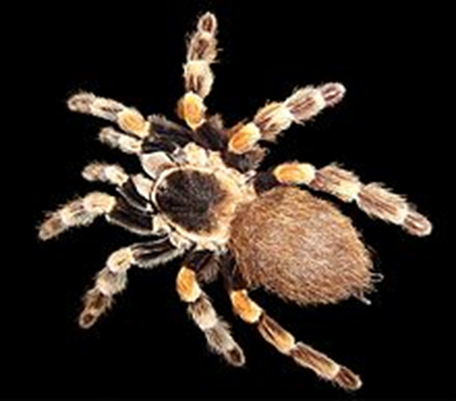
Arachnids
spiders, scorpions, ticks and mites. They all have
•2 body segments - cephalothorax and abdomen
•8 legs
•no antennae

Slide 26
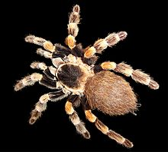

Slide 27
Chilopods
which include centipedes, all have
many body segments
1 pair legs /body segment
1 pair antennae
poison jaws

Slide 28


Slide 29
Diplopods
include millipedes, all possess
•Many body segments
•2 pair legs /body segment
•1 pair antennae

Slide 30
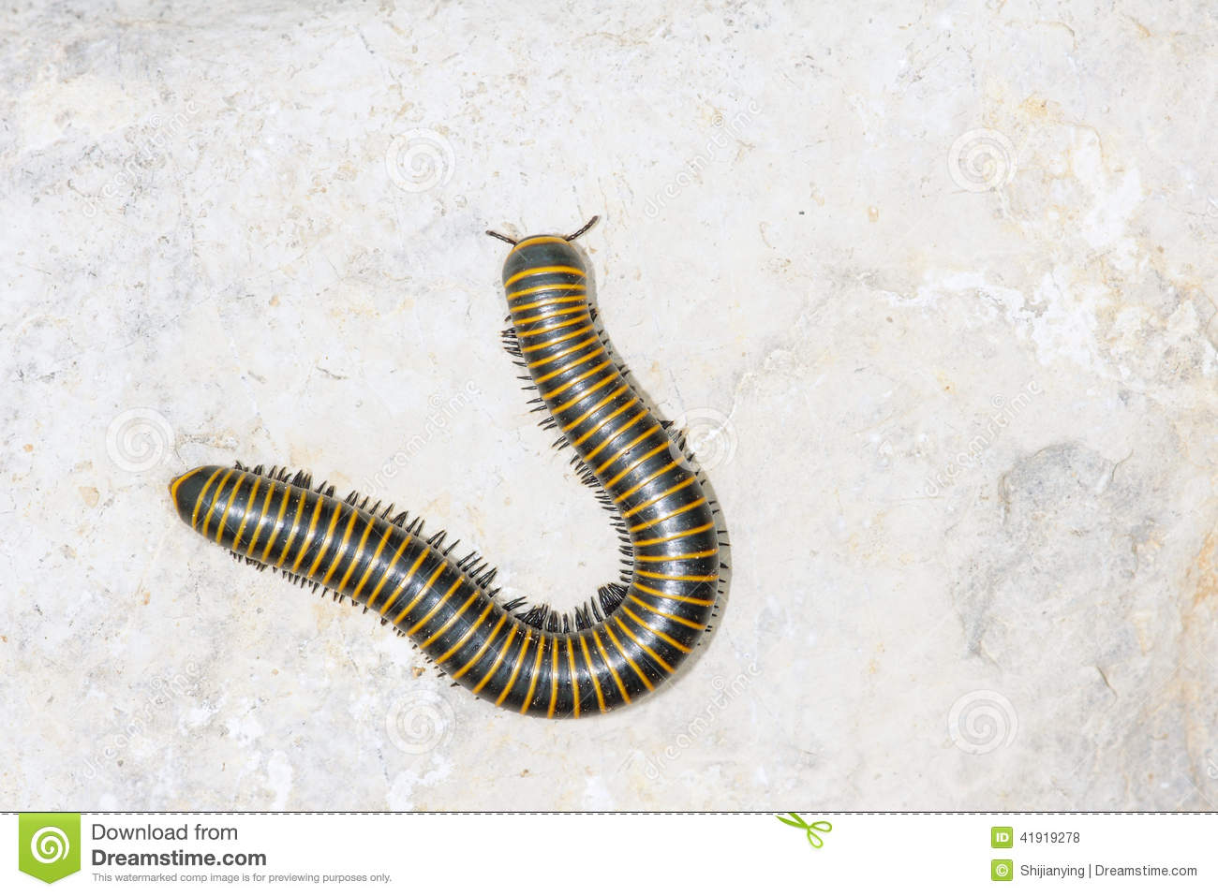

Slide 31
Crustaceans
include crabs.
Their features are:
•Varied number of body segments - usually there is a head, thorax and abdomen but there is much fusion, reduction and modification of segments
•Varied number of legs
•2 pair antennae

Slide 32


Slide 33
Insects
such as mosquitoes , house fly and cockroaches all have
•3 body segments
•6 legs
•1 pair antennae

Slide 34


Slide 35
WHY WE STUDY MEDICAL ENTOMOLOGY?
Arthropods can affect our health and that of our livestock and pets in many ways

Slide 36
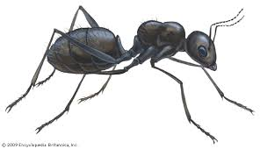
Arthropods affect human by inducing:
Nuisance :
Ants

Slide 37
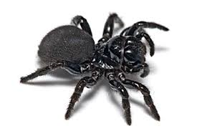
Phobia:
Spiders

Slide 38
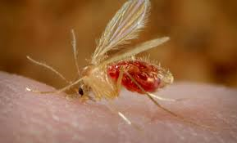
Biting, sucking:
Ants, mosquitoes, sand flies.

Slide 39
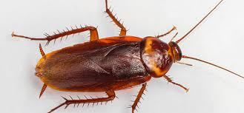
Venoms and allergies:
ants, bees, spiders, ticks, cockroach faeces.

Slide 40
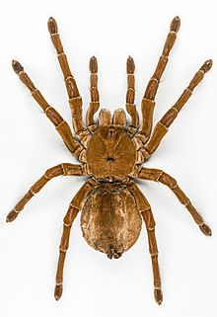
Blistering, inflammation and urtication (irritating hairs)
spiders

Slide 41
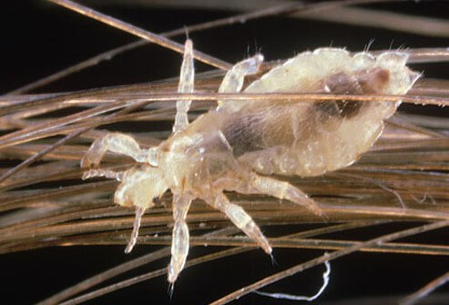
Disease, infestation:
Head, body and pubic lice, mites (scabies).

Slide 42
Disease vectors:
Whereby arthropod does not cause actual disease but transports the organism responsible for the disease ( causative agent)

Slide 43
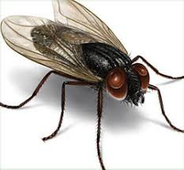
Vector types :
•Mechanical :
House fly
Biological:
Mosquitoes

Slide 44

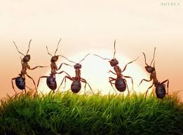
Together we do more

