Slide 1
Plasmodium vivax
Mosab Nouraldein Mohammed Hamad
Musab.noor13@gmail.com

Slide 2
Discovery
Haemamoeba vivax Grassi and Feletti, 1890

Slide 3
Epidemiology
Mostly occur in Asia , Latin America and some parts of Africa
P.vivax originate from Asia
P.vivax cause benign tertian malaria

Slide 4
P. vivax (as well as P. ovale) has dormant liver stages (“hypnozoites”) that can activate and invade the blood (“relapse”) several months or years after the infecting mosquito bite.

Slide 5
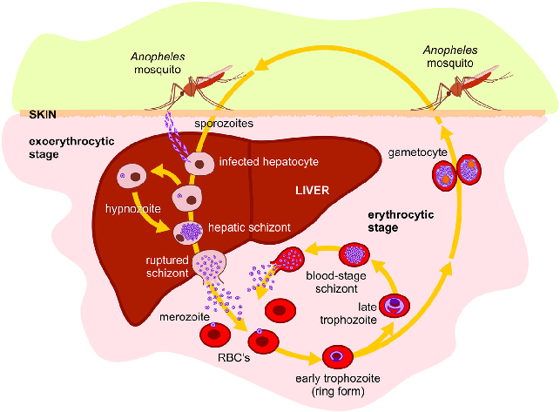
Life cycle

Slide 6
Pathogenesis
Pathogenesis results from rupture of infected red blood cells, leading to fever. Infected red blood cells may also stick to each other and to walls of capillaries. Vessels plug up and deprive tissues of oxygen. Infection may also cause the spleen to enlarge

Slide 7
P. vivax can populate the bloodstream (all sexual and asexual stages present in peripheral blood)

Slide 8
The parasite can go dormant in the liver for days to years, causing no symptoms and remaining undetectable in blood tests (form hypnozoites)

Slide 9
Symptoms
Cardinal signs : fever, sweat and cold stages
Abdominal pain
Nausea
Vomiting

Slide 10
LAB DIAGNOSIS
Thick and thin blood film
Buffy coat
Serology (ELISA)
Culture in RPMI or NNN medium
Molecular methods (PCR)
Rapid test (ICT) is a screening test not diagnostic.

Slide 11


Morphology
Wright’s stain---reddish nuclei; bluish cytoplasm and yellowish brown malarial pigment
1. Morphological features of P. vivax
Early trophozoite (ring form)
1 red nucleus on the ring-like light blue cytoplasm ; single
infection in a cell.
.

Slide 12
Late trophozoite
It is irregular shape like ameboid form with pseudopodia; within cytoplasm ,brown pigment granules (malarial pigment---haemozoin) appear.
infected RBCs are
pale in color,and have
schuffner’s dots in it
(fine red granules) .

Slide 13




Immature schizont
oval in shape , nucleus
divided into 2-4 or more ,
malarial pigment begins to
concentrate in a mass.
Mature schizont
nucleus divided into
12-24 ;and cytoplasm also
divided , each nucleus
surrounded by a portion of cytoplasm to form merozoites, malarial pigment clumped.
Male gametocyte
oval in shape; 1 loose
nucleus in centre of it ;
malarial pigments diffuse .
Female gametocyte
oval in shape ; 1 compact
nucleus not in centre of it .

Slide 14
Thrombocytopenia as occur in Falciparum malaria
Anemia
Elevated LDH

Slide 15
Treatment
Chlorquine and quinine----anti-erythrocytic stage drugs. (question: Which stage of plasmodium can these drugs kill?)
Primaquine and pyrimethamine ----anti-exoerythrocytic stage drugs.
Prevention
Chemoprophylaxis
-----Chloroquine / pyrimethamine
used for
prophylaxis of malaria
-----Chemotherapy: 1 week before entry into the endemic area ; for 4 weeks after returning from the endemic area.

Slide 16
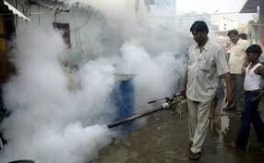
Mosquito control
(1). Reconstruction of environment: eradicate the breeding places of mosquitoes.
(2). Spry insecticides: DDVP and so on.
(3). Use mosquito nets, screen, or mosquito repellents to protect the person from mosquito bites.

Slide 17


