Slide 1
Introduction to laboratory instrumentation lecture one
Mosab Nouraldein Mohammed

Slide 2


Slide 3
Medical laboratory
A medical or clinical laboratory is a laboratory where tests are usually done on clinical specimens in order to obtain information a bout the health of a patient as pertaining to the diagnosis , treatment , and prevention of disease .

Slide 4
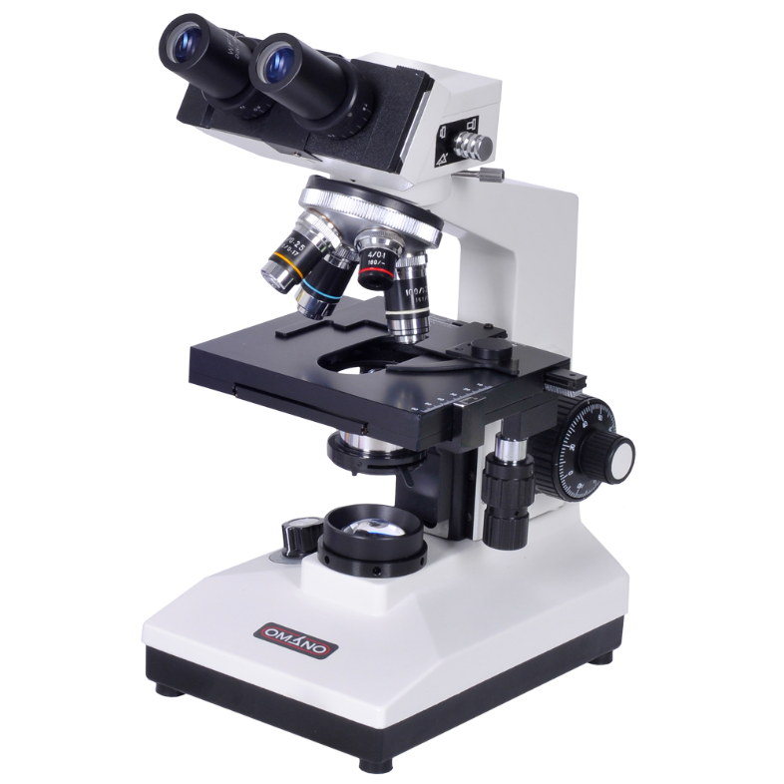
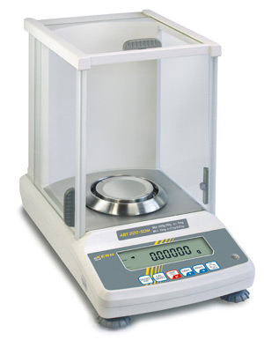
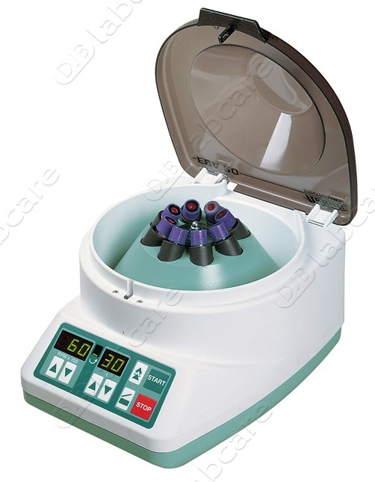
Instrument
Device used for particular purpose (e.g. diagnosis)

Slide 5
Selection criteria of laboratory instrument
1-Will the equipment improve significantly the laboratory service to patients ?.
Define the value of a piece of equipment & differentiae between what is wanted and what is needed.

Slide 6
2- is the cost of purchasing ,running , and maintaining the equipment within the resources available .???

Slide 7
3- is the equipment suited to the type of laboratory and conditions under which it will be used ?
What are the power requirements or is there any information available to show that the equipment will operate in a hot climate under conditions of high humidity .

Slide 8
4-Has the laboratory staff sufficient knowledge and experience to operate and maintain the equipment efficiently and safely ?
If not , will it be possible for necessary training to be given .

Slide 9
5- What parts of the equipment require regular replacement e.g. .lamps , heating element ,washer ,..etc.
What will be the cost of these replacement parts and how easy will it be to obtain them ?

Slide 10
6- does the operation of the instrument dependent on a continued supply of imported ready-made reagents or can it be operated using locally prepared reagents ?

Slide 11
7-service contract – first found out the duration of the manufacturer warranty because it varies from manufacturer to another .
After that warranty period expires , consider what service contract terms and conditions are available and at what cost .

Slide 12

8-environmentally friendly .

Slide 13
Steps to achieve successful purchasing of laboratory equipment:
1- establish the need
2-Define the requirements
3-Define the resources
4-Call tenders
5-Evaluate tenders
6-Select
7-Purchase

Slide 14
Repair and maintenance of laboratory equipment :
To facilitate the repair and maintenance of laboratory equipment, the World Health Organization makes the following recommendations :
1- service manual must be provided
2- spare parts should be clearly listed
3-equipment should be demonstrated by manufacturer or their representative
4- daily care of equipment should be emphasized

Slide 15
5- laboratory staff should receive training in the relevant aspects of equipment operation and maintenance
6-To avoid interrupting essential laboratory services, there should be available suitable equipment to substitute when routine equipment needs to be repaired .

Slide 16
Quiz
1- define :
A-Medical laboratory ?
B- Instrument?
2-Discuss :
A-Selection criteria of lab equipment?
B-Repair and maintenance of lab instrument?
3- how to do purchase lab engine successfully?

Slide 17
References
1-Medical laboratory manual for tropical countries, volume 1
2-Internet

