Slide 1
By mosab nouraldein
zoonoses

Slide 2
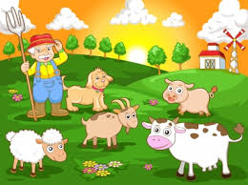
Introduction
Animals play an important role in the lives of humans, providing both psychological and
physiological benefit

Slide 3
However interactions with animals can pose a risk for diseases of animals that can be transferred to humans, leading to infection and disease .

Slide 4
zoonoses
Definition
is any disease or infection that is a naturally transmissible from vertebrate animal to human .

Slide 5
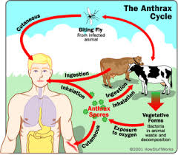

Slide 6
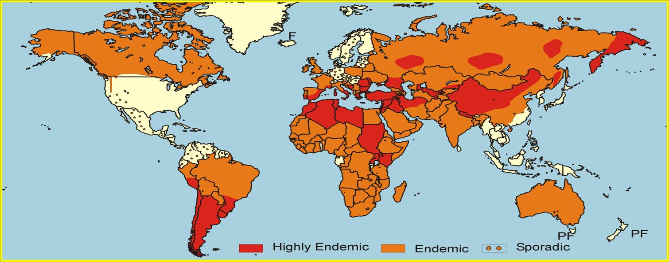
Epidemiology
approximately 200 of zoonotic diseases are known to exist

Slide 7
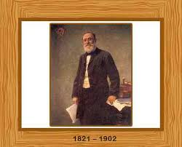
Discovery of zoonoses
The term "zoonoses" was first coined by Rudolf Virchow, a German physician-scientist who is probably better known as the "father of modern pathology”
.

Slide 8
Virchow oversaw some aspects of public health, including examination of meat for human consumption. One of his major tasks was ensuring that pork was free of the parasite Trichinella, a problem he termed a "zoonoses

Slide 9
Transmission
Transmission occurs when an animal infected with bacteria, viruses, parasites, and fungi comes into contact with humans.

Slide 10
You can get zoonotic diseases through
1)direct contact with animals
2)if you work with animals
3)have pets
4),have hobbies that involve animals
5) also You can get some of these diseases from contaminated food or water.

Slide 11
More susceptible
1) children under 5 years
2) persons above 65 years
3) pregnant ladies
4) immunosupressed persons

Slide 12
Classification of Zoonoses
Direct Zoonoses
Direct zoonoses are transmitted from an infected vertebrate host to another host by direct contactor mechanical vector. The pathogen does not undergo developmental change or propagation during the transmission. An example is rabies.

Slide 13
Metazoonoses
A metazoonosis does require an invertebrate host where the pathogen multiples or develops before it can infect a vertebrate host. An example of a metazoonotic disease.
is bubonic plague

Slide 14
Cyclozoonoses
A cyclozoonosis requires more than one vertebrate host but no invertebrate host is needed

Slide 15
Saprozoonoses
are diseases transferred through a non-animal reservoir, such as a plant, or through the abiotic environment, such as through water or soil.

Slide 16
Mode of transmission | Main reservoir | Disease
Ingestion of oocyst | Cat , ruminants | Toxoplasmosis
Pork products | Pigs | Trichinellosis
Ingestion of eggs excreted by dog | Dogs, sheep | Hydatid disease
Water, direct contact | Cattle, sheep, pets | Cryptosporidosis
meat | Cattle,pigs | Cysticercosis
Flea bite | Rats and their fleas | Plague
Bite | Dogs,cats,foxes, | Rabies
Tick bite | Rodents, sheep | Lyme disease
Diary products, milk | Cattle,goats,sheep | Brucellosis
Direct contact | Poultry ,ducks | Avian influenza
Direct contant,inoculasion,ticks | Rodents | Ebola

Slide 17
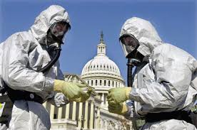

Bioweapons
Certain zoonotic diseases are used in bioterrorism such as Anthrax which is transmitted by direct contact or ingestion

Slide 18
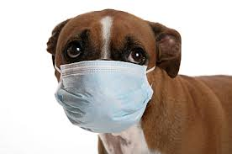
Reverse zoonoses
. When humans infect other animals; it is called reverse zoonoses or anthroponosis

Slide 19
Control
Fortunately, most zoonotic diseases can be avoided with proper prevention measures and maintenance of optimum health in humans and animals

Slide 20
Veterinary and human healthcare professionals should collaborate to promote health and prevention measures for animals and people and in efforts to reduce the incidence of zoonotic diseases.

Slide 21
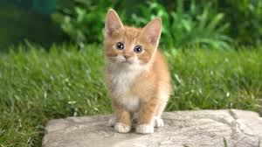
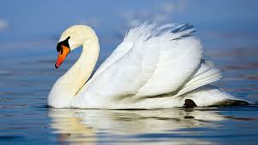
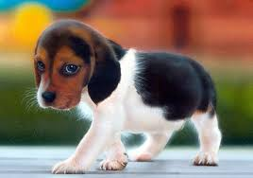
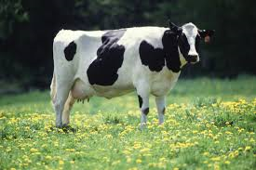
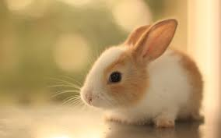
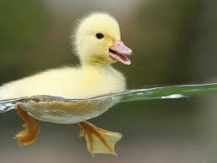

Slide 22
