Slide 1
Centrifuge
Mosab Nouraldein Mohammed
Musab.noor13@gmail.com

Slide 2
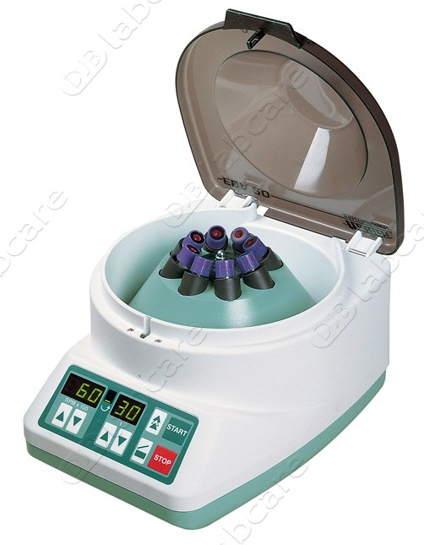
Definition
A centrifuge is a laboratory device that is used for separation of fluids based on density.

Slide 3
Principle
A body is rotated in a circular movement at speed . This creates a force that drives the body away from the center of the circular movement

Slide 4
Components of a centrifuge a
A) central shaft (spindle) : that rotate at high speed
B) a head : fixed to the shaft , with buckets for holding the centrifuge tubes.
C) tubes : containing the liquid to be centrifuged

Slide 5
Centrifugation mechanism
When the spindle rotates the tubes are subjected to centrifugal force. They swing out to the horizontal and the particles in suspension in the liquids in the tubes are thrown to the bottom of the tubes.

Slide 6
Centrifugation targets
These particles form the centrifuge deposit which can be separated from the supernatant ﬂuid and examined.
The deposit may contain, for example:
— blood cells;
— parasite eggs (in diluted stools);
— cells from the urinary tract ( in urine) .

Slide 7
Types of centrifuge
Hand operated centrifuge :
This is operated manually by turning a handle ,It takes two or four tubes .
The hand –operated centrifuge can be used :
-To examine urinary deposits
- To concentrate certain parasites in stools

Slide 8
The speed is insufficient for satisfactory separation of erythrocytes from plasma in blood

Slide 9
Electric centrifuge:
Electric centrifuges are more accurate than hand-operated centrifuges and should be used whenever possible. Electric centrifuges are used with two types of head — the “swing-out” head and the “angle” head .

Slide 10
Swing-out” head
The head is designed to swing the tubes out to a horizontal position during centrifuging. This is the type most frequently needed.

Slide 11
“Angle” head
The “angle” head holds the tubes at an angle of about 45° during centrifuging. It is useful for certain techniques, e.g. agglutination tests in blood-grouping by the test tube method.

Slide 12
Centrifuge categories :
Benchtop centrifuges :
Are broad class of centrifuges with maximum speed in RCFs can range from 100-50.000 x g.
Tubes volumes can range from 1ml to a few liters.

Slide 13
Refrigerated benchtop centrifuges:
Ideal for centrifugation of samples that may be temperature sensitive , such as live cells or proteins .
Sample volumes from under 1 ml to few liters.
Speed can reach up to 60.000 x g

Slide 14
Clinical benchtop centrifuge
Low speed centrifuges ideal for the separation of whole blood components , such as red blood cells as well as other body fluids.
Their speed range between 200-6.000 rpm .

Slide 15
Microcentrifuge :
Used for samples of small volume 1 ml ( PCR tube) , 2 ml ,1.5 ml , 0.5 ml.
Their speeds up to 16.000 x g .

Slide 16
Vacuum centrifuge / concentrators :
Use vacuum ,centrifugal force , temperature and or gas to remove liquid solvent for the concentration or dessiccation of samples .
systems.

Slide 17
This centrifuge is ideal for purification of preparation of samples such as : nucleic acids and proteins .
For evaporation of solvents vacuum centrifuges typically utilize built in heating systems .

Slide 18
Instruction for use
You should always follow the manufacturer’s instructions when using the centrifuge

Slide 19
Installing the centrifuge
The centrifuge must be placed on rubber pads or a mat on a flat level surface .

Slide 20
Balancing the tubes
Balance the tubes that are opposite each other by weighing them in their buckets on the open two pan balance

Slide 21
Safety precautions
Check that the tubes are the correct size for the centrifuge. Tubes that are too long or too small may break.
Fill the tubes to no more than three-quarters full to prevent spillage in the bowl.

Slide 22
Always balance the centrifuge buckets before starting the centrifuge. Failure to do this can cause excessive wear or the centrifuge may move.
Ensure that the lid is closed before starting the centrifuge.

Slide 23
When starting the centrifuge, gradually increase the speed, turning the knob slowly, until the desired speed is reached.

Slide 24
Stop the centrifuge gradually . Never try to slow the centrifuge down with your hand.
Never open the centrifuge until it has come to a complete stop .

Slide 25
Remove the tubes slowly and carefully .

