Slide 1
Trichomonas vaginalis

Slide 2
Trichomonas vaginalis is a sexually transmitted extracellular anaerobic flagellated protozoan parasite that live in the female lower reproductive tract and the male urethra .

Slide 3
Alphred Donne (1836) , described Trichomonas vaginalis in human vaginal discharge .
It was regarded as harmless inhabitant of the vagina for 80 years until linked to vaginitis .

Slide 4
Distribution
World wide .
More than 160 million people worldwide are annually infected by this protozoan parasite .

Slide 5
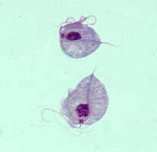
Mechanism of infection
Sexually transmitted infection .

Slide 6
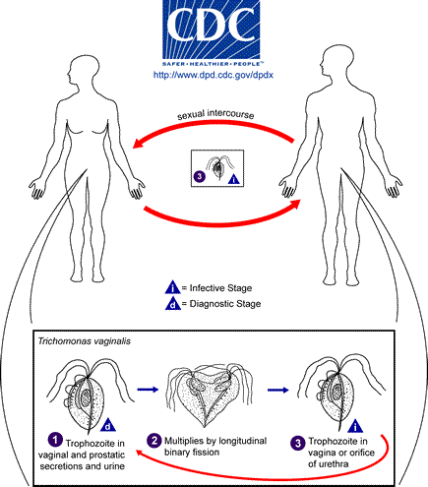
Life cycle

Slide 7
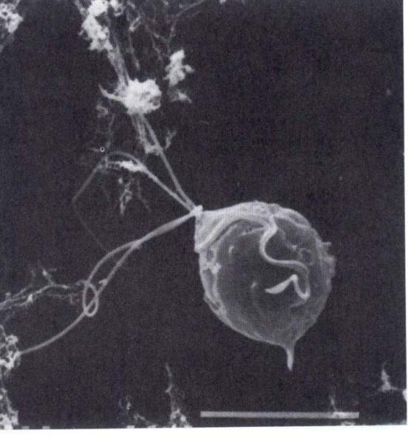
Four anterior flagella
The single lateral flagellum (the undulating membrane (波动膜）

Slide 8
Clinical features
may be Asymptomatic
Vaginitis accompany with frothy greenish vaginal discharge
Abdominal pain
Dysuria
asymptomatic Urethritis & prostatitis .

Slide 9
Trichomonas vaginalis has been detected in 66-77% of the male partners of infected women , and of those men , about 70% were asymptomatic .
In men the infection although usually self limiting and often asymptomatic , is associate with reduced sperm function and infertility .

Slide 10
Complication
Preterm delivery
Low birth weight
Infertility
Predisposing factor to :
Cervical cancer
Prostate cancer
HIV infection

Slide 11
Virulence factors
Cysteine protease
Adhesins
Microtubules
Microfilaments

Slide 12
Immunity
Innate immunity :
Complement system:
T.vaginalis activate the alternative pathway of complement .

Slide 13
Acquired immunity :
Cellular :
Cytotoxic T.cells .

Slide 14
Humoral :
Secretory IgA
IgG
IgM

Slide 15
EVASION MECHANISMS
Cysteine protease degrade C3 portion of complement on trichomanad surface , then the organism is protected against lytic effects of complements
Cysteine protease also degrade IgA, IgG & IgM antibodies
Also T.vaginalis secretes highly immunogenic soluble antigens and these may neutralize antibodies or cytotoxic T.cells .

Slide 16
Trichomonas vaginalis is able to become invisible to the immune system by coating its surface with host plasma proteins .
Also Trichomonas vaginalis has a character of antigenic variation , that enable it to evade immune system.

Slide 17
Serological diagnosis
ELISA
Immunobloting technique
Complement fixation technique
Indirect haemagglutination technique
Trichomonas rapid test .

Slide 18

Thank you

