Slide 1
Introduction to nematodes
Mosab Nouraldein Mohammed

Slide 2
Nematodes are elongated ,cylindrical , unsegmented worm with tapering end & they are bilaterally symmetrical .
( the name nematodes means thread like , from nema, thread.)
The adults vary in size from millimeters to a meter in length & they are colorless and vary from translucent to opaque .

Slide 3
The nematodes belongs to the class Nematoda which is the larger population of invertebrates .
Most nematodes live in fresh water, sea water or soil freely a few are parasitic.

Slide 4
Classification
A- systemic (zoological) classification :
based on Anderson et al classification (1974).
Phylum nematode has two classes
Secernentea
Adenophorea

Slide 5
Characters | Adenophorea | Secernentena
Sensory structure (phasmids) | Absent | Present
Esophagus | Modified with the presence of : gland cells or reserve organ | Normal appearance
Excretory organ | Without lateral canals | Lateral canals present
Caudal papillae | Absent | Present
Infective stage | First stage larva or embryonated egg | Third stage larva or embryonated egg
Genera included | Trichinella & Trichiuris | Ascaris , Entrobius , strongyloides , Ancylostoma , Necator, wuchereria , Brugia, Loa Loa, Onchocerca

Slide 6
Caudal papillae : is a cuticular protuberance (extension) , performing sensory function .

Slide 7
B- Classification based on habitat in the definitive host :
Intestinal nematodes :
Which inhabit :
1- Small intestine :
Such as : Ascaris , Ancylostoma , Necator , strongyloides, Trichinella .
2- Large intestine :
Such as : Enterobius & Trichiuris

Slide 8
Tissue nematodes :
Lymphatic : Wuchereria , Brugia .
Subcutaneous : Loa Loa, Onchocerca , Dracunculus .

Slide 9
C- Classification based on Mode of infection :
By ingestion of:
Eggs: Ascaris , Enterobius , Trichiuris .
Larvae within intermediate host : Dracunculus.
Encysted larvae within muscle : Trichinella
By penetration of skin : Ancylostoma , Necator , Strongyloides
By blood sucking insect : Wuchereria, Brugia ,Loa Loa ,Onchocerca
By inhalation of Dust containing eggs : Ascaris , Enterobius

Slide 10
D- Classification based on whether they lay eggs or producing larvae :
Oviparous : laying eggs
Unsegmented : Ascaris , Trichiuris
Segmented : Ancylostoma , Necator
Egg containing larvae : Enterobius

Slide 11
2. Viviparous : producing larvae
Such as , Wuchereria, Brugia, Dracunculus.
3. Ovoviviparous : laying eggs which contain fully developed larvae which hatch out immediately , e.g. Strongyloides .

Slide 12
General description
Nematodes pass through six developmental stages
Adult stages eggs stage four larval stages (L1-L4)
Each larval stage transforms to the next by shedding of the cuticle ( called as molting)

Slide 13
Adult stage
Shape :
Elongate
Cylindrical
Pointed (tapered) ends
Unsegmented

Slide 14
Size :
Variable , ranging from less than 5 mm (e.g. Strongyloides) to as long as one meter (e.g. Dracunculus)
Female worms are longer than male worms .

Slide 15
Symmetry :
Body is bilaterally symmetrical

Slide 16
Body wall :
Made up of outer layer of cuticle and inner layer of longitudinal muscles.
Locomotion :
Nematodes move by contraction of the longitudinal muscles

Slide 17
Alimentary canal :
Its well developed and consists of mouth at the anterior end followed by a muscular and glandular esophagus , intestine and rectum that leads to subterminal anus at the posterior end .
In some species mouth bears teeth or cutting plate ( e.g. hook worm)

Slide 18
Body cavity ( pseudocele):
It is the space between body wall and alimentary canal, which is filled by fluids secreted from intestine and genital organs .
Sexes :
Nematodes are diecious ( bisexual) , sexes are different ( male &female).

Slide 19
Male reproductive system:
It consists of a long convoluted tube which can be differentiated into : testes , vas deferens ,seminal vesicle & ejaculatory duct
Female reproductive system:
It consists from two or one convoluted tube, each tube is differentiated into an ovary , oviduct & seminal receptacle and uterus and then both tubes joined to form vagina , that open out side through genital pore either in the middle of the body or near the mouth .

Slide 20
Nervous system :
It consists of circular nerve ring ( brain) surrounding the esophagus and six longitudinal nerve trunk ( one dorsal , one ventral & four lateral) .
The dorsal nerve is responsible for motor control while the lateral nerves are for sensory and the ventral one combines both the functions .

Slide 21
Excretory system :
They have various ways for waste disposal :
Through the anus
Excretion of nitrogenous waste in the form ammonia through the body wall
In few species , there is an excretory canal near esophagus ,

Slide 22
Physiology :
Parasitic nematodes derive much of their energy from the metabolism of glycogen , most larval forms derives their energy from lipid metabolism .
Pathogenesis :
It causes the damage to human tissues by mechanical disruption and toxicity .

Slide 23
The tissue damage depends on:
Species of nematodes
Worm burden
habitat of the parasite
Development stage
Physiological condition
Immunological response of host

Slide 24
Life cycle :
Nematodes complete their life cycle in one host except tissue nematodes which needs two hosts ( definitive & intermediate host).

Slide 25
Structure of the Egg:
Eggs of nematodes consists from three layers :
Embryo membrane : consist of lipoprotein
Chitonous layer: consist of chitonous and protein
Lipid layer / ascaroside : consist of lipoprotein and ascaroside

Slide 26
Ascarosides :
It’s a glycolipids containing the sugar ascarylose

Slide 27
Quiz (1)
Classify medically important nematodes?
Define this terms :
Molting ?
Pseudocele ?
Oviparous ?
Ascarosides ?
Discuss :
The pathogenicity of nematodes ?
Factors affect tissue destruction by nematodes

Slide 28
References
Essentials of medical parasitology
Text book of human parasitology
Text book of medical parasitology

Slide 29
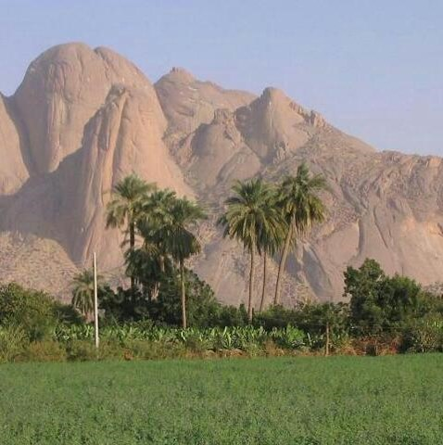
Thanks a lot

