Slide 1
Entamoeba histolytica
Mosab Nouraldein Mohammed
Semester 8

Slide 2
Distribution
World wide , but more common in tropical and subtropical countries
History :
E. histolytica was first described by Fedor Losch ( 1875) in Russia .
The species name was first coined by fritz Schaudinn in (1903) .

Slide 3
Disease
It’s the causative agent of amoebic dysentery

Slide 4
Transmission
Fecal oral route , by ingestion of mature cyst

Slide 5
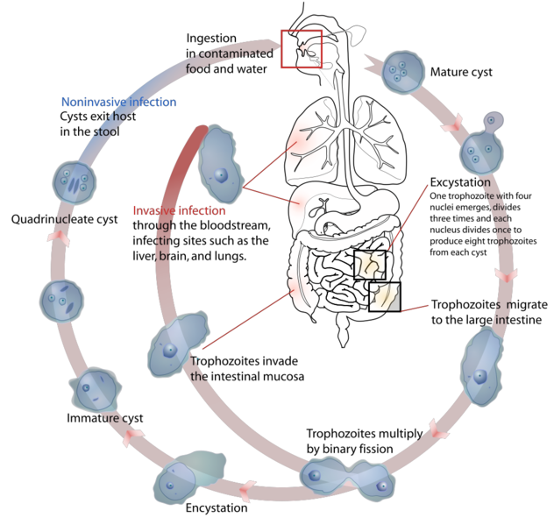
Life cycle –( direct )
Direct life cycle

Slide 6
Pathology
Abdominal pain
Dysentery
Amoebic colitis .
Extra intestinal amoebasis that may leads to abscess formation in liver , lung , brain ,..etc.

Slide 7
The development of extraintestinal amoebiasis depends on :
Level of immunity
Nutrition
Intestinal environment of the host

Slide 8
Immunity to Entamoeba histolytica
Innate immunity :
Stomach acid (HCL) serves as important first line of defense against enteropathogens through its ability to kill acid sensitive microorganisms .
However mature amoebic cyst ( infective stage) are highly resistant and survive passage through the acidic environment of the stomach .

Slide 9
The next layer of innate immunity may be the mucus layer ( mucus membranes) , which is thought to act as a protective barrier , preventing E. histolytica from invading intestinal epithelial cells .
Trophozoite however , can disrupt the mucus membranes by secreting cysteine protease and glycosidase to allow for penetration of the colonic mucosa .

Slide 10
Intestinal epithelial cells exposed to E.histolytica trophozite secrete potent chemokines such as IL-8 , resulting in immune cell recruitment.
Neutrophils are one of the first immune cells respond to amebic invasion .
also Its activated by interferon –gamma , tumor necrosis factor –alpha or lipopolysaccharides .

Slide 11
Macrophages also play an important role in host response against intestinal amoebiasis .
Its also activated by interferon –gamma & tumor necrosis factor –alpha .

Slide 12
Amebicidal activity of neutrophils is attributed to releasing of reactive oxygen species ( ROS) .
Amebicidal activity of macrophages is attributed to the production of nitric oxide .

Slide 13
Complement may act to prevent dissemination of trophozoites and extraintestinal amoebiasis . Once E.histolytica trophozoite activate membrane attack complexes (MACs) .

Slide 14
Acquired immunity
Mucosal immunoglobulin A ( humoral immunity)
Cell –mediated interferon –gamma appears to provide protection from amoebiasis through its ability to activate neutrophils and macrophages to kill the E.histolytica trophozoite .

Slide 15
Mechanisms of parasite evasion
mature amoebic cyst ( infective stage) are highly resistant and survive passage through the acidic environment of the stomach .
Trophozoite , can disrupt the mucus membranes by secreting cysteine protease and glycosidase to allow for penetration of the colonic mucosa .

Slide 16
Amebic peroxiredoxin , a 29-KDa surface protein with antioxidant properties protect amoeba from neutrophils reactive oxygen species (ROS) .
Amebic arginase and cyclooxygenase are limiting production of nitric oxide by macrophages .

Slide 17
Tissue damage ( ulceration)
An appropriate immune response clears E.histolytica trophozoite without causing significant damage to the host tissue .
Tissue destruction induced by :
E.histolytica cytolytic factors .
excess amount of TNF-alpha ( while TNF-alpha stimulates neutrophils and macrophages to release ROS ( reactive oxygen species ) & NO ( nitric oxide) to fight E.histolytica ) .

Slide 18
Serological diagnosis
Cellulose acetate precipitin test ( CAP ).
Enzyme linked immunosorbent assay (ELISA)
Radioimmuno assay (RIA) .

Slide 19
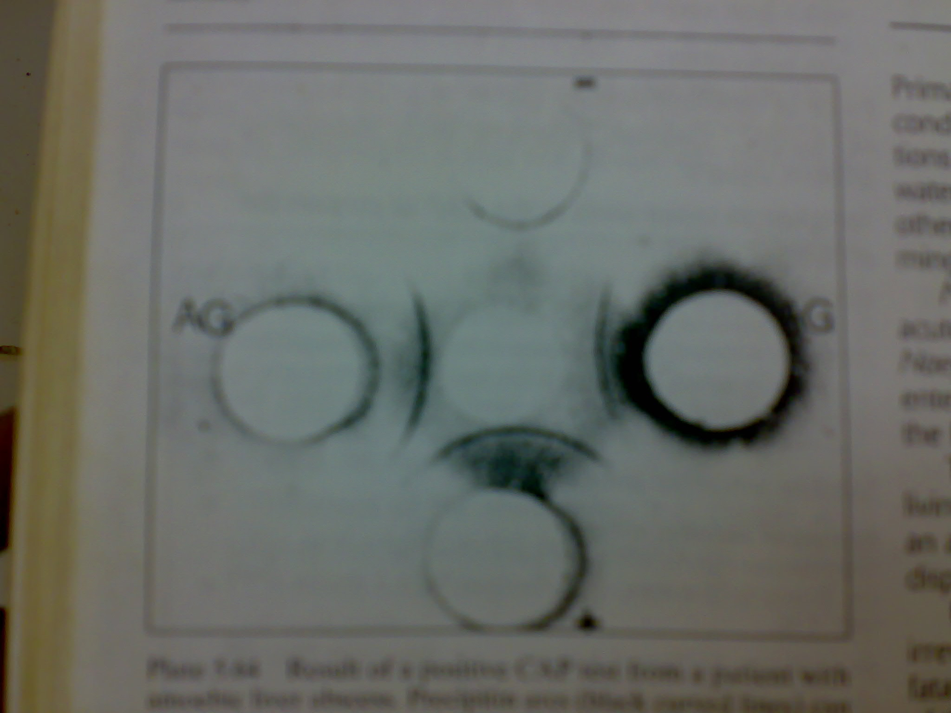
CAP TEST

Slide 20
QUIZ
1-Enumerate the factors which lead to amoebic liver abscess?
2-Discuss :
A-Natural immunity to E.histolytica?
B-Adaptive immunity to E.histolytica?
3-how E.histolytica evade immune system?
4-How to diagnose extraintestinal amoebiasis ,serologically?

Slide 21
References
Essentials of medical parasitology
Host immune response to intestinal amoebiasis (www.ncbi.nlm)
Medical laboratory manual for tropical countries, volume 1

