Slide 1
Plasmodium malariae
Mosab Nouraldein

Slide 2
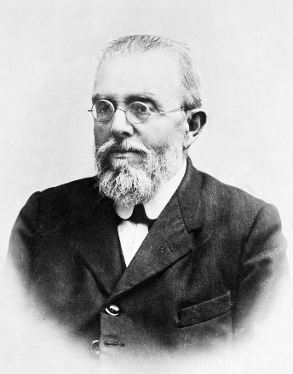
History
Discovered by Feletti and Grassi 1889
They named it Haemamoeba malariae.

Slide 3
Geographical distribution
Sub-Saharan Africa, Southeast Asia, Latin America

Slide 4
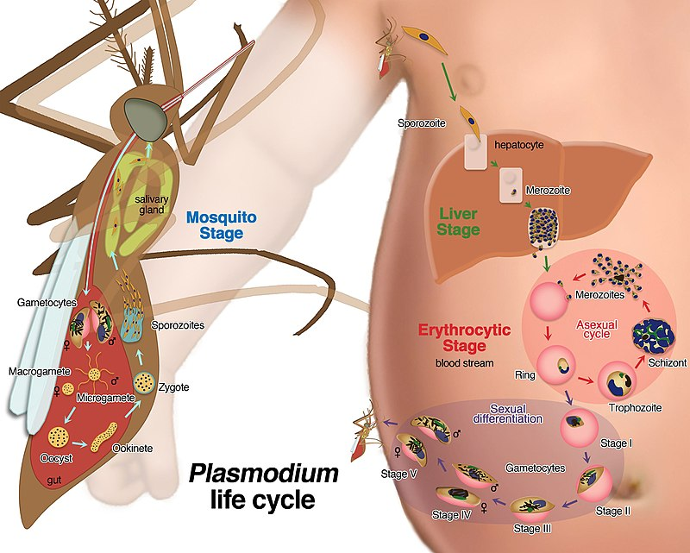
Life cycle

Slide 5
Plasmodium malariae have low parasitemia due to:
Low number of merozoite produced from asexual cycle
Long period of asexual cycle(72 hours)
Development inside aged(old) RBCs

Slide 6
Clinical features
Cardinal signs of malaria (every72hours/ quartan malaria):
Fever stage
Sweat stage
Cold stage
Others:
Nausea
Chills

Slide 7
Complication:
Most cases occur with mild symptoms due to low parasitemia
Nephrotic syndrome
Edema
Plasmodium malariae has a recrudescence such as P.falciparum

Slide 8
Lab diagnosis
Examination of thick and thin blood film
All stages present in peripheral blood(trophozoite-schizont & gametocyte)
Blood concentration techniques(e.g. Buffy coat method)
Size of infected RBCs is normal
PCR

Slide 9
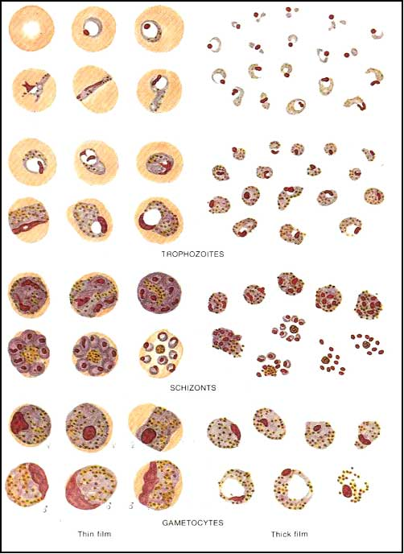

Slide 10
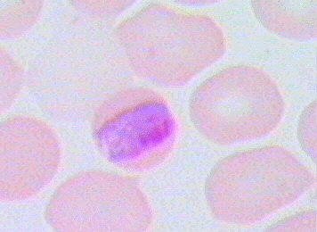
Late trophozoite (band form)

Slide 11

Schizont (Rosette form )

Slide 12
Control
Early diagnosis
Early treatment
Health education
Vector control

