Slide 1
Ascaris lumbricoides
Mosab Nouraldein mohammed Hamad

Slide 2
Ascaris lumbricoides is the largest nematodes parasitizing the human intestine .
The name derived from Askaris means intestinal worm and lubricus means resembling with common earth worm .

Slide 3
Distribution
Cosmopolitan , mainly affecting tropical countries .

Slide 4
Epidemiology
There are number of factors contribute to the high frequency of infection with Ascaris lumbricoides , these include its :
Ubiquitous distribution
The high number of egg produced by fertilized female
The hard nature of the egg , which enable them to survive unfavorable condition ( can survive in the absence of oxygen, live 2 year at 5-10 c, unaffected by desiccation for 2 to 3 weeks)
In favorable condition ( moist, sandy soil) they can survive for up to 6 years .

Slide 5
Transmission
Ingestion of embryonated egg ( containing L2)from contaminated soil ,water or food.

Slide 6
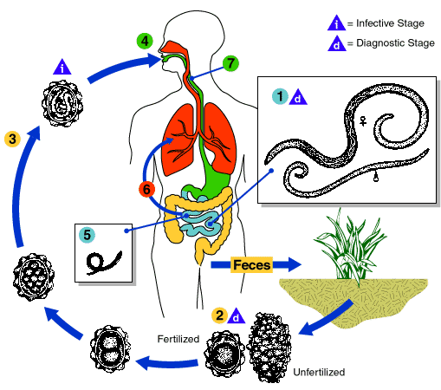
Life cycle

Slide 7
Clinical feature
Mostly its asymptomatic
Symptomatic disease is usually related to :
Larval stage : pulmonary disease
Adult stage : intestinal disease
Symptoms usually develop after 9 to 12 days after ingestion of egg .

Slide 8
Pulmonary symptoms
Caused by migratory larva
Bronchospasms
Dyspnea
Wheezing
Fever
Non productive cough
Chest pain

Slide 9
Loeffler’s syndrome ( Eosinophilic pneumonia):
In severe cases patients dyspnea and a transient patchy infiltrates seen on chest X-ray along with peripheral eosinophilia .

Slide 10
Inestinal symptoms
Caused by adult worm .
Asymptomatic
Abdominal pain
Malnutrition and growth retardation
Steatorrhea
Intestinal obstruction

Slide 11
Extra intestinal complication
Adult worm can enter the biliary tract , leading to cholecystitis , pancreatitis , intrahepatic abscess.
Adult worm also can migrate to the pharynx and cause respiratory obstruction
Allergy :
May be due to toxic fluids ( ascarase or ascaron) released by adult worm

Slide 12
Laboratory diagnosis
Egg detection in stool examination ( fertilized or un fertilized )
Larva detection in sputum
Serologically by :
ELISA
IFAT
IHA

Slide 13
Other findings
Eosinophilia
Charcot Leyden crystals in sputum and stool .

Slide 14
Egg can be detected in direct wet preparation ( Saline or iodine wet mount) , if not , sedimentation concentration techniques can be used.
Floatation techniques can not be use due to heavy weight of egg .
Occasionally adult stage can be seen by naked eye in sputum or stool .

Slide 15
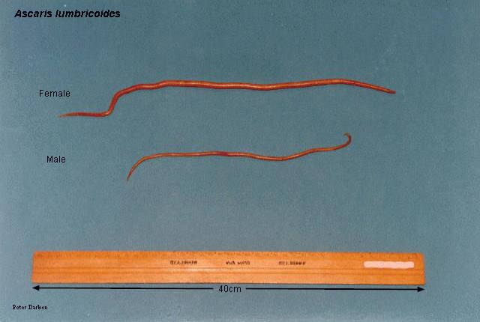
Adult worm

Slide 16
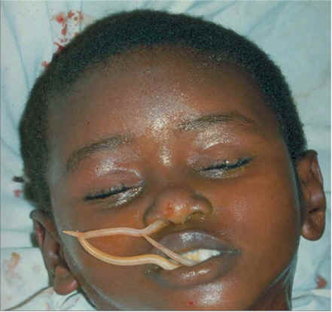

Slide 18
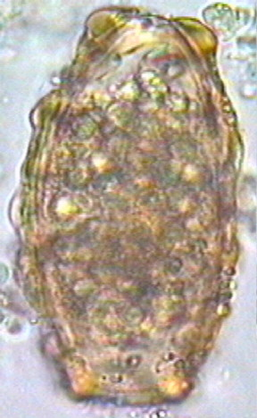
Types of egg
Unfertilized :
( with thick albuminous coat )

Slide 19
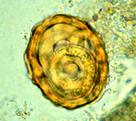
Fertilized egg :
(With thin albuminous
Coat)

Slide 20
Character | Fertilized | Unfertilized
Shape | Round | Elongate
Size | Smaller | Larger
Albuminous cover | Thin albuminous coat | Thick albuminous coat
Floatation technique | Float | Does not float
Ovum | Large unsegmented | Small , unsegmented with highly refracticle granules

Slide 21
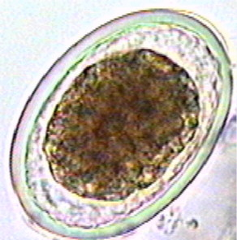
Decorticated egg ( without albuminous coat)

Slide 22
Prevention & control
Treatment of patients ( albendazole or mebendazole)
Health education
Using of untreated human feces as fertilizer should be forbidden
Improve the level of sanitation ( using latrines , washing hands before eating & after defecation )

Slide 23


