Slide 1
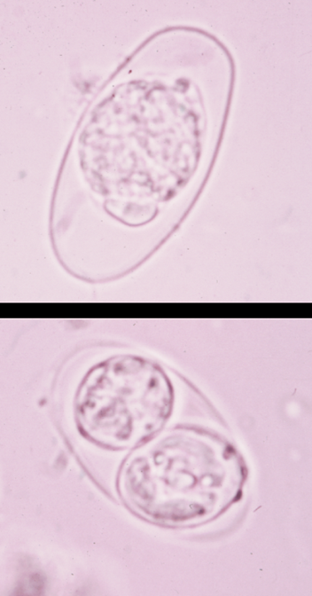
Isospora belli

Slide 2
Introduction
Isospora belli is an intestinal coccidian parasite .
Distribution : worldwide .
It infects only humans .
Habitat : small intestine

Slide 3
Transmission
Transmitted by ingestion of infective oocysts in water or food contaminated with faeces .

Slide 4
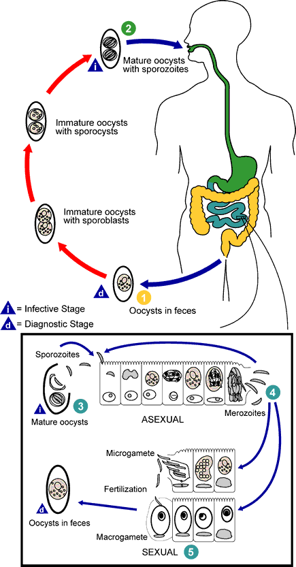
Life cycle

Slide 5
Clinical features
Mostly asymptomatic
But it can cause abdominal pain , diarrhea associated with malabsorption .
Infection of immunocompetent is self-limiting .

Slide 6
Lab diagnosis
Specimen : stool
Diagnostic stage : immature oocyst
Techniques :
direct wet mount
Formol ether centrifugation concentration technique.

Slide 7

Modified ZN staining technique ( oocyst is acid fast) .
Enterocapsule test ( String test) .

Slide 8
Diagnostic stage
Immature oocyst
Oval in shape
Contain central undivided mass of protoplasm
Occasionally more mature oocyst may be seen.

Slide 9
After being excreted in the faeces , the oocyst takes 4-5 days to develop to infective stage .

Slide 10
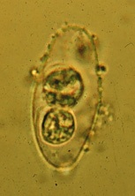
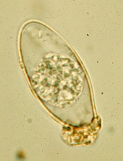
Oocyst (immature/mature)

Slide 11
Control
Health education
Improve sanitation
Personal hygiene .

