Slide 1
fleas

Slide 2
Classification
Order : siphonptera
Family: Pulicidae
It has many genera such as:
Genus :Xenopsylla
Species: X.cheopis
X.brasilliensis
X.astia
Genus : Tunga
Species :Tunga penetrans

Slide 3
Genus : pluxes
Species : Pluxes irritans

Slide 4
distribution
Fleas are found throughout most of the world , but many species have more restricted distribution , for example the genus Xenopsylla which contains important plague vectors is confined to the tropics and subtropics.

Slide 5
Adult morphology
Small (1-8.5mm)
More or less oval
Varying in colour from light to dark brown
Wingless
Have three pairs of powerful and well developed jointed legs
The hind pair of legs are specialized for jumping
The legs and much of the body is covered by small spines .

Slide 6
Head is triangular in shape
It has a pair of black eyes ( few species are eyeless).
Short ,three segmented antennae
Mouth part , pointed downward
Thorax is divided into prothorax, mesothorax and metathorax.
Abodemen is composed of eight segments.
Adult flea live for up to6-12 months.or up to 2 years or more.

Slide 7
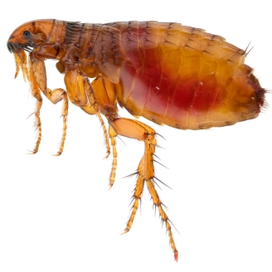

Slide 8
Egg
Very small in size
Oval or round in shape
White or yellowish
Usually coated with thinly and sticky substances.
The female may lay 300-1000 eggs during its entire life cycle.
Egg hatch within 2-14 days , depending on species , temperature and humidity.

Slide 9
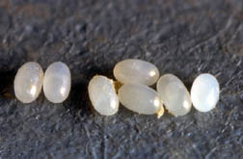

Slide 10
Larva
Minute in size
Legless
Has blackish head
Small pair of antennae
Has 13 pale brown segments
It’s a very active stage
They avoid light , seek shelter in cracks and dark places.
Larvae feed on almost organic debris, including the animal and human faeces.

Slide 11
They are usually 3 instar larva, but in some species only 2 instar larval stage.
Larval period 10-21 days , but may extended to 200 days in some species , due to limited food supply and low temperature.
Die at too low or too high humidity.

Slide 12
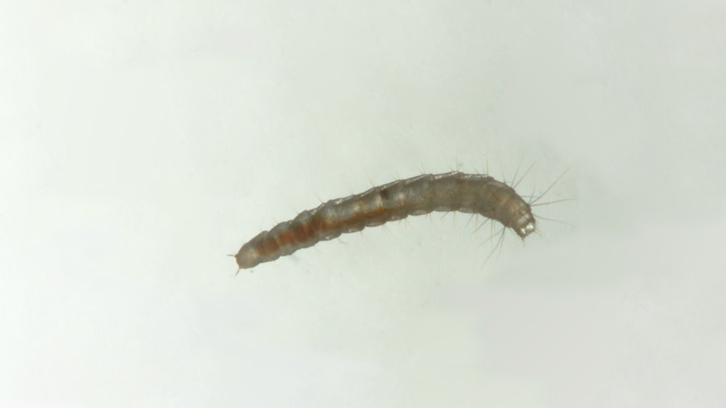

Slide 13
Pupa
pupa (cocoon) Spin from last larval stage with whitish colour
Develop into adult within 8-12 days in the optimal condition , but may take 6-12months under unfavorable conditions.

Slide 14
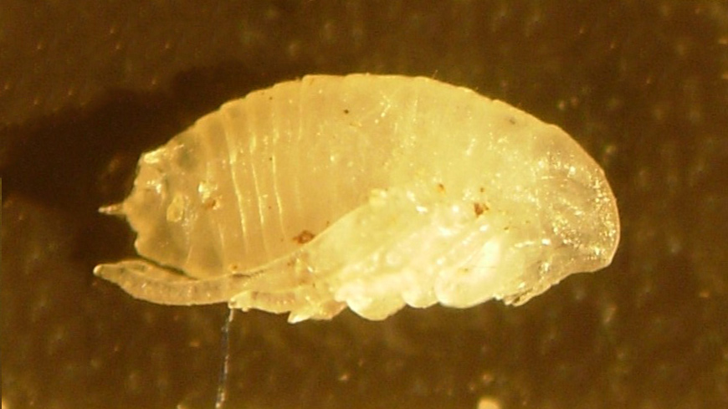

Slide 15
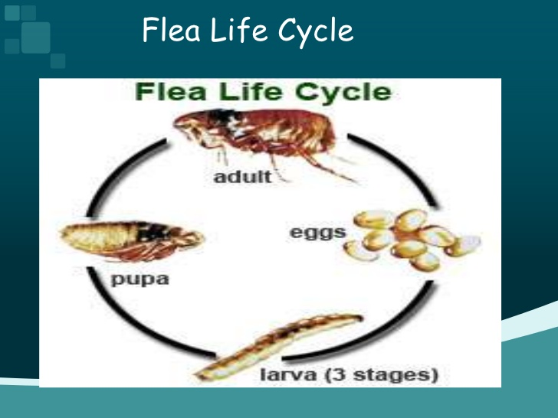

Slide 16
Feeding habits
Both sexes are hematophagus

Slide 17
Source of nutrients
The fleas have one or two favorite species of the host.
Human fleas (pulex iritans) feeds also on pigs
Rat fleas (xenopsylla) will attack man in the absence of rats.

Slide 18
Breeding areas
They deposit eggs near cracks, dirt and debris in the host dwelling place.

Slide 19
Adults resting areas
May remain live in cocoons for about a year.
Fleas avoid light, then they are usually found sheltering amongst the hair of animals or on man under his clothing or in his bed .
Fleas move rapidly , can jump 18cm vertically and 35 cm horizontally.

Slide 20
Medical importance
Nuisance
Vector for plague (Yersinia).
Fleas borne endemic typhus
Assist in the transmission of many parasites to human for example (Diphyllidium caninum, Hymenolepis diminuta and Hymenolepis nana)

Slide 21
