Slide 1
Hemoflagellate
MOSAB NOURALDEIN

Slide 2
Flagellates are divide into 3 class according to their habitat:
Intestinal flagellate (Giardia lamblia)
Urogenital flagellates (Trichomonas vaginalis)
Hemoflagellates (trypanosomes and leishmania species)

Slide 3
Trypanosoma species
Trypanosoma brucei rhodesiense
Trypanosoma brucei gambiense
Trypanosona brucei brucei
Trypanosoma cruzi.

Slide 4
Trypanosoma brucei rhodesiense and Trypanosoma brucei gambiense cause African trypanosomiasis.
Trypanosona brucei brucei cause nagana disease in animals .

Slide 5
Trypanosoma cruzi cause chagas disease ( American trypanosomiasis).

Slide 6
Trypanosomiasis is a vector born disease .
African trypanosomiasis is transmitted through Tse tse fly of the genus Glossina.
American trypanosomiasis is transmitted by Triatominae bug( kissing bug).

Slide 7
American trypanosomiasis also may be transmitted through transfusion of contaminated blood and transplacentally (congenital transmission).

Slide 8
Trypanosoma brucei complex

Slide 9
Trypanosoma brucei gambiense associate with chronic trypanosimasis.
Trypanosoma brucei rhodesiense associate with acute trypanosomiasis

Slide 10
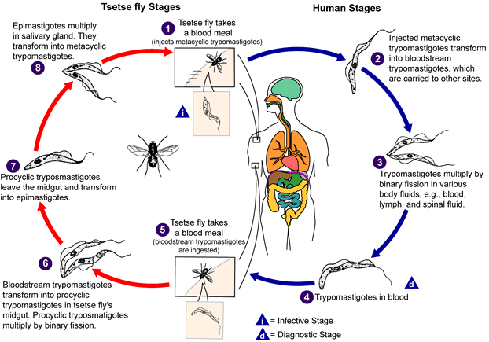
Life cycle of African trypanosomes

Slide 11
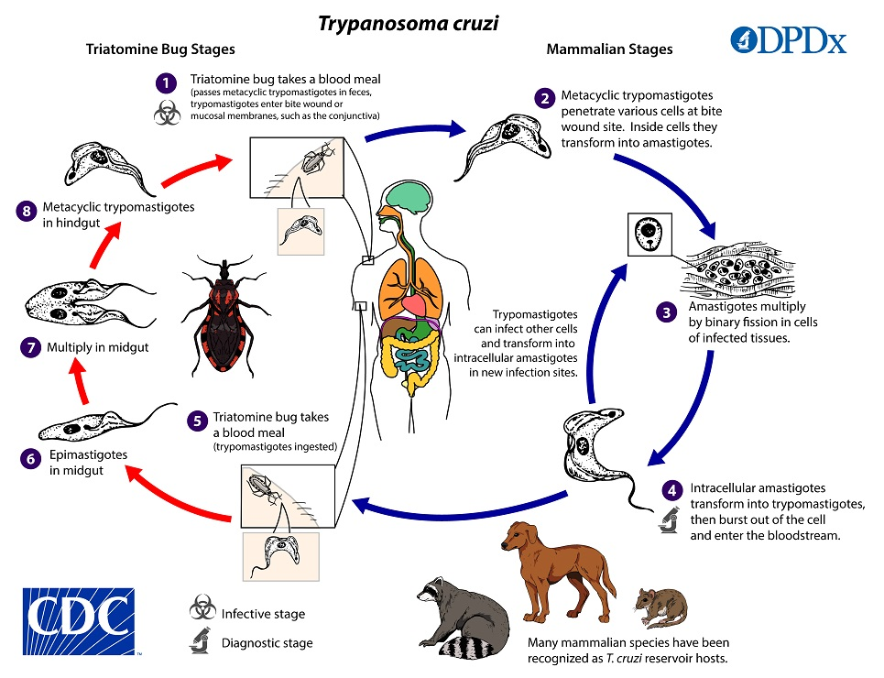
Life cycle of American trypanosomes

Slide 12
Clinical features
(African trypanosomiasis)
First stage:
Red sore named chancre .
Fever
Headache
Lymphadenopathy (enlargement of lymph glands).

Slide 13
Joints pain
Muscle ache.

Slide 14
Winterbottom’s sign

Slide 15
Last stage:
Involvements of CNS:
Changes in personality.
Alteration of circadian rhythm( biological clock).
Confusion

Slide 16
Difficulties in walking and speaking
Seizures .

Slide 17
Clinical features of American trypanosomiasis(chagas disease)
First stage:
asymptomatic in very early stage.
Fever
headache
Lymphadenopathy (enlargement of lymph nodes).

Slide 18
Chronic (second) stage:
Enlargement of the ventricles of the heart and that may lead to heart failure.
Mega esophagus (enlargement of esophagus).
Mega colon.

Slide 19
Romans sign of chagas disease
Its an swollen around the eye of the patient with American trypanosomiasis

Slide 20
Laboratory diagnosis
Specimen : blood
Methods:
Blood smears:
Wet blood film: to see the motile trypanosome
. Stained dry film to see the fixed trypanosome

Slide 21
Blood concentration techniques (e.g. buffy coat).

Slide 22
Diagnostic stages:
Trypomastigotes ( african trypanosomiasis)
Trypomastigotes and amastigotes in chagas disease.

Slide 23
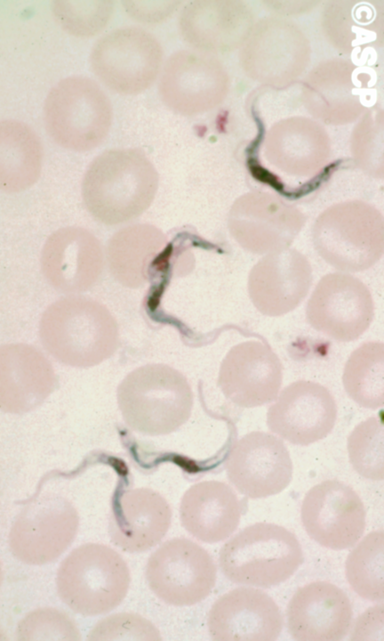
Trypomastigote of African trypanosomiasis

Slide 24
Control
Vector control
Heath education
Safe blood transfusion

Slide 25
Leishmania
Leishmania spices cause leishmaniasis which is a vector borne parasitic disease with different clinical appearances ( visceral, cutaneous , mucocutaneous).

Slide 26
Sand fly is a vector of this parasitic infection.
Leishmaniasis occur in all of the globe expect Australia ( due to absence of the vector).

Slide 27
Old world vector: Phlebotomine sand fly
New world vector: sand fly of the genus Lutzomyia.

Slide 28
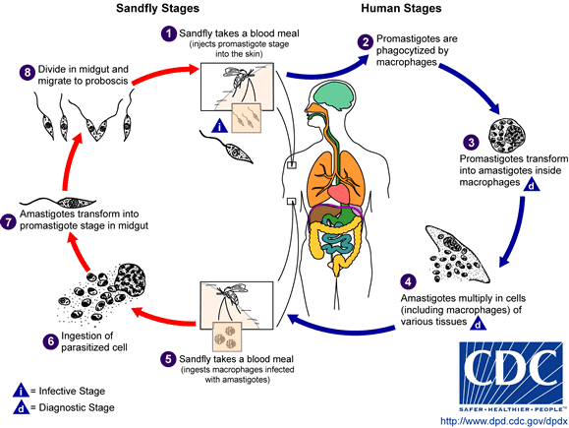
Life cycle of Leishmania parasite

Slide 29
Cutaneous leishmaniasis
(oriental sore, tropical sore)
Caused by:
L. tropical
L. major
L. aethiopica

Slide 30
It’s the most spread form of leishmaniasis.
Usually self healing .

Slide 31
Mucocutaneous leishmaniasis
Usually affect the mucocutaneous parts of the body.
Caused by L. aethiopica and L. braziliensis.

Slide 32
Visceral leishmaniasis
(kala azar)
The most severe form of leishmaniasis.
Affect the visceral organs , mainly RES,( spleen, lymph node and bone marrow).

Slide 33
Caused by :
L.donovani complex
L. Infantum
L.chagasi (new world: Americas )

Slide 34
most common Clinical features
Fever
Splenomegally
Hepatomegally
Anemia
Leucopenia
Thrombocytopenia .

Slide 35
Post kala azar dermal leishmaniasis(PKDL)
Its a complication of visceral leishmaniasis , characterized by nodular rash in patient who has recovered from VL.
Mostly occur in India and Sudan.

Slide 36
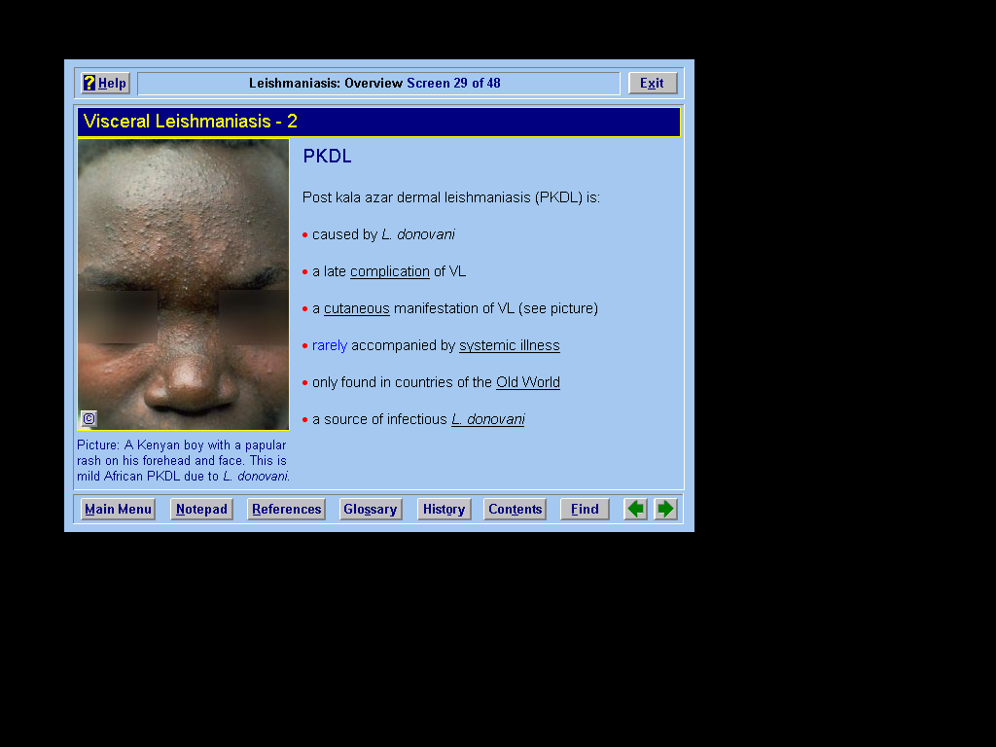

Slide 37
Diagnosis :
Microscopy :
Examination of Giemsa stained aspirate obtained from:
Lymph node, bone marrow or spleen.
Diagnostic stage: Amastigote

Slide 38
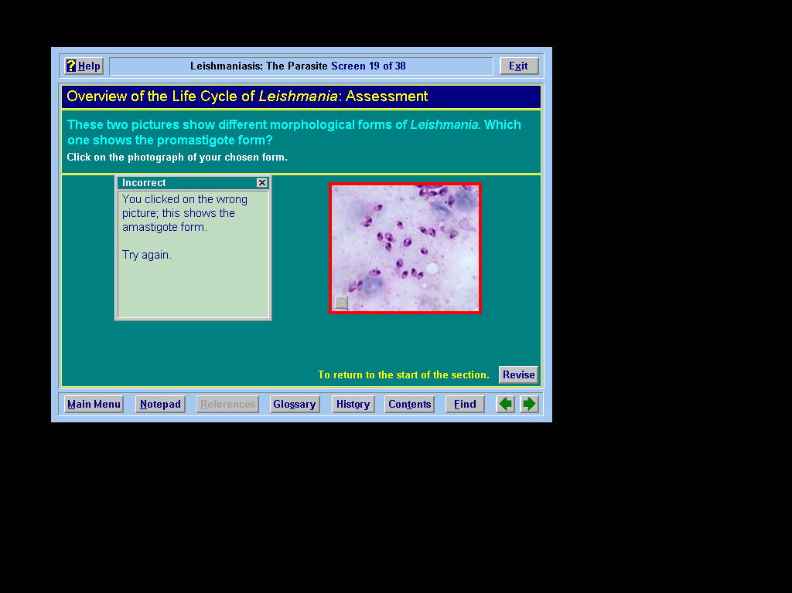
Amastigotes

Slide 39
We avoid splenic aspirate due to the presence of thrombocytopenia.
Blood concentration techniques : e.g. ( buffy coat method).

Slide 40
Serological tests:
Formal gel test
DAT
KATEX

Slide 41
Skin test : Leishmanin skin test
Cultivation:
Invivo cultivation( animal inoculation).
Invitro cultivation: e.g. NNN medium

Slide 42
Control
Vector control
Health education
Early diagnosis and early treatment.

