Slide 1
Diagnostic tests
Mosab Nouraldein

Slide 2
Circumoval precipitin test
Antigen preparation:
- Fresh urine sample was collected from positive urinary schistosomiasis patient.
- Red blood cells around S. haematobium eggs were removed by added saponin reagent.
- Urine was centrifuged the sediment was washed three time by normal saline to remove saponin reagent.
- Normal saline was added to the sediment and incubated over night to remove excess saponin.
- After the incubation urine was centrifuged and the sediment was used as antigen for circumoval precipitin test.

Slide 3
Processing:
2 ml from the veinous blood was collected and serum was separated from the red blood cells. Patient's serum was incubated with viable Schistosoma haematobium eggs at 37 c for 48 hours. The result was read under the light microscope, positive reaction was shown by an oval precipitate around the viable eggs.

Slide 4
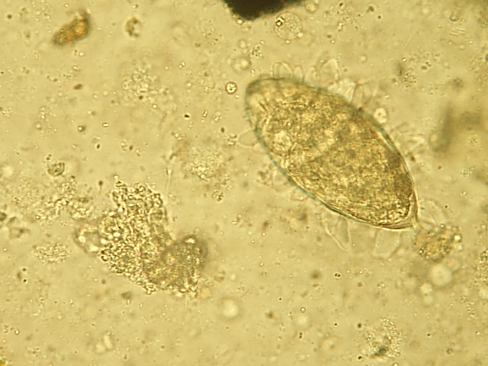

Slide 5
Sabin-Feldman dye test
Definitions:
1. a method for the detection of antitoxoplasma antibody in serum, based on the finding that Toxoplasma gondii cells (from peritoneal exudate in mice) are fairly well stained with alkaline methylene blue, whereas organisms in a serum that contains specific antibody have no affinity for the dye; furthermore, normal toxoplasma cells become rounded, and the nucleus and cytoplasm deeply stained, when treated with methylene blue; conversely, when dye is mixed with organisms and antibody, the cells retain their crescent shape and only the shrunken nuclear endosome is stained.

Slide 6
Examination of a rectal biopsy for schistosome eggs
When schistosome eggs cannot be found in faeces they can sometimes be found in a rectal biopsy.
The eggs are often non-viable and calciﬁed. A biopsy is examined as follows:
1 Immediately after removal, place the tissue in physiological saline and soak it for 30–60 min.
2 Transfer the tissue to a slide and cover with a cover glass. With care, press on the cover glass to spread out the tissue and make a sufﬁciently thin preparation.

Slide 7
3 Examine the entire preparation microscopically for eggs .
Note: if the preparation is too thick to examine, add a drop of lactophenol solution and wait a few minutes for the tissue to clear sufﬁciently.
4 Identify the eggs and estimate the number of uncalciﬁed eggs in the biopsy and the proportion that are calciﬁed (black).

Slide 8
Detection and counting of S. haematobium eggs in urine
The excretion of S. haematobium eggs in urine is highest between 10.00h and 14.00h, with a peak around midday. Even when persons are heavily infected, eggs may not be present in the urine all the time. It may be necessary to examine several specimens collected on different days due to the irregular pattern of egg excretion.

Slide 9
1 Collect 10–15ml of urine (between 10.00h and 14.00h) in a clean dry container.
Note: either exercising before passing urine or collecting terminal urine (last few drops),
2 Report the appearance of the urine. In moderate to heavy infections, the urine will usually contain blood and appear red or red-brown and cloudy. When visible blood is present, add 2 drops of saponin solution to lyze the red cells.

Slide 10
3 Transfer 10ml of well mixed urine to a conical tube and centrifuge to sediment the schistotome eggs
. 4 Discard the supernatant ﬂuid. Transfer all the sediment to a slide, cover with a cover glass, and examine the entire sediment microscopically
5 Count the number of eggs in the preparation and report the number/10ml of urine.

Slide 11
Casoni skin test
A test for hydatid disease in which hydatid fluid is injected intradermally; immediate or delayed wheal and flare reaction is positive.

Slide 12
Mazzotti test
A test for onchocerciasis using an oral test dose of diethylcarbamazine (50 or 100 mg), resulting in the appearance of an acute rash in 2 to 24 hours from death of microfilariae in the skin.

Slide 13
DEC Patch Test
A local application of 10% DEC anhydrous lanolin is applied to the skin and covered with a dressing. The patch is then checked for local dermatitis caused by the dying microfilariae. This is safer than the Mazzotti test because there is no risk of provoking a systemic reaction, but is not as sensitive as a skin snip.

Slide 14
Filtration technique for detecting and quantifying S. haematobium eggs in urine
Method 1 Using bluntended (untoothed) forceps, carefully place a polycarbonate ﬁlter on the ﬁlter support of the ﬁlter holder. Re-assemble the ﬁlter holder and attach it to the end of a 10ml Luer syringe .

Slide 15
2-Remove the plunger from the syringe. Fill the syringe to the 10ml mark with well-mixed urine, and replace the plunger. Holding the syringe over a beaker or other suitable container, slowly pass the urine through the ﬁlter.
Clogging of ﬁlters If a membrane ﬁlter clogs, remove the ﬁlter holder and attach it to another syringe containing 3% v/v acetic acid. Pass the acid through the ﬁlter. This may help to clear it. If, however, the blockage does not clear, use another membrane to ﬁlter the remaining sample of urine. Both ﬁlters must be examined to give the number of eggs in the 10ml urine sample.

Slide 16
3 Remove the ﬁlter holder and unscrew it. Using blunt-ended forceps, carefully remove the ﬁlter and transfer it face upwards to a slide. Add a drop of physiological saline, and cover with a cover glass.
4 - Count the number of eggs and report the number per 10ml of urine.
Note: If more than 50 eggs are present there is no need to continue counting (50 eggs or more/10ml of urine is considered a heavy infection). Report the count as ‘More than 50 eggs/ 10ml

