Slide 1
Plasmodium ovale
Mosab Nouraldein

Slide 2
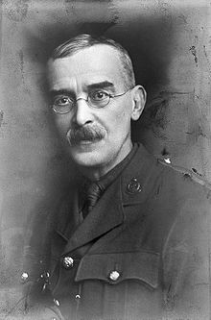
History
described in 1914 by Stephens

Slide 3
Geographical distribution
sub-Saharan Africa and islands in the western Pacific
P. ovale is able to infect individuals who are negative for the Duffy blood group, which is the case for many residents of sub Saharan Africa. This explains the greater prevalence of P. ovale (rather than P. vivax) in most of Africa.

Slide 4
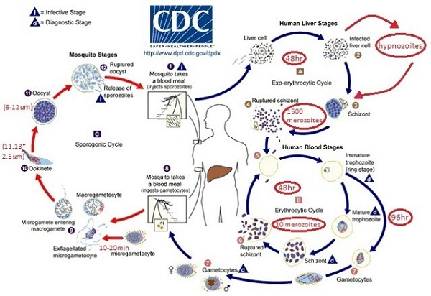
Life cycle

Slide 5
Clinical features
symptoms generally appear 12 to 20 days after the parasite has entered the blood.
Malaria attack (cardinal signs) /tertian every48hours:
Fever stage
Sweat stage
Cold stage

Slide 6
Cause relapse such as P.vivax

Slide 7
Lab diagnosis
Examination of thick and thin blood fims
Trophozoites, schizont and gametocyte are present in peripheral blood
Infected RBCs are enlarged , mostly with oval shape.
PCR

Slide 8
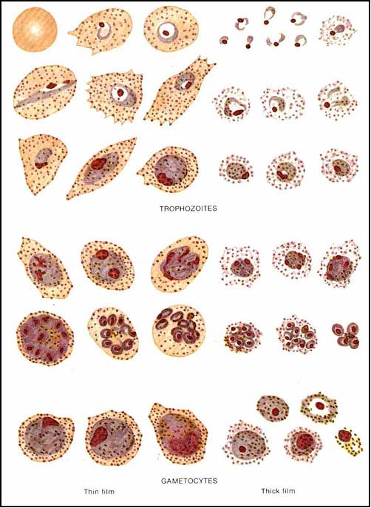

Slide 9
CONTROL
Early diagnosis
Early treatment
Vector control
Health education

