Slide 1
Sample 1
GENDER : FEMALE
AGE : ADULT

Slide 2
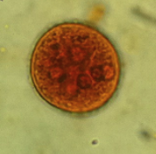
ENT.COLI ( P0SITIVE )

Slide 3
Parameters
Phosphorus : 2.2 mg/dl ( low )
Magnesium : 1.9mg/dl
Calcium :9.4 mg/dl
Glucose : 102 mg/dl
Cholesterol :205 mg/dl ( high)
LDL : 137 mg/dl ( high)
Triglycerides : 132 mg/dl
HDL : 37 mg/dl

Slide 4
CONTIUED
K : 3.3 mg/dl ( low)
Na : 138 mg/dl

