Slide 1
Trypanosoma brucei

Slide 2
Epidemiology
Trypanosoma brucei is a causative agent of African trypanosomiasis ( Sleeping sickness).
Distrubted in both east and west Africa.
T. Brucei gambianese : west Africa
T.burcei rhodesiense: East Africa

Slide 3
Sleeping sickness is a vector borne disease.
Transmitted mainly by the bite of infected Tse tse fly.

Slide 4
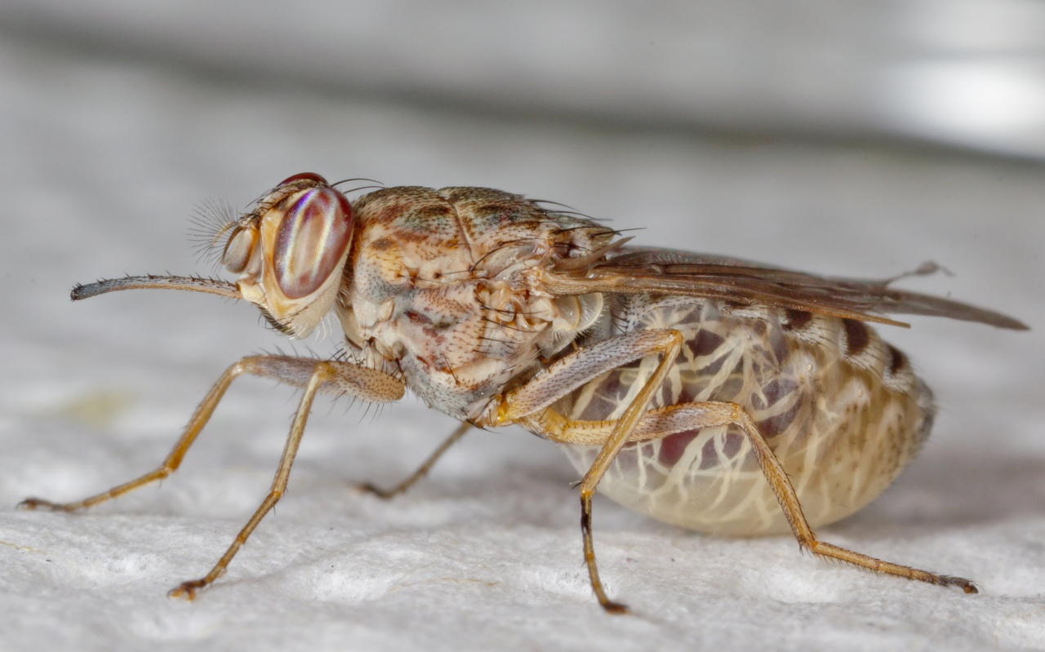
Vector: Tse tse fly

Slide 5
Life cycle: indirect life cycle.
Tse tse fly : intermediate host
Mammalian host( human or animal) : definitive host.

Slide 6
Modes of transmission:
Vector borne: through the bite of infected Tse tse fly.
Blood transfusion
Transplacental.

Slide 7
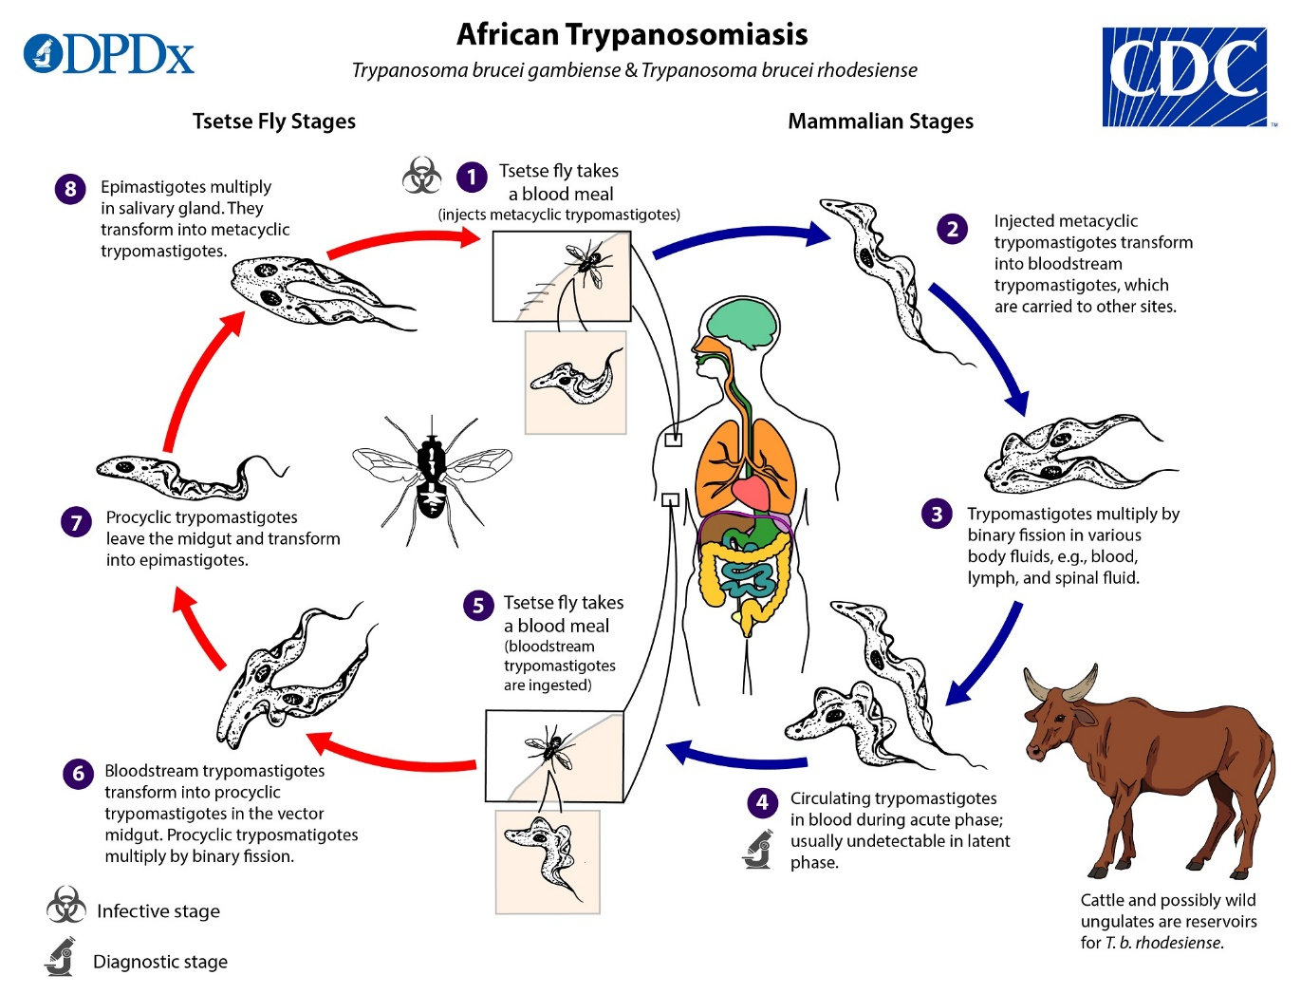
Life cycle:

Slide 8
Clinical features:
Anxiety
Mood changes
Fever
Headache
Weakness

Slide 9
Insomnia( inability to sleep) at night
Sleepiness during the day (may be uncontrollable)
Sweating
Swollen lymph nodes all over the body
Swollen, red, painful nodule at site of the fly bite

Slide 10
Complications
Injury related to falling asleep while driving or during other activities
Gradual damage to the nervous system
Uncontrollable sleep as the diseasegets worse
Coma

Slide 11
Lab diagnosis:
Specimens:
Blood
Cerebrospinal fluid
Lymph node aspirate.
Diagnostic stage:
Trypomastigote.

Slide 12
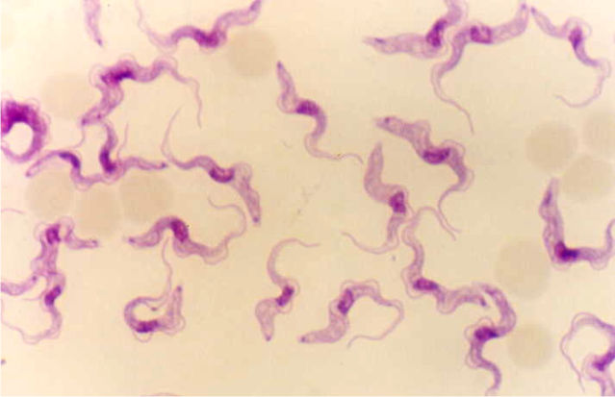
Trypomastigote of T. brucei

Slide 13
CONTROL
Vector control.
Early diagnosis and early treatment of the patients.
Health education.

