Slide 1
Mosquitoes
Mosab Nouraldein

Slide 2
Mosquitoes are insects that are distributed world wide .
There are over 3000 species of mosquitoes belonging to 34 genera.
All species of mosquitoes have aquatic larval and pupal stage.

Slide 3
Mosquitoes are the most important group of insects that transmit diseases to human.
The most important man-biting mosquitoes belong to the genera:
Culex , Aedes and Anopheles.

Slide 4
Classification of mosquitoes
Class: insecta (Hexapoda)
Order: Diptera
Suborder: Nematocera
Family: Culicidae
Subfamily: Anopheline
Subfamily: Culicinae
Genus: Culex
Genus : Aedes
Genus: Anopheles

Slide 5
Morphology
Body is divided into 3 segments: head, thorax and abdomen.
The head contain:
Compound eyes
Pair of antennae (each has 12 segments).
One pair of palp
Sucking mouth

Slide 6
Mouth part and salivary gland
The mouth part are known as proboscis.
The proboscis of female composed from: labium, labrum, hypopharynx, toothed mandible and maxillae.
Maxillae penetrate the skin of the animal and man .
The male of mosquitoes do not bite because the mandible and maxillae are reduced in size or absent.

Slide 7
Salivary gland:
A pair of trilobed salivary glands found in both sexes , situated in the anterior part of the thorax.
Each salivary gland composed of three lobes (=acini) :
Median acinus and 2 lateral acini , each one containing a central canal known as neck.
These 3 lobes(acini) unite to form a single salivary duct which pass through the entire length of hypopharynx.

Slide 8
Saliva contains anticoagulants which prevent the blood from clotting and obstructing the mouth part as it is sucked into the stomach.
Digestive enzymes are not present in the saliva.

Slide 9
Thorax
Divided into 3 parts (prothorax, mesothorax and metathorax).
Containing 3 pairs of jointed legs , one pair of wings and one halter(=balance regulator).
It is the center of movement.

Slide 10
Abdomen
Compose of 8 segments
One pair of cerci (sensory organs).
Male containing one pair of claspers.

Slide 11
Subfamily: culicinae
Containing Aedes and Culex mosquitoes.

Slide 12
The head of female culicinae
Short palp with 5 segments
Antennae composed of 12 segments
Short hair between segments.

Slide 13
The head of male culicinae
Long palps and bend to outside.
Antennae are composed of 12 segments that contain long hair.

Slide 14
egg
Culex | Aedes
Brown .long and cylindrical | Black ,ovoid
Excreted in mass (about 200eggs) –raft | Laid singly
 | Has distinctive mosaic pattern

Slide 15
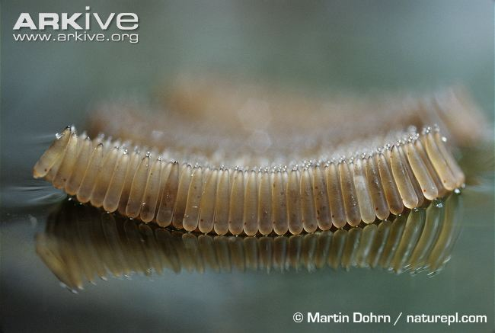
Eggs : raft of Culex

Slide 16
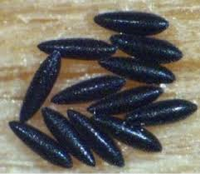
EGGS OF AEDES

Slide 17
Larva
Culex | Aedes
Head: contain larval eyes and chewing mouth | Head: contain larval eyes and chewing mouth
Thorax: containing swimming hair ,positioned into 3pairs | Thorax: containing swimming hair ,positioned into 3pairs
Abdomen: containing 9 segments ,each contains two pair of swimming hair and segment number 8 contain siphon, segment number 9 for balance containing anal gills | Abdomen: containing 9 segments ,each contains two pair of swimming hair and segment number 8 contain siphon ,segment number 9 for balance containing anal gills
Resting at angel to the surface | Resting at angel to the surface

Slide 18
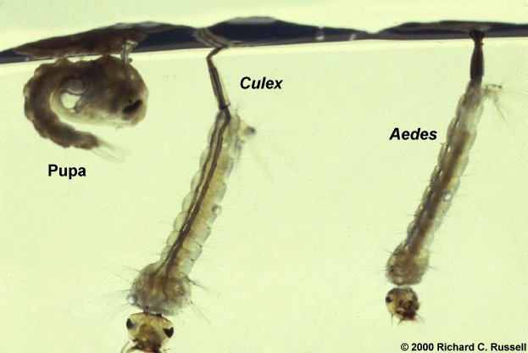
larvae and pupa

Slide 19
Pupa
Culex | Aedes
Comma shape | Comma shape
Cephalothorax : head is fused with thorax | Cephalothorax : head is fused with thorax
8 abdominal segments | 8 abdominal segments
Breath through pair of small trumpet like structure on thorax | Breath through pair of small trumpet like structure on thorax
The swimming paddles positioned at abdominal segment number 8 | The swimming paddles positioned at abdominal segment number 8

Slide 20
Adult
Culex | Aedes
Resting position: more or less parallel to the surface | Resting position: horizontal to the surface
Have no black, white or silver scales pattern on thorax | Have black, white or silver scales pattern on thorax
Legs have no black and white rings | Legs often have black and white ring
Breeding site: with great variety of aquatic habitat | Breeding site: natural or man made containers
Medical importance: lymphatic filariasis, viral encephalitis(Arbovirus) | Medical importance: lymphatic filariasis, yellow fever, dengue

Slide 21
Subfamily : Anopheline
Includes Anopheles mosquitoes , world wide distribution.

Slide 22
Anopheles egg
Blackish ,boat shaped
Eggs can not withstand dessiccation
Eggs are laid singly.

Slide 23
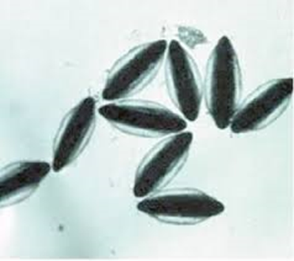
Egg of anopheles

Slide 24
Anopheles larva
Resting position horizontally under water surface.
Larvae does not contain siphon, just one pair of spiracles positioned at segment number 8
Abdominal segments:
Each segments has a single or one pair of palmate hairs that called float hair.
As in all mosquitoes there are four larval instar.

Slide 25
Anopheles pupa
Comma shaped
Head and thorax are combined to form cephalothorax
Dorsally has a pair of short trumpet –shaped breathing tubes which have broad opening( funnel shaped).
Have 8 abdominal segments

Slide 26
Anopheles adult
Adult Anopheles rest with the body at an angel to the surface.
Have dark and pale scales on the wings

Slide 27
Female anopheles mosquitoes
Palp are about long as proboscis
Pilose antennae

Slide 28
male anopheles mosquitoes
Palps are as long as proboscis but are distinctly swollen at ends.
Have plumose antennae

Slide 29
Thorax of anopheles
Smooth and shinning
Have no hair

Slide 30
Breeding sites
Wide ranging from fresh and salt water marshes , swamps and rice fields.

Slide 31
Medical importance
Biting nuisance
Malaria
Lymphatic filariasis
Transmit the Arboviruses

Slide 32
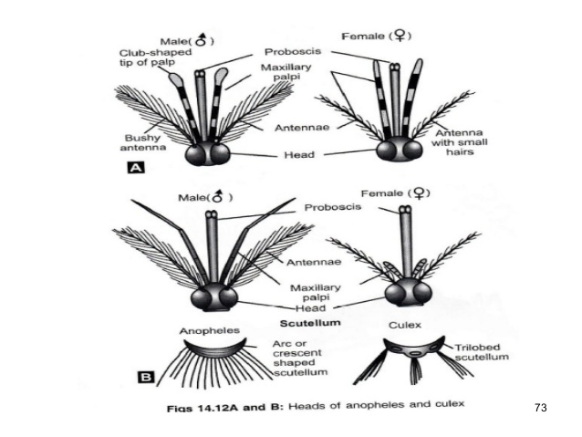

Male & female of Culex and anopheles

Slide 33
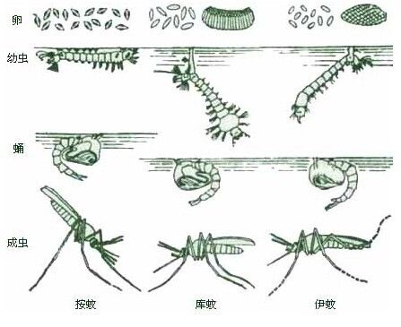
ANOPHELES, CULEX,AEDES

Slide 34
Sand fly
Widely distributed in tropics and subtropics.
Have 3 genera: Sergentomyia, lutzomyia and phlebotomus ( all are hematophagus)
Species from the two genera lutzomyia and phlebotomus have medical importance ( vectors for leishmaniasis)

Slide 35
Adult -morphology
Minute size ( 2-5 mm) in length
Have hairy appearance
Large black eyes
Have Long legs
Abdomen is densely covered with hair

Slide 36
Antennae are long ,(12 segments) ,short hair and are similar in both sexes.
Mouth part are short but adapted for blood sucking

Slide 37
egg
Very small(0.3-0.4mm) in length
Brown or black
Have mosaic pattern on the egg shell
Female lays 15-100 eggs at each oviposition

Slide 38
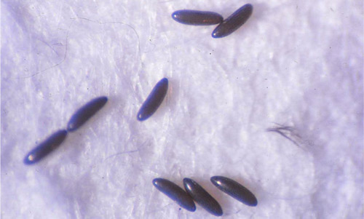
EGG OF SAND FLY

Slide 39
larva
There are four instar larva
mature larvae have black head
Have pair of small mandibles
Body is greyish or yellowish and segmented
Larvae are usually scavenger feed on organic matter , fungi, decaying leaves,..etc.

Slide 40
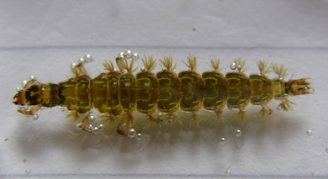
LARVA OF SAND FLY

Slide 41
Pupa
Has large pupal eye
Cephalothorax , 9 abdominal segments

Slide 42
The life cycle from oviposition to adult emergence range from 30-100days.

Slide 43
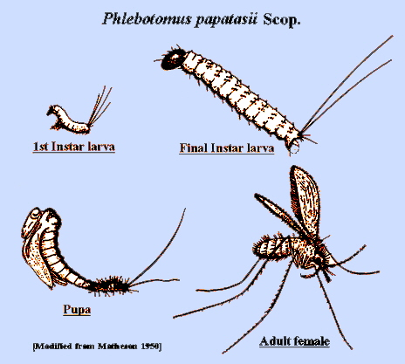

Slide 44
Feeding habits
Nocturnal activity
Most species feed out door (exophagic) , few are endophagic (feed indoor)
Adults are week fliers (hopping type of flight)
Because of their short mouth part they are unable to bite through clothing.

Slide 45
Species that rest in house before and after blood meal is known as endophilic such as Phlebotomus papataci and Lutzomyia longipalpis .

Slide 46
Feeding habits
Males feed on nectar and plant juices .
Females feed on nectar and plant juices and suck blood from man and animal.
Sand flies breed in cracks and holes in the ground.

Slide 47
Medical importance
Annoyance
Leishmaniasis
Sand fly fever ( papataci fever, 3 days fever): fever of viral origin caused by phlebovirus

Slide 48
Both mosquitoes and sand fly have complete metamorphosis. (egg-larva-pupa-adult).

