Slide 1
Filariasis
Lymphatic filariasis

Slide 2
Lymphatic filariasis
It caused by :
Wuchereriabancrofti
Brugia malayi
Brugia timori

Slide 3
Wuchereria bancrofti
Wuchereria bancrofti cause bancroftian filariasis which is lymphatic filariasis.
Wuchereria bancrofti was named after physician Otto wucherer and parasitologist Joseph Bancroft , both of whom extensively studied filarial infections .

Slide 4
Epidemiology
W. bancrofti is responsible for 90% of lymphatic filariasis .
The most infections occur in Africa , Turkey , India , Southeast Asia and parts of South America .

Slide 5
The mosquito vectors of W.bancrofti have a preference for human blood , humans are apparently the only animals naturally infected with W.bancrofti , there is no reservoir host .

Slide 6
Transmission
Vector borne disease , transmitted by mosquitoes belonging to the genera Culex , Anopheles and Aedes .

Slide 7
Periodicity
The circadian rhythm observed in the appearance of filarial microfilariae in the peripheral blood .

Slide 8
Diurnal periodicity
A circadian rhythm with primary expression of the periodicity during daylight hours .
Nocturnal periodicity
A circadian rhythm with primary expression of the periodicity during nighttime hours .

Slide 9
Periodic nocturnal W.bancrofti ( this is the most wide spread) .
Some sub-species of W.bancrofti are subperiodic ( nocturnal and diurnal) .

Slide 10
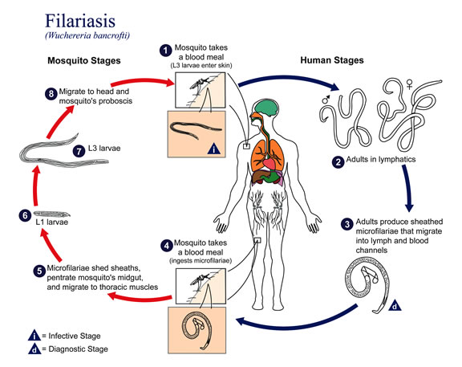
Life cycle

Slide 11
The worm will mature within 6-8 months , male and female worms will mate and then release microfilariae .These microfilariae can be released for up to ten years .

Slide 12
Pathology
Asymptomatic phase
Inflammatory (acute) phase:
The antigens from the female adult worms elicit inflammatory responses .

Slide 13
-The worm in the lymph channels disrupt the flow of the lymph causing lymphedema .patient will exhibit fever, chills and tender skin of the lymphedematous extremity .
Orchitis : inflammation of the testes .
Epididymitis : inflammation of the spermatic cord.

Slide 14
Obstructive ( chronic ) phase :
Is marked by lymph varices , lymph scrotum , hydrocele, chyluria (lymph in urine) and elephantiasis .
Microfilariae are not normally present in this phase .

Slide 15
It associated with scar formed at the affected tissue sites , other features include thickening of the skin and elephantiasis .

Slide 16
Elephantiasis affects males mainly in the legs , arms and scrotum . In females the legs , arms and breasts are affected .

Slide 17
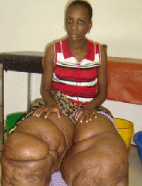

Slide 18
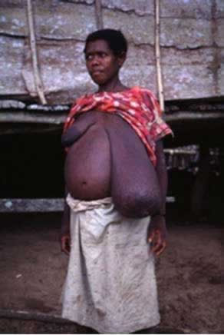

Slide 19
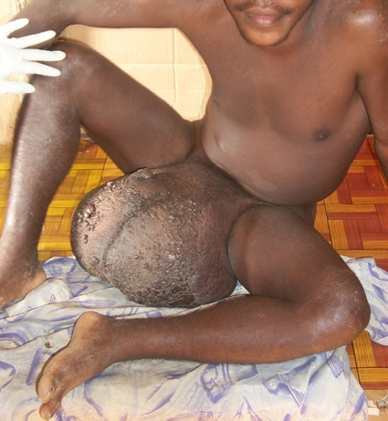

Slide 20
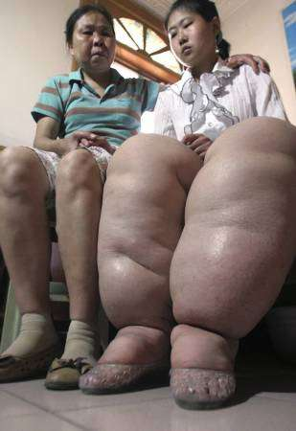

Slide 21
Non –filarial elephantiasis
It occurs in patients with tuberculosis and siliceous deposits.
It causes damage to local lymphatic with obstruction occurs when the deposits are absorbed from the soil through bare feet .

Slide 22
Occult filariasis
Rare condition caused by a hypersensitivity which is caused by to hypersensitivity reaction to microfilarial antigen
The features of lymphatic filariasis are not present and microfilariae are not detected in the blood .
.

Slide 23
Tropical pulmonary eosinophilia
It is a hypersensitivity reaction to filarial infection . The syndrome includes high eosinophil count , pulmonary symptoms , fever ,dyspnea and loss of weight .
It affects both children and adults with males being more commonly affected than females .

Slide 24
It interfere with breathing and can lead to chronic pulmonary fibrosis .Symptoms are worse at night .
Usually TPE associate with , eosinophilia , raised ESR, high titer of IgE .
Eosinophils often appear vacuolated .

Slide 25
Lab diagnosis
Specimens :
Blood ( mostly)
Urine ( in case of chyluria )
Blood should be collected in Trisodium citrate .

Slide 27
Techniques :
Giemsa stained thick blood film.
Lyzed capillary blood technique
Venous blood filtration concentration technique
Venous blood tube concentration technique .
Examination of urine deposit ( chyluria) .

Slide 28
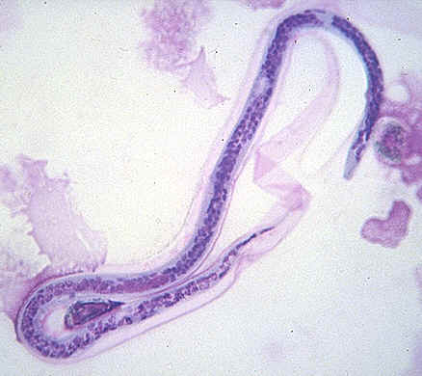
W.bancrofti ,microfilariae

Slide 29
Periodic nocturnal : 22:00-04:00
Sub-periodic nocturnal : 20:00-22:00

Slide 30
Microfilariae
Large in size
Sheathed
Body nuclei are fewer and more distinct.
There are no nuclei in the end of the tail ,which is pointed .

Slide 31
Control
Vector control ( using insecticides , using bed nets) .
Treating infected persons (using DEC) .
Health education

Slide 32
Brugia species
Brugia malayi and Brugia timori cause lymphatic filariasis
Two variants of B.malayi are recognized :
Periodic nocturnal B.malayi this is the most wide spread
Sub-periodic nocturnal B.malayi .

Slide 33
B.timori shows a nocturnal periodicity .

Slide 34
Distribution
B.malayi is endemic in parts of south-East Asia .B.timori is endemic Indonesia ( timor island) .

Slide 35
Transmission
They are transmitted by mosquitoes of the genera Anopheles ,Aedes and Mansonia .

Slide 36
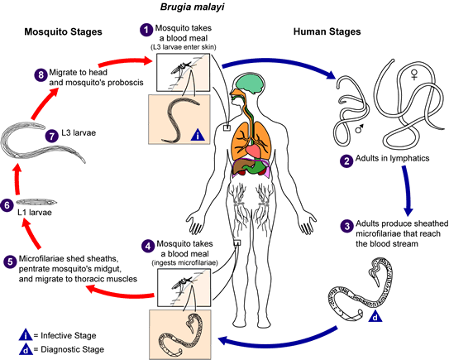
Life cycle

Slide 37
Clinical features
Symptomless carrier are common among Brugia infected persons .
Compared with Bancroftian filariasis , Malaysian filariasis symptoms are developed rapidly with children more affected than adults .

Slide 38
Elephantiasis occurs less frequently and tends to involve only the lower limbs .Filarial abscesses are common with B.timori infections .

Slide 39
Lab diagnosis
Specimen : blood
Urine ( chyluria: rarely occur)

Slide 40
B.malayi microfilariae
Large
Sheathed ( stained darkly)
2 nuclei in the end of the tail

Slide 41
B.timori microfilariae
Longer than B.malayi
Sheathed ( stained pale with Giemsa stain)
2 nuclei at the end of the tail .

Slide 42
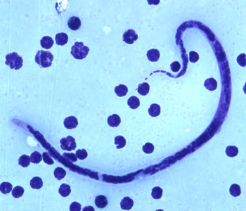
B.timori microfilariae

Slide 43
Control
Vector control ( using insecticides , using bed nets) .
Treating infected persons (using DEC) .
Health education

