Slide 1
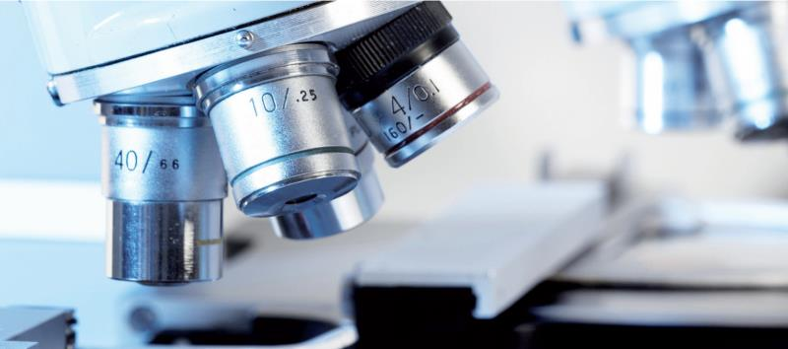
The history of Medial laboratory in Sudan

Slide 2
Early history of research
This presentation is about some of the heights of early research in Sudan and the more recent research activities in the country

Slide 3
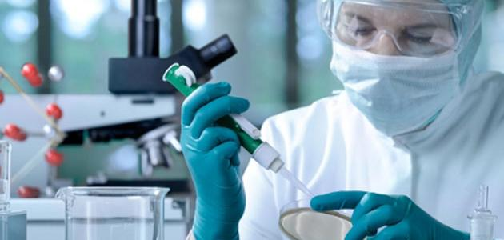

Slide 4
Early history
The beginning of medical research was mainly due to Sir Henry Wellcome in 1902 when he donated lab equipment, a library and a museum to Sudan
In 1903 Sir Andrew Belfour assumed the responsibility of Director of research (Wellcome Research lab). He was also Medical Officer of Health in Khartoum province and sanitary advisor to the Sudan Medical Department. This was the early link between medical laboratory and services in Sudan

Slide 5
Early history
The objectives of the Wellcome Research Lab was to study health problems of importance in humans and animals in Sudan, particularly infectious tropical disease and to promote technical education in these areas

Slide 6
Early history
Andrew Balfour succeeded in eliminating mosquitoes and malaria in Khartoum as a result of his applied field research
Another important disease that was addressed was Visceral leishmaniasis which was diagnosed in Sudan in 1904 but there was no known treatment for it and it was invariably fatal
JB Christopherson, working in the Khartoum succeeded in treating some VL patients with Sodium Antimony Tartrate but the drug was toxic

Slide 7
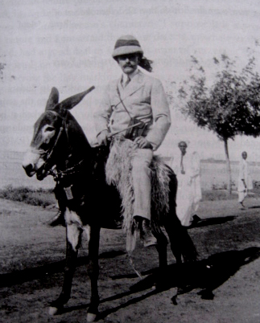
A tribute to J B Christopherson
This is how JBC moved around Khartoum and Omdurman: the milkman’s way!

Slide 8
Earl research in mycetoma
Dr. Albert Chalmers, Director of the Wellcome Tropical Research laboratories (1913-1920), together with Captain R.G. Archibald, pathologist, and Dr. J.B. Christopherson, carried out valuable systemic mycological and pathological studies of the causal organisms of mycetoma.

Slide 9
Stack labs
In 1925 the Wellcome Labs were taken over by Sudan under the Department of Education and were moved to the Stack Labs near the Khartoum Civil Hospital and the Kitchener School of Medicine. The lab was named after Sir lee Stack Governor General of Sudan who was assassinated in Egypt in 1924
Malaria entomological surveys were carried out in the Gezira by Louis
Yellow fever was discovered by Kirk and Louis in Western Sudan in 1934

Slide 10
Mohamed Hamad Sati
In the years that followed, the Stack Labs undertook epidemiological, operational and basic research in many diseases such as leishmaniasis, Onchocerciasis, meningitis, relapsing fever, Rabies, enteric fever and others

Slide 11
Sudanese Ministry of Health
The Ministry was established in 1949
Mansour Ali Haseeb was appointed Assistant Director of Research in 1952 and he was also the Director of Stack
One of his main achievements is in establishing training center of lab assistants at the Stack labs. He sent some of them for further training in Lebanon. Among them was Mohamed Salih EL Faki who establish a tissue culture lab in the mid 1960s. I used this lab for the study of interaction between lymphocytes and infected macrophages
This shows the standard to which technicians were trained

Slide 12
The Institute of Tropical Diseases included a Tropical Diseases Hospital in Omdurman. The first Director was Dr Abdel Ghaffar Abdel Raheem
Five researchers were trained in Britain. Following the retirement of Dr Abdel Ghaffar Dr Elkadaro became the Director.
He and his staff in collaboration with Institute of Endemic Diseases started working on leishmaniasis and other diseases. This collaboration is still going on

Slide 13
Collaborations between Sudan and Britain
Collaboration between Sudan and the United States in health research:

Slide 14
Onchocerciasis in Abu Hamad
Onchocerciasis in Abu Hamad was first described by the ate Prof Morgan in the 1950s.

Slide 15
Introduction of genetics and molecular biology in Sudan: a great highlight
Recent years have witnessed a very important development. Sate of the art methodologies were introduced in Sudan in the area of genetics and molecular biology by Prof Imad Fadl EL Mula at Alneelain University and Prof Muntaser EL Tayeb at the . These lead to a better understanding of important diseases in Sudan at the cellular and subcellular levels. Many publications attest to this

Slide 16
Introduction of genetics and molecular biology in Sudan: a great highlight
Prof Imad Fadl EL Mula of Al Neelain was the first Clinical Geneticist in Sudan. He founded the department of clinical genetics at the Radiation and Isotope Center

Slide 17
Introduction of genetics and molecular biology in Sudan: a great highlight
Prof Muntaser introduced Molecular biology at first in the National Public health lab and later at the IEND
He worked on the genetics of endemic diseases and cancer
He established the first MSc degree in molecular biology. Many scientists and health professionals have been trained and are now active in their own research

Slide 18


