Slide 1

باسمك اللهم ابدأ

Slide 2

College Of Medical Lab. Science
Parasitology Practical sem (1) exam

Slide 3
1:14 Answer the provided questions
①- what is the possible parasitic cause of such condition
②- What is the infective stage
③- What is the intermediate host
④- name other clinical conditions associated with this infection
⑤- How can you diagnose such case

Slide 4
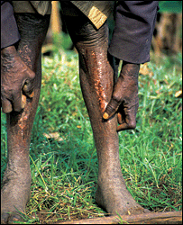
①- what is the possible parasitic cause of such condition
②- What is the infective stage
③- What is the intermediate host
④- Name other clinical conditions associated with this infection
⑤- How can you diagnose such case

Slide 5
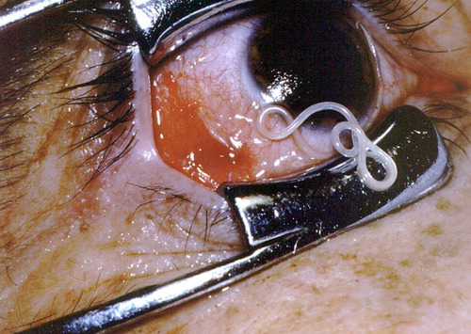
①-Identify this worm
②-What is the intermediate host
③Name other clinical condition associated with the infection by this worm

Slide 6
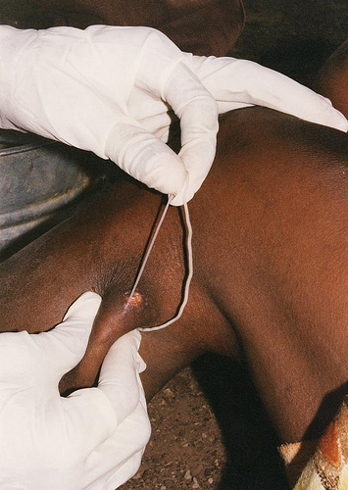
Q(4)
①-Identify this object
②-What is the clinical presentation of this infection
③-What is the route of transmission

Slide 7
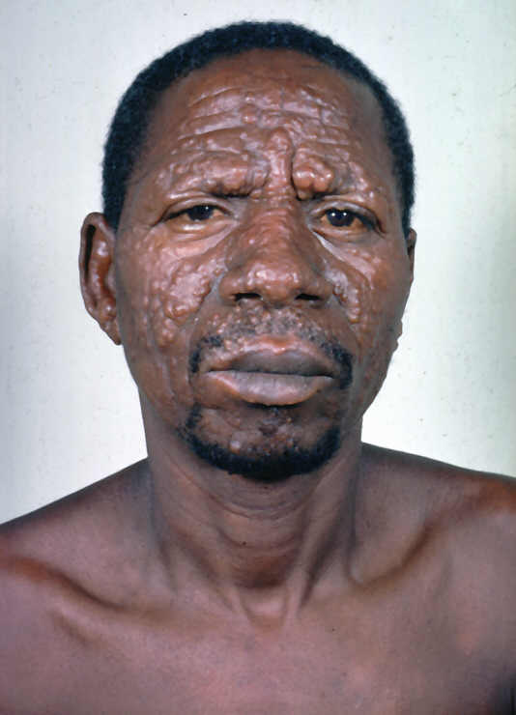
①- What is the possible parasitic cause of such condition
②- What is the infective stage
③- What is the diagnostic stage

Slide 8
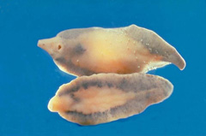
①-Identify this worm
②-What is the intermediate host
③Name clinical condition associated with the infection by this worm

Slide 9
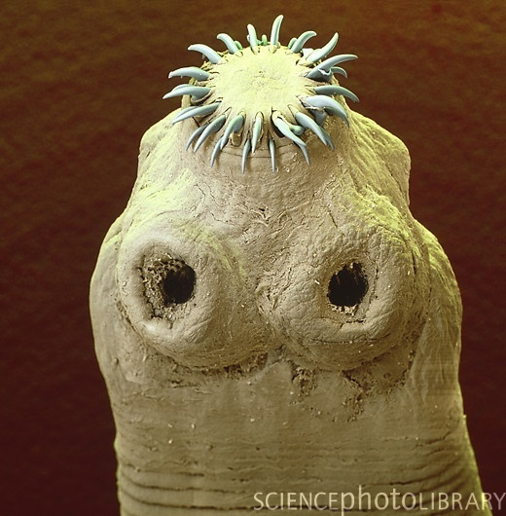
Q(7)
①Identify?
②Name the disease cased by this parasite?
③Name the intermediate host and infective stage?

Slide 10
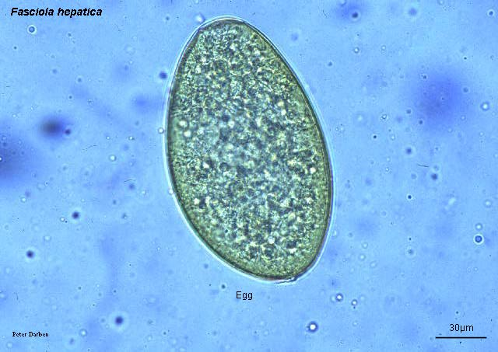
Q(8)
①How would you confirm the False positive faecal smears for this parasite?

Slide 11
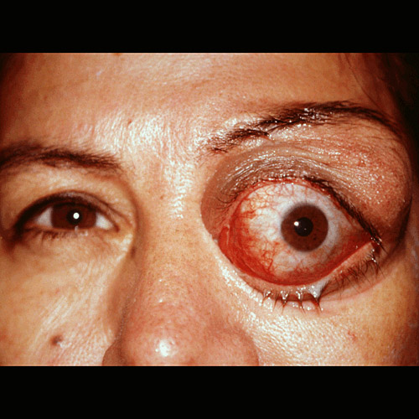
A Case Study:-
53-year-old female, Presented to the hospital with a enlargement of her eye and bleeding
Surgeon hospital had removed a cyst from her eye.
(1)What caused the cyst that were removed?
(2)How is this parasite transmitted to humans?
(3)How does the lab help in the diagnosis of this parasite?

Slide 12
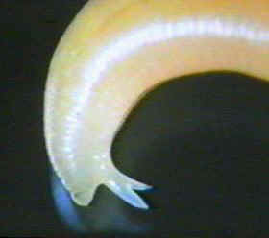

Identify this structure?
Please suggest this worm?
-(1 minutes and 1\2)

Slide 13
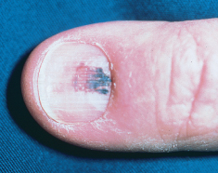
Mention the parasite cause this condition?
Mention the sample that used to diagnose this parasite?
- (1 minutes & 1\2)
Q(11)

Slide 14
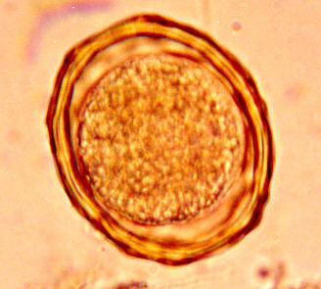
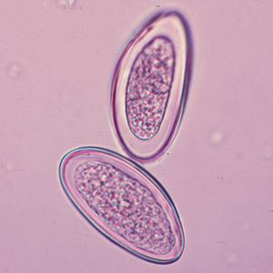
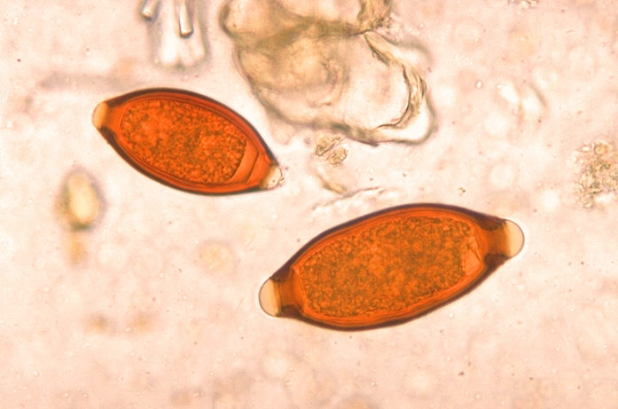
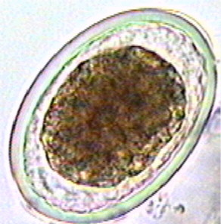
1
2
3
4
Identify?
1\...........2\...................3\................4\.................
Q(12)

Slide 15
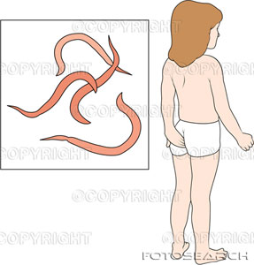
Q(13)
suggest and describe this parasite

Slide 16
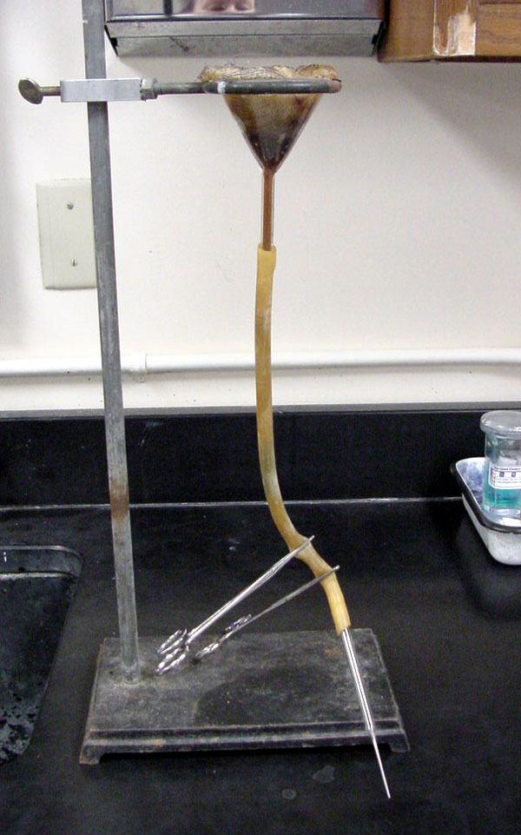
Q(14)
1- Identify
2- Name the parasite that diagnose by this by this technique?
3- Determine the amount of the stool that used in this technique?

Slide 17
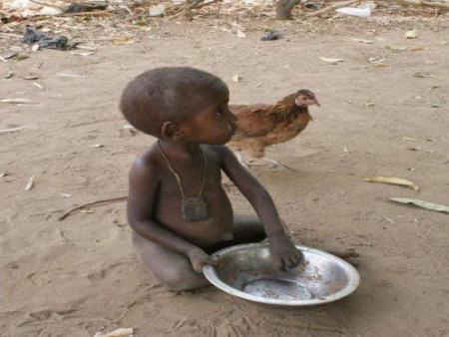
15-16:
Mention the parasite and its stage (one in time) that can be transmitted in these environment and behaviour,
(1 minute)

Slide 18


Slide 19
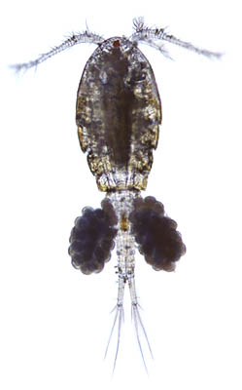
17-20: these subjects serve as biological intermediate hosts for many parasites.
① Identify
② Name the parasite
③ Name the stage inside the intermediate host
(2 minutes each)

Slide 20
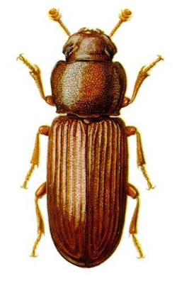

Slide 21
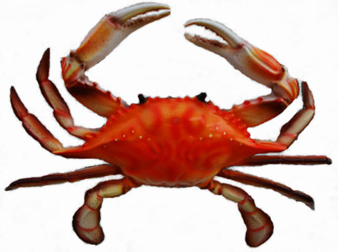

Slide 22


Slide 23

imad
Good Luck

Slide 24
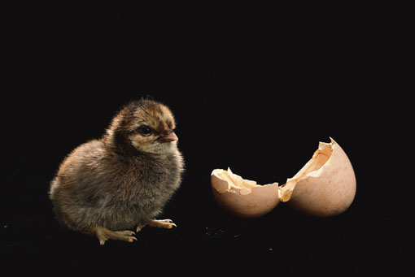
imad
Good Luck

