Slide 1
Medical parasitology
Supplementary semester 5

Slide 2
Answer each question within 2 minutes

Slide 3
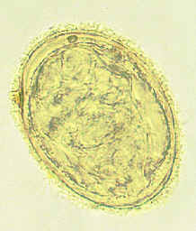
QI) IDENTIFY

Slide 4
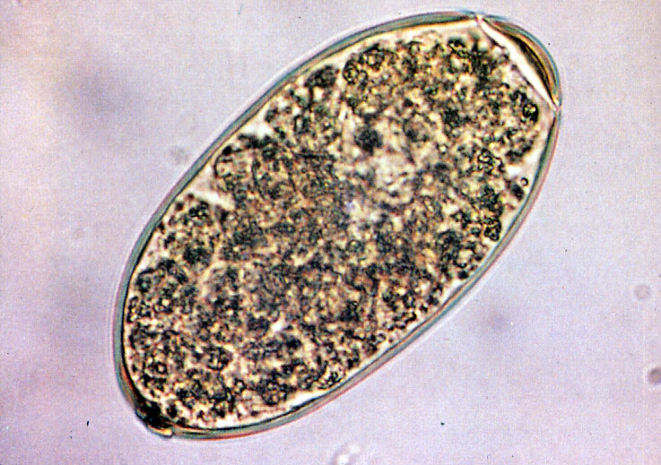
Q2 ) Identify

Slide 5
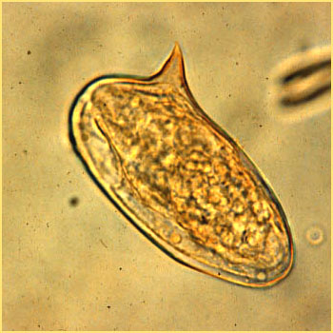
Q3) IDENTIFY

Slide 6
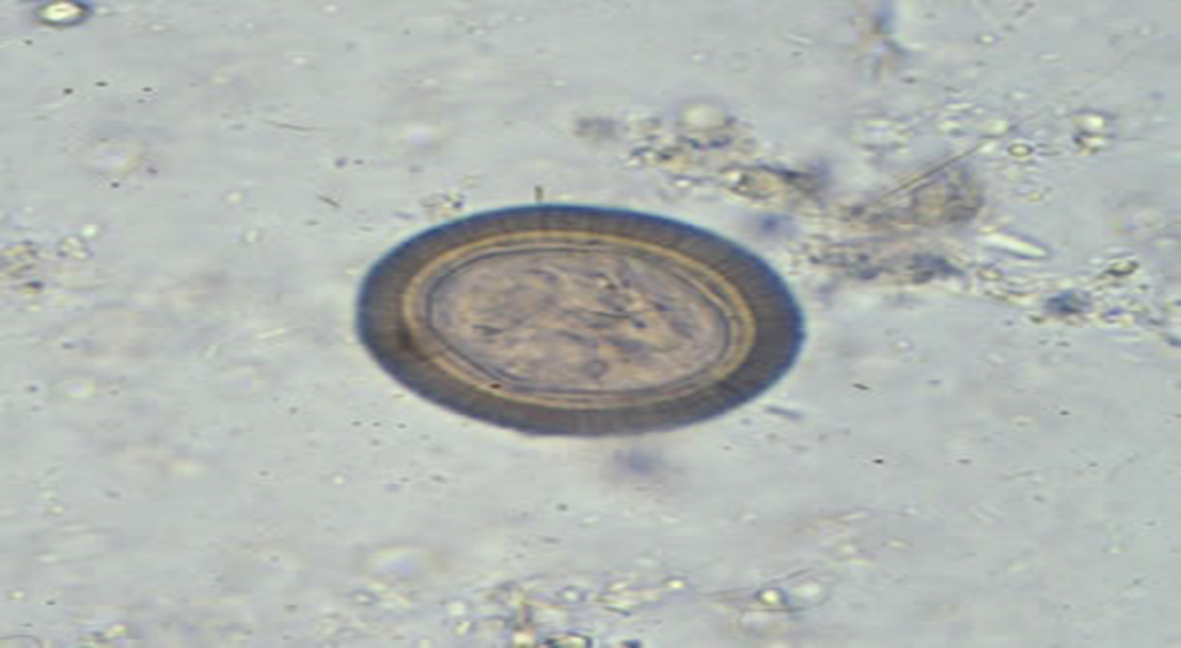
Q4) IDENTIFY
?

Slide 7
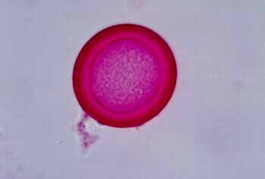
Q5) IDENTIFY

Slide 8

Q6) IDENTIFY

Slide 9
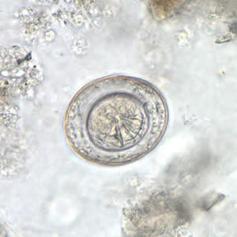
Q7)IDENTIFY

Slide 10
Q8) How to differentiate between egg of Taenia species?

Slide 11
Q9) How to differentiate between H.nan and H.diminuta ?

Slide 12
QI0) mention the name of basic stain in modified ZN stain

