Slide 1
Non pathogenic-(commensal)- amoeba
Mosab nouraldein

Slide 2
Intestinal commensal amoeba
It includes the following species:
Entamoeba dispar
Entamoeba coli
Entamoeba hartmanni

Slide 3
Entamoeba polecki
Endolimax nana
Iodamoeba buetschlli

Slide 4


Slide 5
Transmission
Faecal oral route: ingestion of mature cyst

Slide 6
Habitat
Large intestine

Slide 7
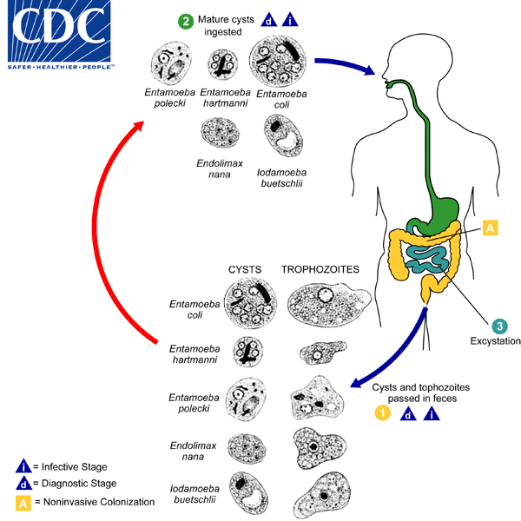
Life cycle

Slide 8
Pathology
Non pathogenic and mostly asymptomatic (COMMENSALS).

Slide 9
Lab diagnosis
Specimen: stool
Diarrhea : contain trophozoite
Formed : contain cyst .

Slide 10
Diagnostic stage:
Cyst and /or trophozoite

Slide 11
Why we study non pathogenic amoeba
To differentiate between commensal and pathogenic amoeba.

Slide 12
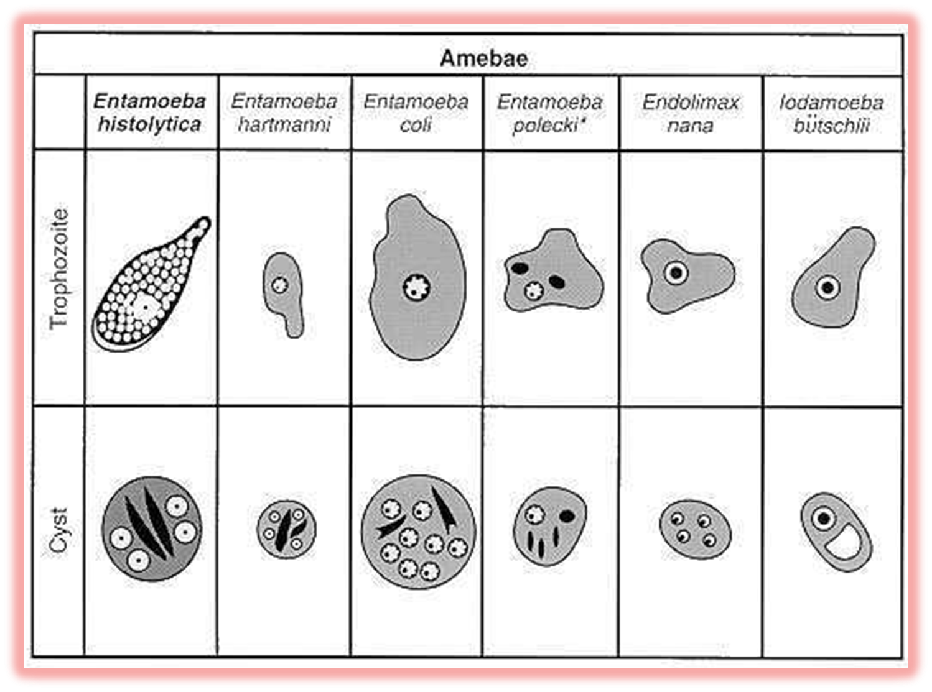

Slide 13
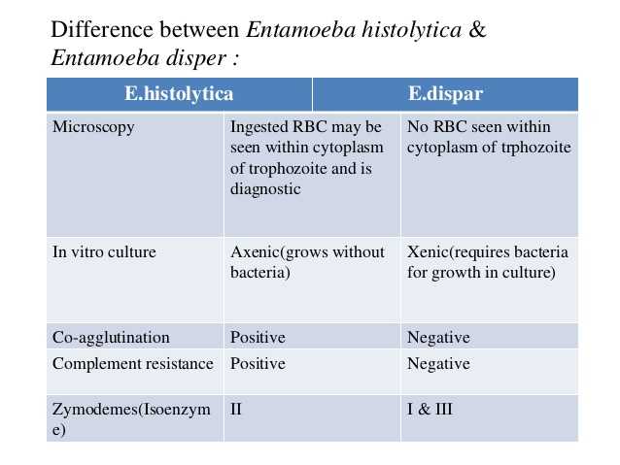

Slide 14
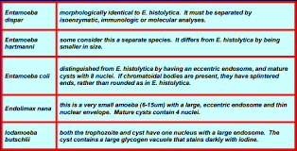

Slide 15
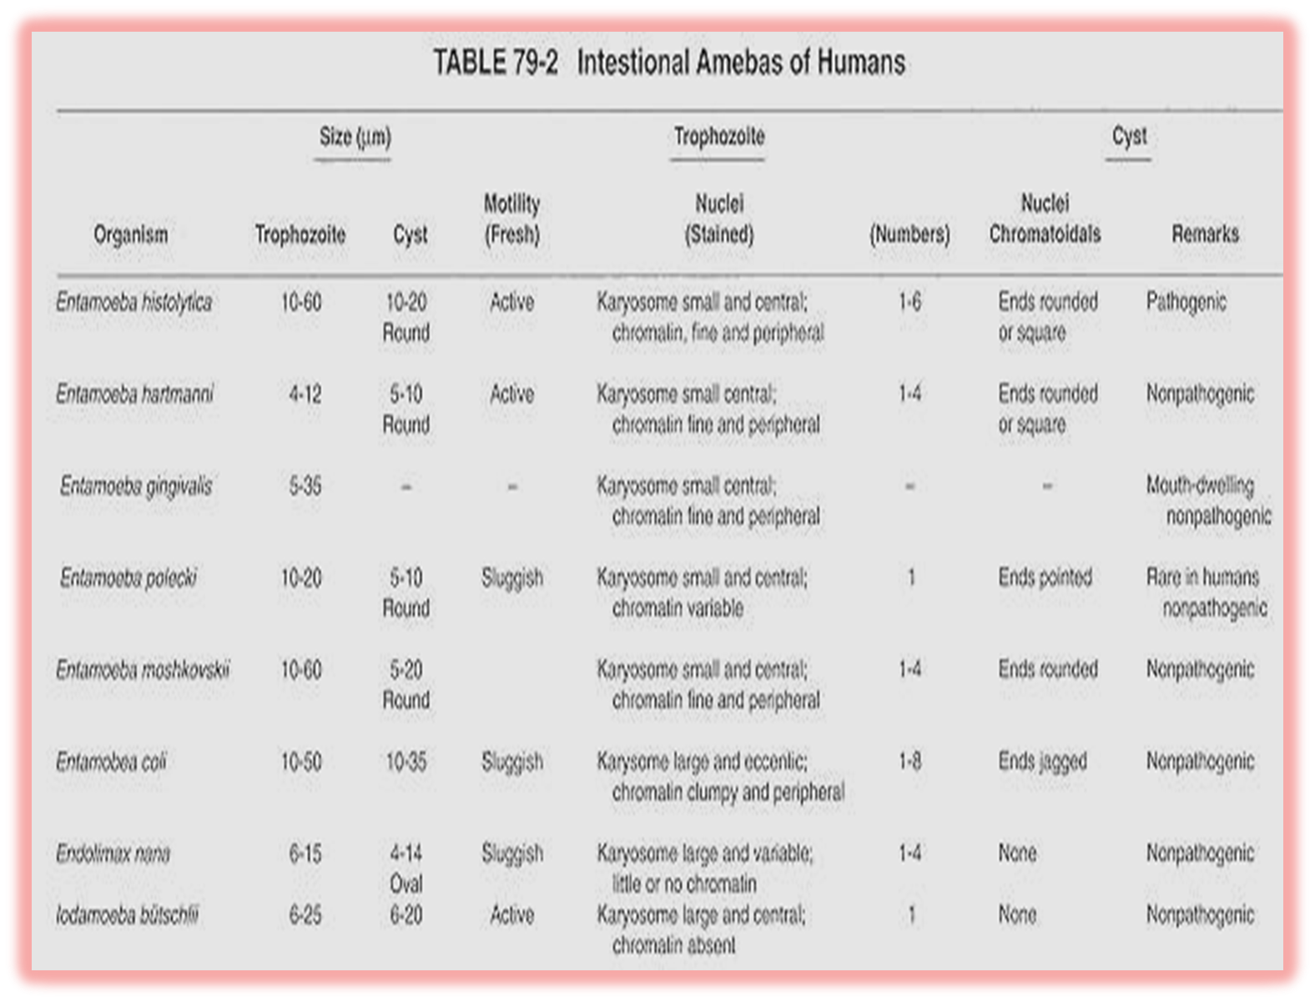

Slide 16
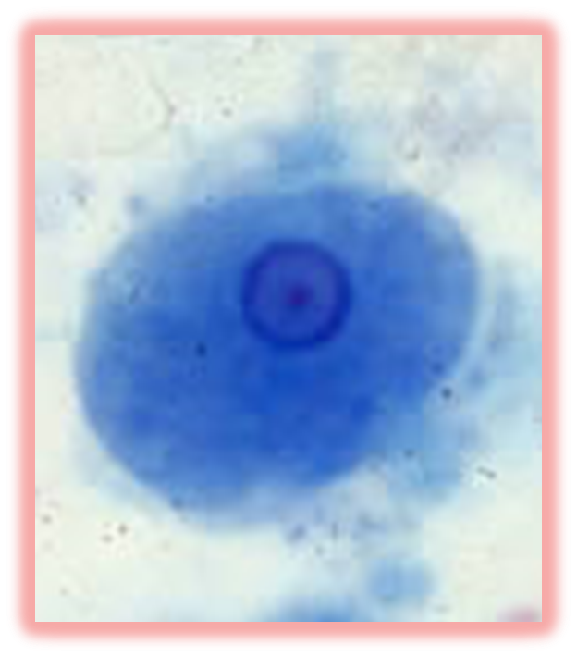
Entamoeba hartmanni –trophozoite

Slide 17
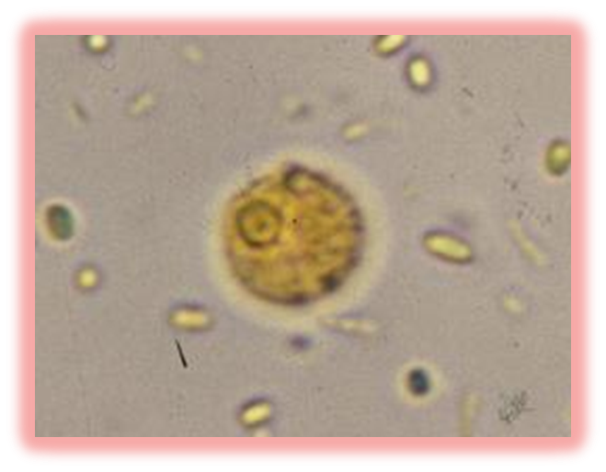
Entamoeba hartmanni –cyst

Slide 18
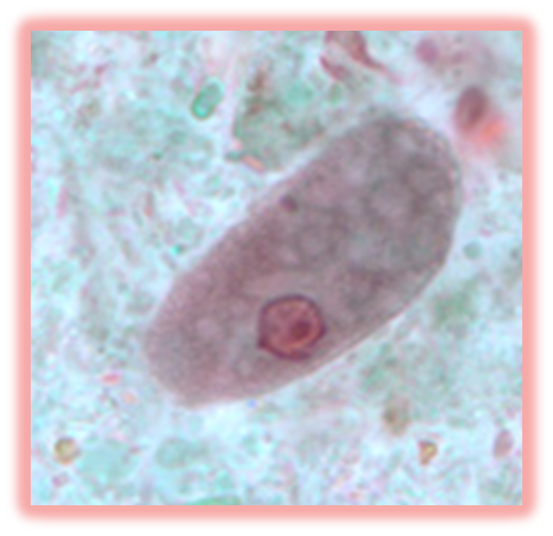
Entamoeba coli-trophozoite

Slide 19
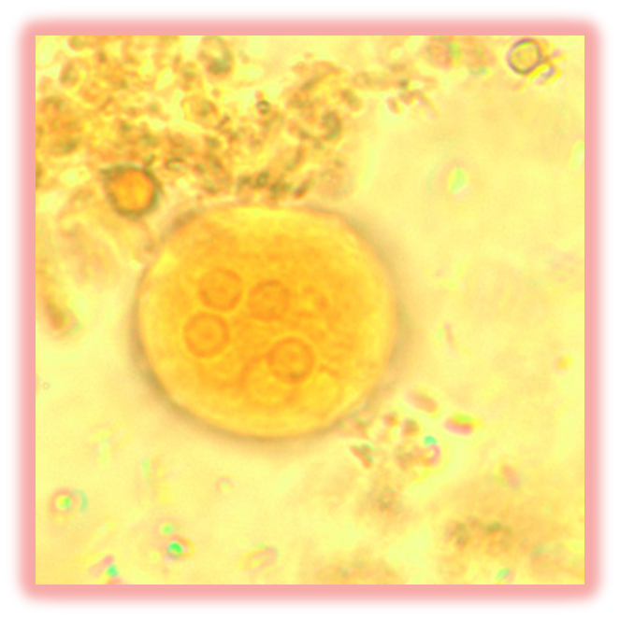
Entamoeba coli –cyst

Slide 20
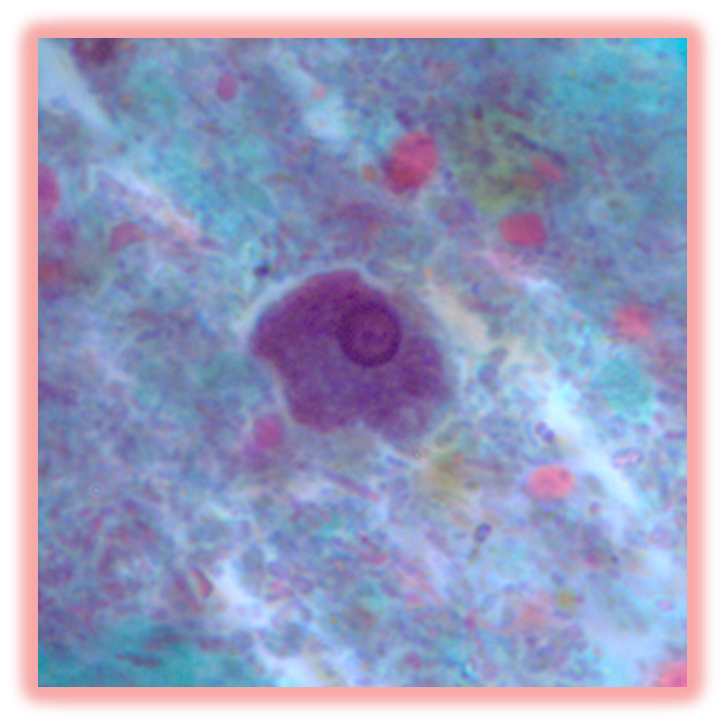
Entamoeba polecki –trophozoite

Slide 21
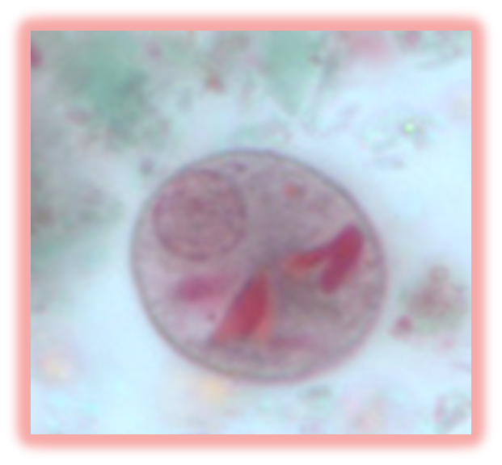
Entamoeba coli –cyst

Slide 22
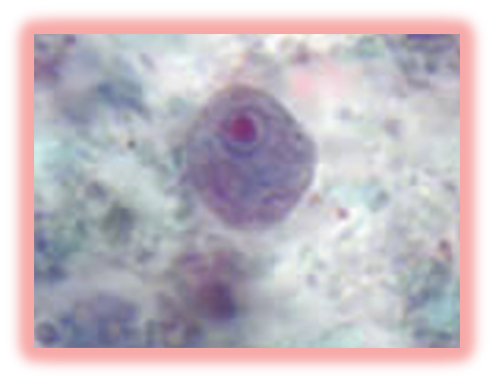
Endolimax nana-trophozoite

Slide 23
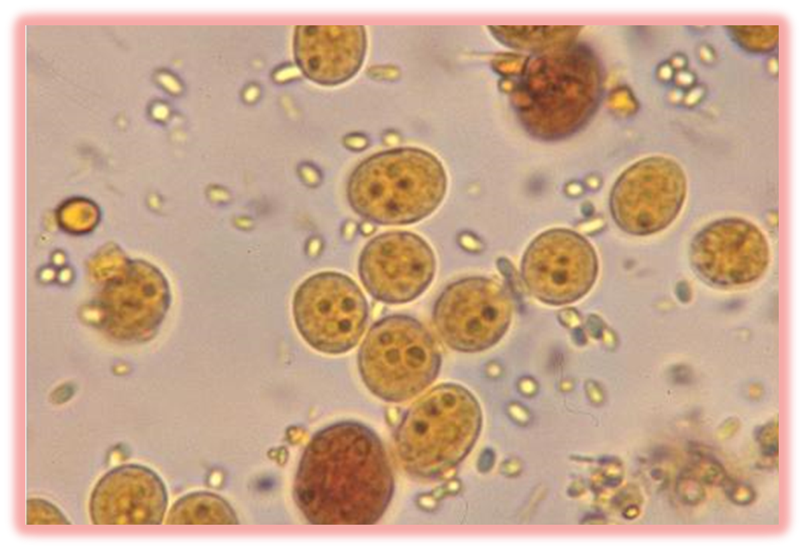
Endolimax nana -cyst

Slide 24
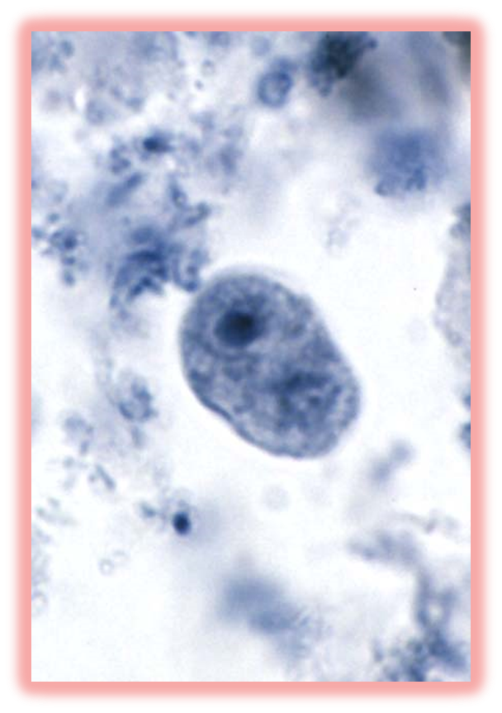
Iodamoeba buetschlli- trophozoite

Slide 25
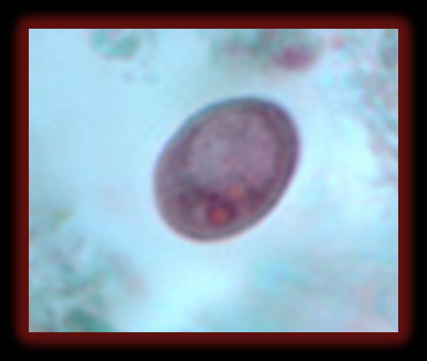
Iodamoeba buetschlli –cyst

