Slide 1
MOSAB NOURALDEIN
RDTs, QBC, Culture & PCR for malaria parasites

Slide 2
Objectives
By the end of lecture every one should understand :
The term, principle ,mechanism , advantages and disadvantages of the following malaria diagnostic tools :
RDTS, Culture ,QBC & PCR

Slide 3
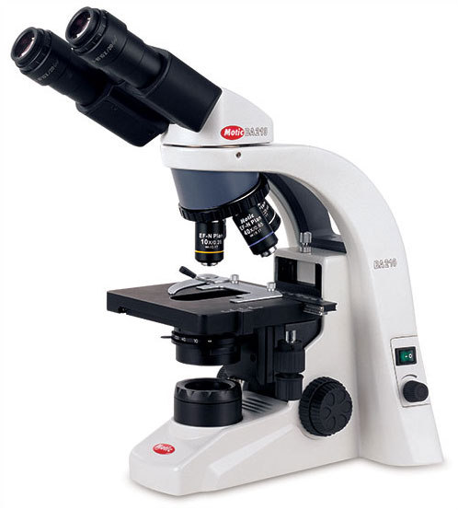
Introduction
The traditional method to malaria diagnosis has been by microscope examination of a thick & thin blood film .

Slide 4
cont
1- It needs availability of microscope
2- Also availability of trained microscopist
3- very low parasitaemias are easily missed
4-strong quality control measures

Slide 5
RDTs for malaria
Malaria rapid diagnostic tests (RDTs) assist in the diagnosis of malaria by detecting malaria parasites (antigens) in human blood .

Slide 6
Principle
RDTs are lateral flow immunochrotagraphic antigen-detection tests, which rely on the capture of dye-labeled antibodies to produce a visible band on a strip of nitro-cellulose .

Slide 7
Mechanism
With malaria RDTs , the dye-labeled antibody first binds to a parasite antigen , and the resultant complex is captured on the strip by a band of bound antibody, forming a visible line ( T-test line) in the results window.
A control line ( C-line) gives information of the integrity antibody –dye conjugate , but does not confirm the ability to detect parasite antigen .

Slide 8
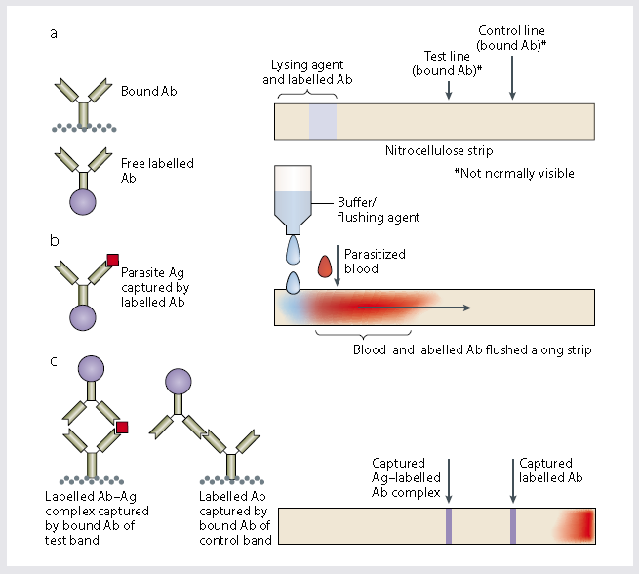
Mechanism in diagram

Slide 9
Antigenic targeted by RDTs
Histidine -rich protein-2,which is a water soluble protein produced by trophozoites and young (but not mature) gametocytes of P.falciparum .
(the RDTs use HPR2 detect P.falciprum only )

Slide 10
cont
Plasmodium Lactate Dehydrogenase , which is produced by both asexual and sexual stages of malaria parasites .

Slide 11
Cont
Pan –specific aldolase , which is an antigen common to all four species of human malaria it is used in conjugation with HRP2 to ) distinguish falciparum or mixed infections from non falciparum infection) .

Slide 12
cont
Parasight –F test and ICT malaria Pf have been very effective in fields trials and
detected the HRP2 .
Optimal test uses monoclonal antibodies against species –specific plasmodium lactate dehydrogenase (detects only the viable parasite ) .

Slide 13
Advantages
No need for laboratory facilities
Simple & rapid
No need for electricity or laboratory equipments (microscope)
Minimal requirements for training
Acceptable level of sensitivity and specificity

Slide 14
Disadvantages
More expensive than microscopy
Limitation in species identification
Persistent positivity after effective treatment
False positive results due to cross reactivity may be observed in patients with rheumatoid factor ,hepatitis C ,toxoplasmosis , …etc

Slide 15
Quantitative buffy coat
QBC is a laboratory test to detect infection
with malaria or other blood parasites .
It based on the principle of centrifugal stratification of blood components .

Slide 16
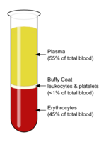
Buffy coat
It is a fraction of an anticoagulated blood sample that contains most of the WBCs and platelets following density gradient centrifugation of the blood .

Slide 17
Mechanism
The blood is taken in QBC capillary tube coated with acridine orange (a fluorescent dye) and centrifuged ,the fluorescing parasites can then be observed under ultraviolet light at the interface between RBCs and buffy coat .

Slide 18
Advantages
This test is more sensitive than the conventional thick smear and in >90% of cases the species of parasite can also be identified .

Slide 19
Disadvantages
Expensive
Sophisticated (required skilled and experienced microscopist ) .

Slide 20
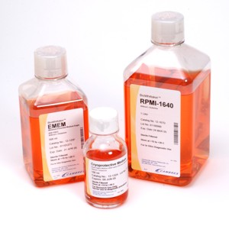
Cultivation
Malaria culture is the method to grow
malaria parasites outside the body .

Slide 21
Requirements
Balanced salt solution
Carbohydrates
Amino acids

Slide 22
Sources of plasmodium
Erythrocyte infected with P.falciprum may originate from the following sources
Human patient
Frozen culture

Slide 23
Preparation of culture medium for cultivation of P.falciparum
RPMI1640 medium
One packet of RPMI 1640 (containing 25 mM of HEPES buffer, glucose) dissolved in 960 ml of double distilled water. 40 μg/ml of gentamycin sulfate (1.2 ml of gentamycin/L) was to it added. This solution was passed through a Millipore filter of 0.22 μm porosity and store at 4°C as 96 ml aliquots in glass media bottle.

Slide 24
Cont
Washing medium (Incomplete medium)
4.2 ml of 5 % sodium bicarbonate (5 gms of sodium bicarbonate was dissolved in 100 ml double distilled water and filtered through a Millipore filter of 0.22 µm porosity and store at 4°C) was added to 96 ml of stock RPMI 1640 media.
Note: The sodium bicarbonate should be added to the RPMI 1640 media only at the time of requirement and should be prepared afresh.

Slide 25
Preparation of serum
O+ blood was collected in centrifuge tube without anticoagulant and kept at 4°C. Next day it was centrifuged at 10000 rpm for 20 min at 4°C. Serum was separated aseptically and kept in aliquots. The serum was inactivated by keeping it at 56°C water bath for half an hour.
Note: After inactivation the serum could be stored in deep freezer at – 20°C / - 70°C up to six months.

Slide 26
Complete medium
Normal inactivated O+ human serum (10 ml) was added to 90 ml of incomplete media.

Slide 27
Preparation of RBCs for culture
O+ blood was collected in anticoagulant into centrifuge tubes. Then this was centrifuged at 1500 rpm for 10 min at room temperature. Plasma and buffy coat was removed with sterile Pasteur pipette. After this washing media was added, centrifuged at 1500 rpm for 10 min and supernatant was removed. This washing process was repeated twice. Equal amount of complete media was added to the pellet and stored at 4°C.

Slide 28
Procedure for in vitro culture
1.Initiation of culture
2.Subculture (addition of fresh erythrocyte)
3.Cryopreservation

Slide 29
Limitations
1-Maintenance of red blood cells in vitro
a- The osmotic fragility of the red cells increases when they are incubated invtro
b decrease in glucose consumption
2- Maintenance of the extracellular merozoites
3- Maintenance of the intracellular parasite
a- normal red cells deteriorate more rapidly after 24 h in vitro

Slide 30
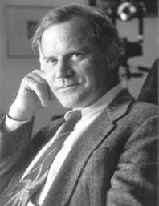
Polymerase chain reaction
In 1985, Kary Mullis invented a process he called PCR, which solved a core problem in genetics: How to make copies of a strand of DNA you are interested in (e.g. malaria parasite)

Slide 31
Polymerase chain reaction (PCR)
Plasmodium nucleic acids are detected using polymerase chain reaction (PCR).
PCR is useful for confirming the species of malarial parasite after the diagnosis has been established by either microscopy or RDTs.

Slide 32
Steps
Denaturation
Annealing
Extension

Slide 33
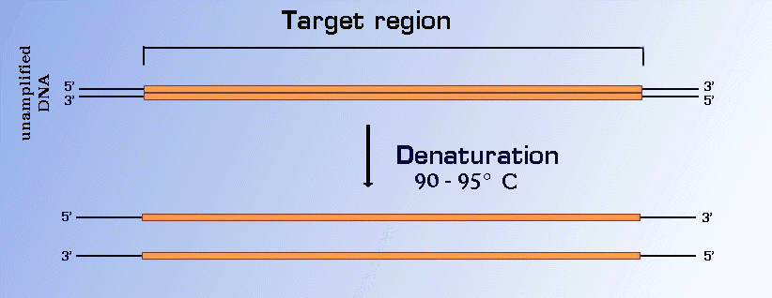
Denaturation
the double-stranded DNA (dsDNA) is denatured to separate the strands of the molecule.
This is done simply by heating a test tube to 90-95 degrees centigrade for 15 to 60 seconds.

Slide 34
Annealing of primers
To copy DNA, polymerases require a short sequence called a primer.
The PCR uses two primers, each complementary to opposite strands of the region of DNA, which have been denatured by heating.
They cannot "anneal" to the strand of DNA at temperature 95 degrees centigrade, so the test tube is cooled to 45 - 60 degrees C.

Slide 35
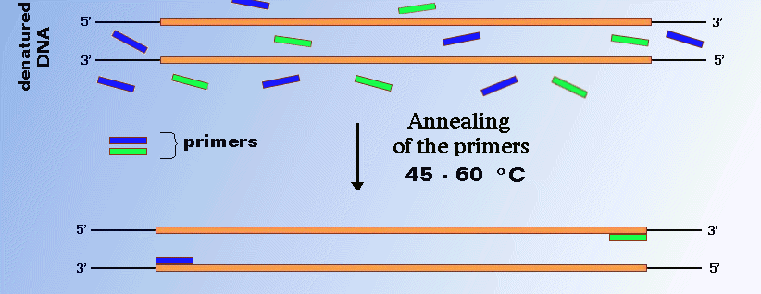
The primers are designed so that each primer directs the synthesis of new strand of DNA towards the other (Figure below).

Slide 36
Extension
The primer molecules are elongated by the action of DNA polymerase.
Deoxynucleosides triphosphates (dNTPs) required for the synthesis of DNA are present in large excess, so the synthesis step can be repeated a lot of times.

Slide 37
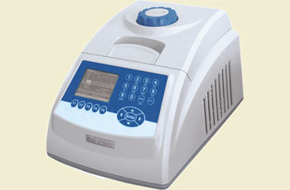
Polymerase chain reaction
PCR is a reference method .
It is 10-fold more sensitive than microscopy .
It is also more reliable for determining the species in a mixed infection .

Slide 38

Thank you

