Slide 1
Parasitology department
2nd year GROUP A
Parasitology quiz

Slide 2
Please answer all questions
2 min /question

Slide 3
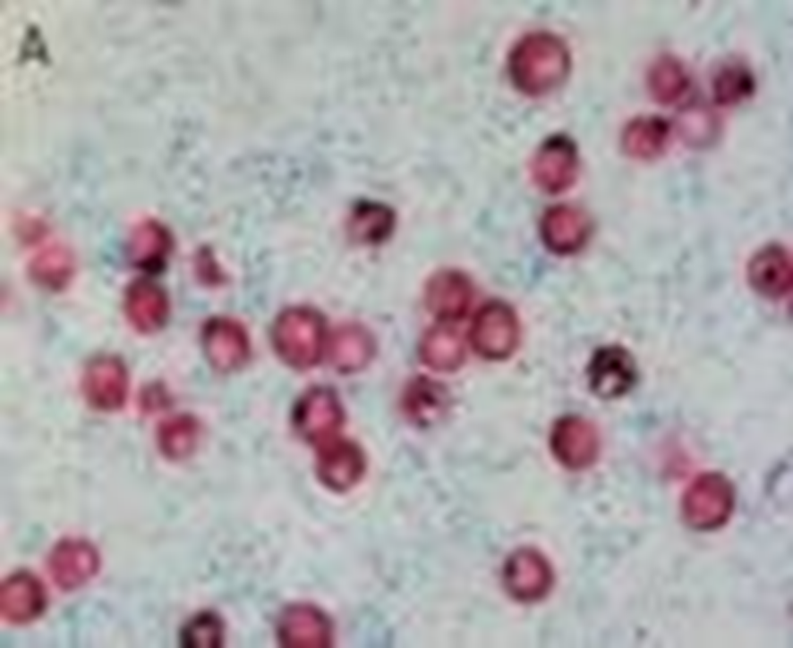
1)Identify

Slide 4
2)Mentions (2) types of reproduction in CILIATES ?
1-………………………………….
2…………………………………….

Slide 5
3)DESCRIBE THE FOLLOWINGS:
1- Motility of Entamoeba coli ?.........................................
2-Motility of Giardia lamblia ?..........................................

Slide 6
4)MENTION (4) FIXATIVES USED TO PRESERVE FAECAL SPECIMENS ?
1-……………………….
2-----------------------------
3-----------------------------
4--------------------------------

Slide 7
5)MENTION (ONE) OF THE USES OF STRING TEST ?
…………………………………………………………………………………………………………………………………………………………………….

Slide 8
6)DEFINE THE FOLLOWINGS :
LIFE CYCLE ?.............................................
MUTALISM?........................................

Slide 9
7)MENTION THE USES OF TEMPORARY STAINS ?

Slide 10
8)METION (2) PARASITES STAINS WITH COLD ZN STAIN?

Slide 11
9)MENTION THE USE OF CAP TEST ?

Slide 12
10)DEFINE THE TERM DYSENTRY ?

