Slide 1
Stool analysis 2
Mosab Nouraldein

Slide 2
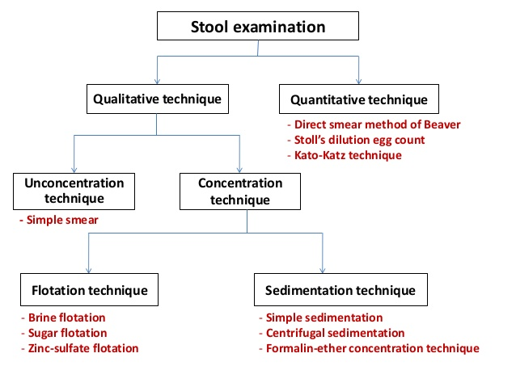

Slide 3
Stool concentration methods

Slide 4
aim
To detect the parasite when they are not found in wet mount.
To the detect the parasites which are few in number
To follow up the treatment
To investigate prevalence and incidence of parasitic diseases.

Slide 5
Selection
It depends on:
The species of parasite
The degree of concentration required
The number of specimens to be examined
The equipment available
Time available

Slide 6
Types
Sedimentation methods
Flotation methods

Slide 7
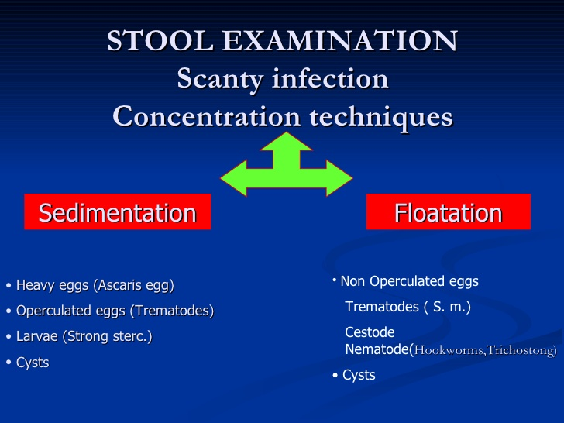

Slide 8
Formol ether concentration method
The parasite are sedimented by centrifugation and diethyl –ether is used to dissolve fecal fat and to separate fecal matter from the sedimented parasite.
It’s rapid and give good concentration for the parasite.

Slide 9
Its suitable for fresh specimens -unless you want to detect the motile trophozoite- also for specimens preserved in MIF, Beyer’s and other stool preservatives.
Ethyl acetate can be used instead of diethyl ether to avoid the flammability of ether.

Slide 10
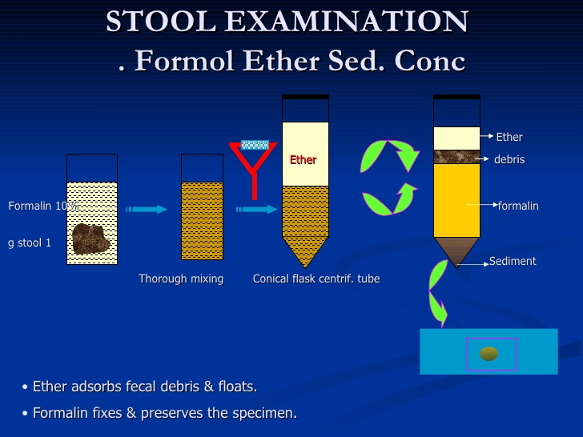

Slide 11
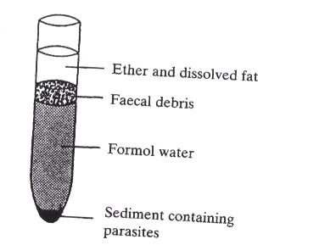

Slide 12
Formol detergent method
Simple , safe and inexpensive .
Suitable for field conditions.
Used when the facilities of Formol ether concentration method is not available
Formol detergent solution has low specific gravity .
Time consuming require more than an hour .

Slide 13
The detergent is used to clear the fecal debris .

Slide 14
Zinc sulphate flotation method
Not suitable for wide range of parasites.
Zinc sulphate has high specific gravity .
Time consuming
Able to detect intestinal protozoa and T.trichiura.

Slide 15
Saturated sodium chloride method
Not suitable for all parasites
Used solution of high specific gravity (Sat-NACL)
Time consuming
Able to detect intestinal protozoa and hook worms

Slide 16
Sugar flotation method
Used to concentrate most of intestinal protozoa.
Not recommended as other methods .

Slide 17
Quiz 1: intestinal amoeba

Slide 18
1) Have similar shape but differ in size
A) E.dispar & E.histolytica
B) E.dispar & E.nana
C) E.dispar & E.hartmanni
D) E.nana and E. coli
E) E. nana & E.polecki

Slide 19
2) Has prominent endosome:
A) E.nana
B) E.polecki
C) I.butschlii
D) E.dispar
E) E.coli

Slide 20
3) Named due to staining appearance:
A) E. orangalis
B) E.dispar
C)I.butschlii
D)D. fragilis
E) E. redish

Slide 21
4) Have hole like nuclei:
A) E. polecki
B) I.butschlii
C) E.nana
D) E.hartmanni
E) D.fragilis

Slide 22
5) Eat bacteriods:
A) E.coli cyst
B) E.histolytica cyst
C) trophozoite
D) I. butshlii
E) E. polecki

