Slide 1
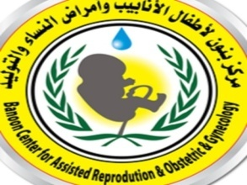
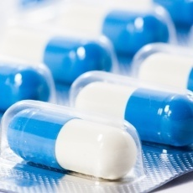
Antibiotic Resistance: Overview
Mosab Nouraldein
Banoon fertility center

Slide 2
The threat of antibiotic resistance weaken development in health care, food production, and life expectancy.
It is estimated that, without an effective response, resistance to antimicrobial medicines might lead death of 19 persons/ every minute by 2050.

Slide 3

Between 1962 and 2000, no new major classes of antibiotics were approved to treat common and deadly Gram-negative infections.

Slide 4

Since 1990, 78% of major drug companies have scaled back or cut antibiotic research due to development challenges.
Historical data show that, generally, only 1 out of 5 infectious disease drugs that reach the initial phase of testing in humans will receive approval from the FDA.

Slide 5
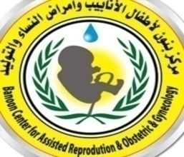
Antibiotic is a term that refers to the medicines that kill or inhibit bacteria.
they were first discovered in 1929 and were used to replace older chemical therapeutics.

Slide 6
Susceptible infections : are infections that can be treated effectively with antibiotics.
Antibiotic resistance : happens when germs develop the ability to defeat the drugs designed to kill them. That means the germs are not killed and continue to grow.

Slide 7
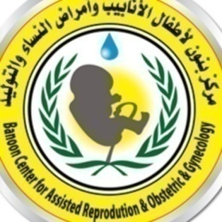
Multidrug-resistant germs: are resistant to multiple antibiotics available for treatment.
Pan-resistant infections: are caused by germs resistant to all antibiotics available for treatment

Slide 8

Infection control: prevents or stops spread of infections.
Antibiotic stewardship: is improving the way antibiotics are prescribed and used.
Resistance mechanisms :are defense strategies that germs develop to help them survive and avoid the effects of antibiotics.

Slide 9
Definition
Antibiotic resistance is The ability of microbes to undergo genetic changes that enable them to defeat the drugs designed to kill them.

Slide 10
ABR resistance intimidation divided into three groups according :
Urgent , Serious & Concerning.

Slide 11
Antibiotic resistance can affect any person, at any stage of life. People receiving health care or those with weakened immune systems are often at higher risk for getting an infection.

Slide 12
Antibiotic-resistant germs can spread between people with and without symptoms of infection. Depending on the germ, they can spread to people in many ways:
Close contact, through air, contaminated water and surfaces, sexual contact , from animals.

Slide 13
Antibiotic-Resistant Infections Threaten Modern Medicine
Sepsis Treatment:
Anyone can get an infection and almost any infection can lead to sepsis — the body’s extreme response to an infection. Without timely treatment with antibiotics, sepsis can rapidly lead to tissue damage, organ failure, and death

Slide 14
Surgery:
Patients who have surgery are at risk for surgical site infections. Without effective antibiotics to prevent and treat surgical infections,
many surgeries would not be possible today.

Slide 15
Chronic Conditions :
Chronic conditions (e.g., diabetes) put people at higher risk for infection. These conditions and some medicines used to treat them can weaken the immune system.

Slide 16
Organ Transplants:
Organ transplant recipients are more vulnerable to infections because they undergo complex surgery. Recipients also receive medicine to suppress (weaken) the immune system, increasing risk of infection

Slide 17
Dialysis for Advanced Kidney Disease:
Patients who receive dialysis treatment have a higher risk of infection, the second leading cause of death in dialysis patients.

Slide 18
Cancer Care:
People receiving chemotherapy for cancer are often at risk for developing an infection during treatment. Infection can quickly become serious for these patients

Slide 19
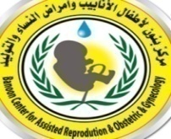
Antibiotic resistance in food chain
The high volume of antibiotics in food-producing animals contributes to the development of antimicrobial-resistant bacteria.
In some countries, the total amount of antibiotics used in animals is 4 times larger than the amount used in humans.

Slide 20

In many countries much of the antibiotics used in animals are for growth promotion and prevention of disease, not to treat sick animals.
Consumption of vegetables represents a route of direct human exposure to bacteria found in soil. The present study evaluated the complement of bacteria resistant to various antibiotics on vegetables often eaten raw (tomatoes).

Slide 21

resistance mechanisms
Germs develop new cell processes, that avoid using the antibiotic’s target.
Germs change or destroy the antibiotics with enzymes, proteins that break down the drug
Germs restrict access by changing the entryways or limiting the number of entryways.

Slide 22
Germs change the antibiotic’s target so the drug can no longer fit and do its job.
Germs get rid of antibiotics using pumps.

Slide 23
How Antibiotic Resistance Moves Directly Germ to Germ
Resistance traits can be inherited generation to generation. They can also pass directly from germ to germ by way of mobile genetic elements.

Slide 24
Mobile Genetic Elements
Plasmids : Circles of DNA that can move between cells.
Transposons: Small pieces of DNA that can go into and alter the overall DNA of a cell. These can move from chromosomes (which carry all the genes essential for germ survival) to plasmids and back.

Slide 25
Phages :Viruses that attack germs and can carry DNA from germ to germ

Slide 26
How Mobile Genetic Elements Work
Transduction :Resistance genes can be transferred from one germ to another via phage.
Conjugation :Resistance genes can be transferred between germs when they connect.

Slide 27
Transformation: Resistance genes released from nearby live or dead germs can be picked up directly by another germ.

Slide 28
ABR in Sudan
Antibiotics Resistance in Sudan" has revealed that the situation in Sudan is very severe even when compared with some neighboring countries.

Slide 29
Immediate action is required due to the excessive use of antibiotics especially the third generation cephalosporins.
60 to 80% of E.coli and K. pneumonia isolates encountered in two teaching hospitals in Khartoum are active producers of extended-spectrum beta-lactamase (ESBL) .

Slide 30

the prevalence of Methicillin-resistant Staphylococcus aureus (MRSA) infections in Sudan is ranging between 30 to 80%, whiles 2 to 25% of Staphylococcus aureus strains are emerging as vancomycin-resistant.

Slide 31
The situation is further aggravated by the emergence of 3 to 5% of resistance among Pseudomonas spp even to carbapenems which are uniquely resistant to hydrolysis by most β-lactamases.

Slide 32
Certainly there is a complex socioeconomic and behavioral factors associated with antibiotics resistance including the misuse of antibiotics by health professionals, unskilled practitioners and public in general.

Slide 33
Poor drug quality, inadequate surveillance and stewardship also contributed significantly to the emergence and spread of antibiotic-resistant bacteria.

Slide 34
CONTROL
Infection prevention and control:
Prevent infections and reduce the spread of germs.

Slide 35
Tracking and data:
Share data and improve data collection .

Slide 36
Antibiotic use and access:
Improve appropriate use of antibiotics, reduce unnecessary use (called antibiotic stewardship), and ensure improved access to antibiotics.

Slide 37
Vaccines, therapeutics, and diagnostics:
Invest in development and improved access to vaccines, therapeutics, and diagnostics for better prevention, treatment, and detection.

Slide 38
Environment and sanitation:
Keep antibiotics and antibiotic resistant threats from entering the environment through actions like improving sanitation and improving access to safe water.

Slide 39
FINALLY
When antibiotics kill useful microbes and fail to kill pathogens , here we should say that we are starting post antibiotic era .

Slide 40

Thank you

