Slide 1
Stool analysis
One

Slide 2
Collection of specimens
Collect approximately 100g of faeces in a clean, dry container without preservatives. A screw-top container is most suitable. Make sure that any adult worms or segments passed are included.

Slide 3
Precautions
Never leave stool specimens exposed to the air in containers without lids.
Never accept stool specimens mixed with urine.
Never examine stool specimens without ﬁrst putting on gloves.

Slide 4
Always examine stool specimens within 1–4 hours after collection. If several specimens are received at the same time, examine the liquid stools and those containing mucus or blood ﬁrst, as they may contain motile amoebae (which die quickly).

Slide 5
Gross /physical/visual/ macro exam
Faecal samples are best described by their colour, consistency and presence or absence of macroscopic blood or exudate.

Slide 6
Colour
The colour can be described as:
— black (occult blood)
— brown, pale yellow (fat)
— white (obstructive jaundice).

Slide 7
Consistency
The consistency can be described as:
— formed (normal shape)
— soft formed
— unformed or liquid (watery).

Slide 8
The presence of external blood or mucus, usually seen as streaks of red or white, should be noted. Blood may be present in certain medical conditions (e.g. ulcerative colitis, schistosomiasis).

Slide 9
Microscopic examination
Direct microscopic examination of faeces in saline or iodine suspension is useful for the following reasons:
to detect motile trophozoites;
— to detect ova and cysts present in moderate numbers;
— to detect erythrocytes, cellular debris or excess fat.

Slide 10
Select unformed or liquid faeces when using direct microscopy for detection of trophozoites. Formed stools rarely contain motile trophozoites. Also perform a direct examination of any external blood or mucus.

Slide 11
Dispatch of stools for detection of parasites
Stools may be sent to a specialized laboratory for the identiﬁcation of rare parasites that are difﬁcult to recognize. In such cases a preservative should be added to the specimens before they are dispatched for examination. The following preservatives are used:

Slide 12
formaldehyde, 10% solution.
— Lugol iodine, 0.5% solution.
— polyvinyl alcohol (PVA) ﬁxative.
— thiomersal–iodine–formaldehyde (TIF) ﬁxative, for wet mounting.

Slide 13
Formaldehyde solution preserves eggs and cysts of parasites indeﬁnitely if the specimen container is tightly closed. It does not preserve vegetative forms of protozoa, which are destroyed after a few days.
PVA ﬁxative preserves all forms of parasites indeﬁnitely.

Slide 14
thiomersal–iodine–formaldehyde ﬁxative, preserves all forms of parasites indeﬁnitely, including vegetative forms of amoebae.

Slide 15
Intestinal protozoa
Protozoa are microorganisms consisting of a single cell. Intestinal protozoa may be found in stools in their motile form (trophozoites) or as cysts.

Slide 16
Identification of motile forms (trophozoites)
The trophozoites of protozoa are motile.
either because of slow movements of the cell (amoebae);
or because they have rapidly moving ﬂagella (long whip-like threads) or cilia (numerous short hairs).

Slide 17
Trophozoites are chieﬂy found in:
— watery stools
— stools containing mucus
— soft formed stools.

Slide 18
Features of identification
size
— cytoplasm
— pseudopodia
— nuclei
ectoplasm
— endoplasm

Slide 19
vacuoles
— inclusion bodies containing erythrocytes, bacteria, yeast cells, debris, etc.
nuclear membrane (chromatin)
nuclear karyosome
ﬂagella
undulating membrane

Slide 20
Identification of cysts
Cysts are the resistant forms of certain intestinal amoebae, ﬂagellates and ciliates. They are small, round and non-motile and may have one or several nuclei.
Measurement of cysts is useful for the correct identiﬁcation of species.

Slide 21
Importance of cysts
The clinical importance of cysts varies from country to country. The cyst is the infective form of the organism. Healthy persons may be asymptomatic carriers of cysts and are, therefore, a public health hazard.
The most important problem in the laboratory is the precise identiﬁcation of cysts of Entamoeba histolytica, Giardia intestinalis and Blantidium coli.

Slide 22
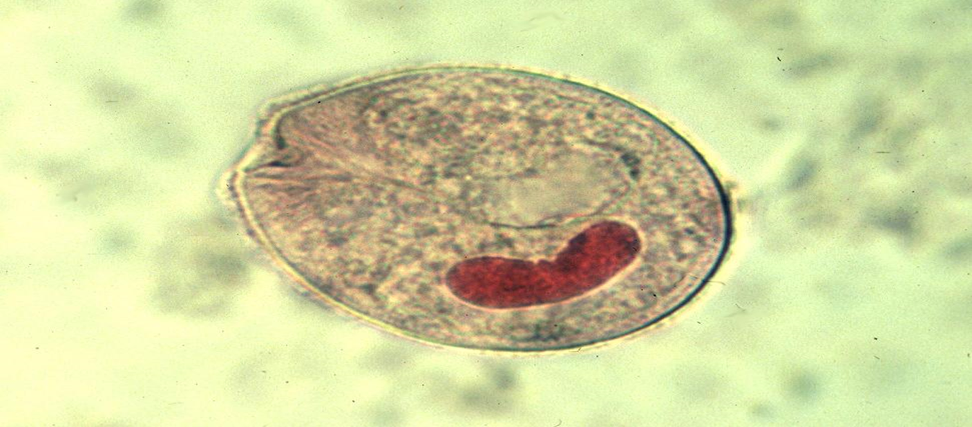

Slide 23

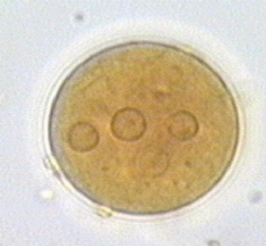

Slide 24
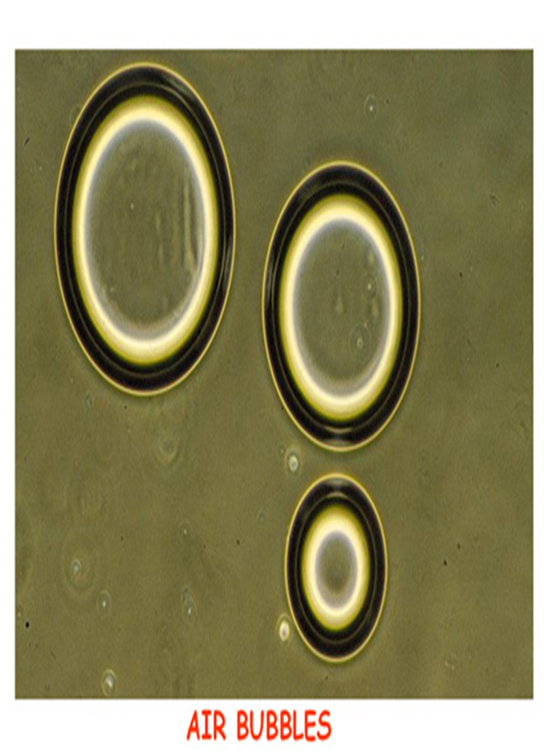

Slide 25
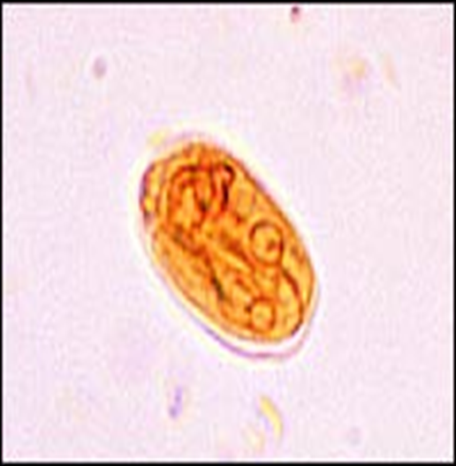

Slide 26
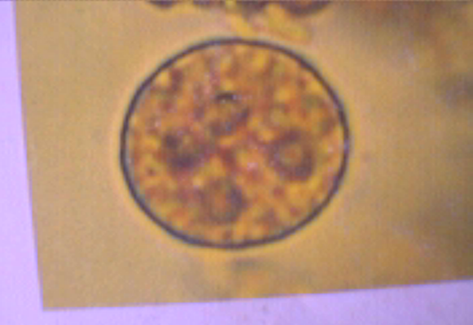

Slide 27


