Slide 1
Giardia lamblia
Giardia duonenalis , Giardia intestinalis
Mosab Nouraldein mohammed
Semester 8

Slide 2
Its an intestinal flagellate protozoan parasite , which inhabit the duodenum and upper part of jejunum
It is the causative agent of Giardiasis .

Slide 3
Distribution:
World wide , more common in warm climate of tropics and sub-tropics
Mode of transmission :
Fecal oral route , ingestion of cyst in food , water or from contaminated hands .

Slide 4
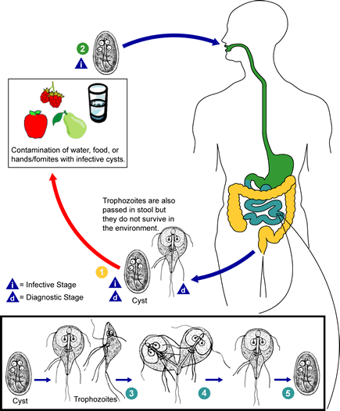
Life cycle

Slide 5
Variation in clinical manifestation
It occurs due to the following factors:
The virulence of Giardia lamblia strain (A&B strains).
The number of cysts ingested ( 10- 25 cyst)
The age of the host
The state of the host immune system

Slide 6
Clinical features
mostly Asymptomatic
Diarrhea
Abdominal pain
Malabsorption
Steatorrhea
Nausea
Vomiting

Slide 7
Immunity to giardia lamblia
Innate immunity :
Stomach acid (HCL) serves as important first line of defense against enteropathogens through its ability to kill acid sensitive microorganisms .
However Giardia lamblia cyst are highly resistant and survive passage through the acidic environment of the stomach

Slide 8
Complement system:
Parasite can be killed by complement after activation of with specific antibodies (classical pathway of complement activation)
Mannose binding lectin:
Giardia lamblia trophozoite is able to glycosylate numerous proteins with the addition of N-Acetyl –Glucosamine , which is known ligand for the mannose binding lectin (MBL) .
And that will lead to trophozoite lysis.

Slide 9
Macrophages :
Can phagocyte Giardia lamblia trophozoite
Dendritic cells :
Can produce small amount of IL-6 & TNF –alpha , in response to giardia lamblia trophozoite .

Slide 10
Contribution of commensal microorganisms ( normal microbial flora):
Intestinal flora may compete the trophozoite in diet and receptors .
Recent case study showed that Entamoeba coli trophozoite phagocytose Giardia lamblia trophozoite .
Nitric oxide :
Inhibit the trophozoite replication as well as differentiation into cyst .

Slide 11
Adaptive immune response :
Humoral immunity :
Infection with Giardia lamblia results in strong antibody response against the parasite .
Antibodies involved :
IgG
secretory IgA

Slide 12
IgA is transported across epithelial surfaces by the poly-immunoglobulin receptor in a process called transcytosis .
Passive transfer of anti-Giardia antibodies in milk can help to protect newborn humans .

Slide 13
Cellular immunity :
T cells can produce several distinct patterns of cytokines following infection with Giardia lamblia , including ( IL -2, IL-4, IL-5, IL -6, INF-gamma, TNF-alpha) .

Slide 14
Mechanisms of evasion:
By antigenic variation :
Giardia lamblia has variant – specific surface proteins (VSPs).
Each individual parasite contains approximately 150 different variant-specific surface protein genes.
But each trophozoite express only one VSP at a time .

Slide 15
Serological diagnosis by :
ELISA
IFAT

Slide 16
Quiz
Mention the reasons of variation in clinical manifestation among patients suffering from giardiasis ?
Discuss :
Innate immune response to G.lamblia?
Specific immunity to G.lamblia ?
Mention the methods used to diagnose G.lamblia serologically?

