Slide 1
Open quiz
Nematodes

Slide 2
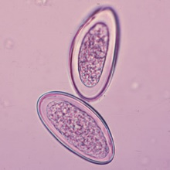
Identify?

Slide 3

Identify ?

Slide 4
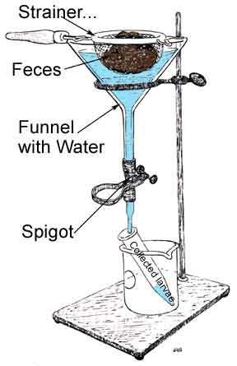
Identify ? Mention the use of this apparatus?

Slide 5
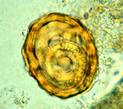
Identify ?

Slide 6
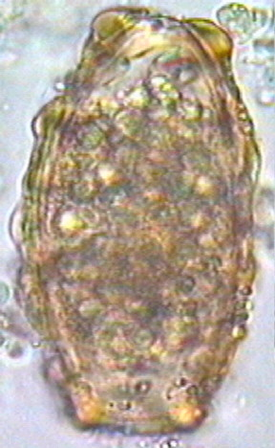
Identify ?

Slide 7
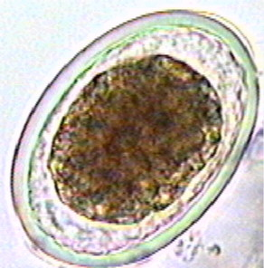
Identify ?

Slide 8
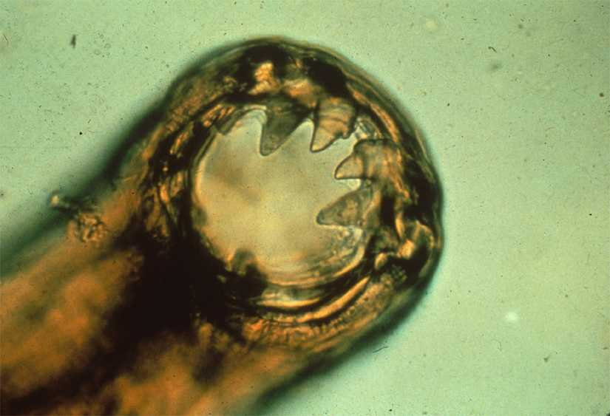
Identify ?

Slide 9
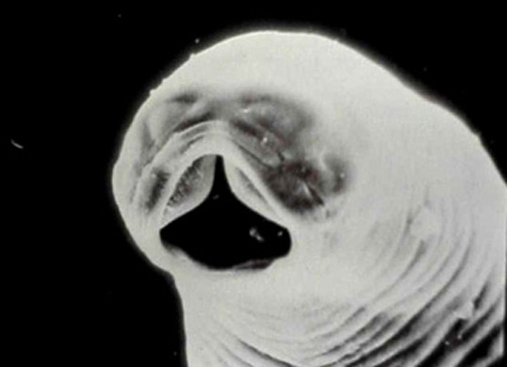
Identify ?

Slide 10
Identify ?

Slide 11
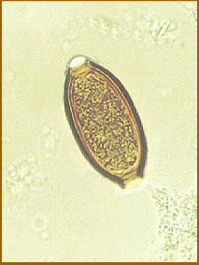
Identify ?

Slide 12
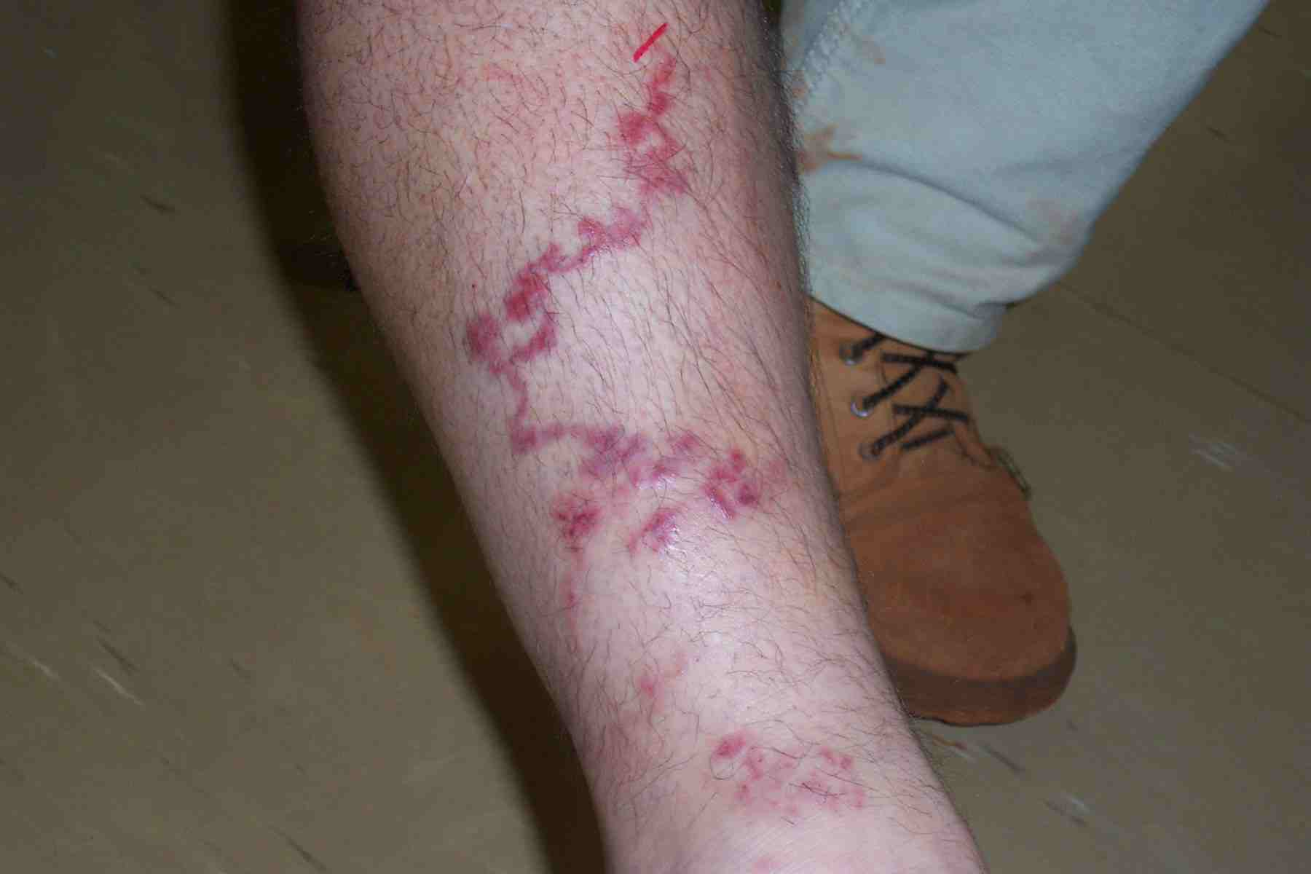
Identify this condition ?

Slide 13
Mention the causative agent of the followings:
Rectal prolapse ?
Iron deficiency anemia ?
Intestinal obstruction ?
Perianal itching ?
Ground itch ?

Slide 14
Describe & draw the followings :
Enterobius vermicularis egg ?
Trichiuris trichiura egg ?
Unfertilized egg of Ascaris lumbricodes ?

