Slide 1
Hook worms
Mosab Nouraldein Mohammed

Slide 2
Hook worm is one of the important cause of iron deficiency anemia . It is so named because the anterior end of the adult worm is bent .

Slide 3
Distribution
Hook worm infection is wide spread in both tropics and temperate countries

Slide 4
Classification
Hook worm belong to the family Ancylostomatidae which consists of two species infecting humans.
Ancylostoma duodenale and Necator americanus .
The word Ancylostoma is derived from hooked mouth ( Ancylos-hooked, stoma –mouth )

Slide 5
Ancylostoma duodenale : old world hook worm
Necator americanus : new world hook worm ( American hook worm)

Slide 6
History
A. duodenale was first detected by an Italian physician Dubini in 1843 , life cycle and pathogenesis was described by Arthur Loss in 1898 .
N. americanus was first described by Stites in 1902 in Texas, USA, hence called as American hookworm

Slide 7
Mode of transmission
Through penetration of skin by the third stage larva (Filariform larva) .
Ingestion of filariasis
Transmammary ( rarely) .

Slide 8
Life cycle
Direct life cycle
Infective stage : Filariform larva
Definitive host : human

Slide 9
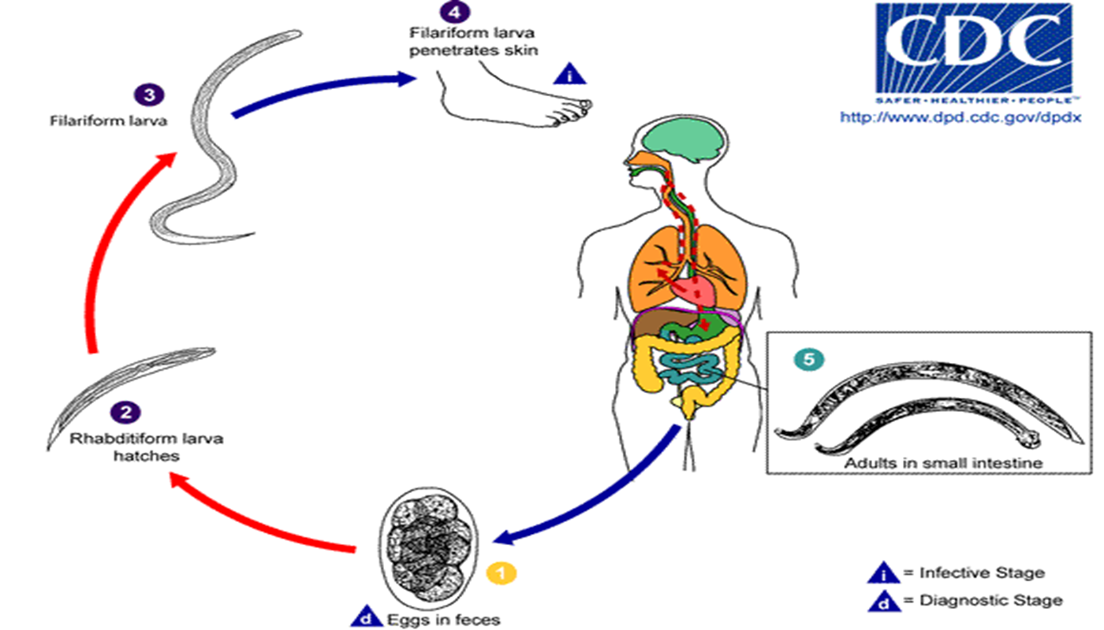
Life cycle

Slide 10
Pathogenicity
Hook worm has ability to suck blood from intestinal vessels by :
1- Attaching and making cuts in the intestinal wall by buccal capsule and teeth followed by sucking the blood through contraction of their muscular esophagus .
2- Secreting hydrolytic enzymes
3- Releasing anticoagulants like factor VIIa/ tissue factor inhibitor

Slide 11
4- Ingestion of extravasated blood .

Slide 12
Clinical features
Infective larvae cause dermatitis and rash at the site of skin penetration ( ground itch ) .
Cutaneous larva migrans ( creeping eruption)
Mild transient pneumonia

Slide 13
Affect due to adult worm in intestine :
Mostly its asymptomatic
Epigastric pain
diarrhea
Loss of weight
Iron deficiency anemia

Slide 14
Wakana disease :
When filarifom larva of A.duodenale is ingested by oral route , both gastrointestinal ( due to adult) as well as pulmonary (due to migrating larva) symptoms are observed .
Common symptoms include nausea, vomiting , pharyngeal irritation , cough , dyspnea

Slide 15
Lab diagnosis
Specimen : stool , dark to black (contain occult blood)
Direct examination ( wet preparation)
Saturated sodium chloride floatation technique
Harada mori culture
Agar plate technique
Baermann technique

Slide 16
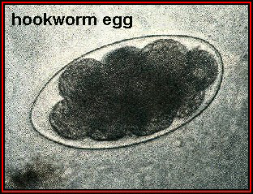
Egg
Shape : oval with an empty space between the shell and content
Size: 60 x 40 μm
Shell: thin egg shell
Color: colorless and transparent
Content: 4-8 cell unembryonated segments
Immature eggs pass in feces ,20.000 eggs

Slide 17
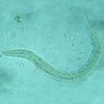
Rhabditiform larva:
Size 200-400 um
Long buccal cavity
Rhabditiform esophagus
Pointed tail

Slide 18
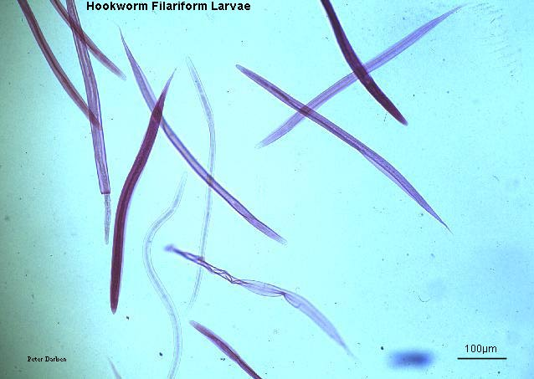
Filariform larva :
600-700um
Cylindrical esophagus
Sharply pointed tail

Slide 19
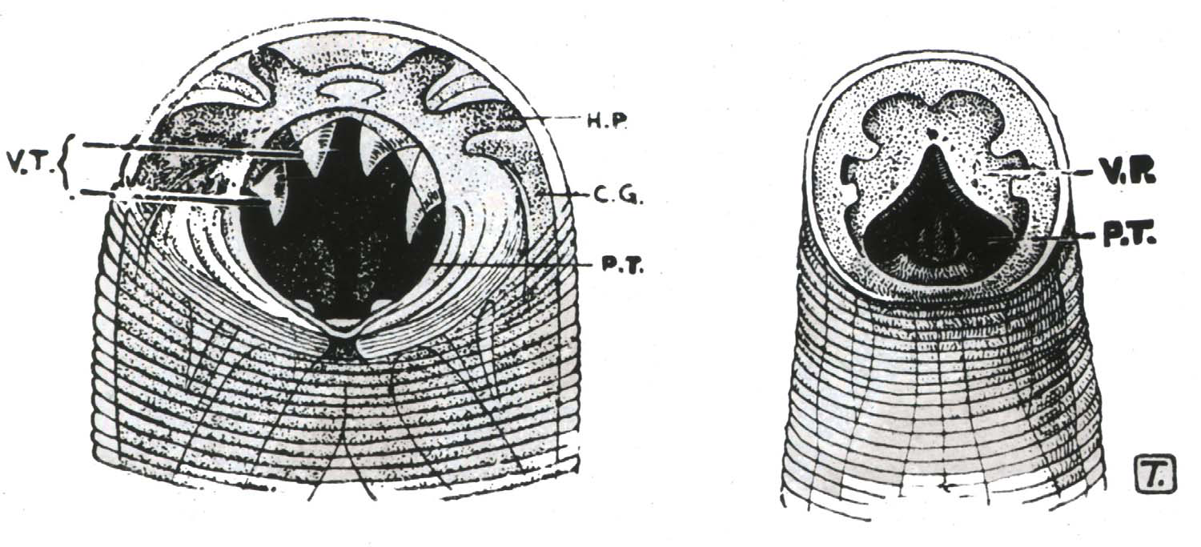
Hook worm species

Slide 20
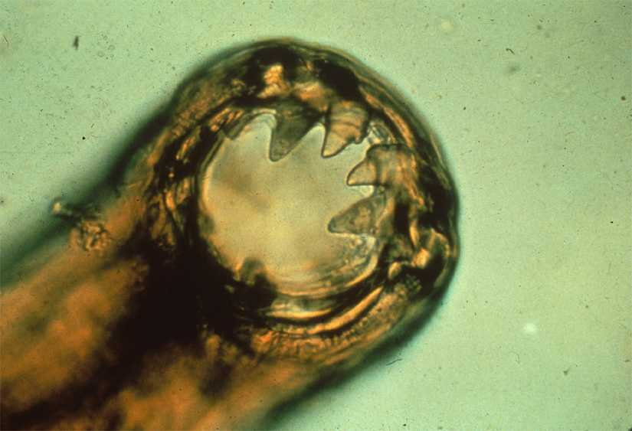
Ancylostoma hooks
Chitinous teeth plates

Slide 21
Other findings :
Eosinophilia
Microcytic hypochromic anemia
Hypoalbuminemia

Slide 22
Egg counting technique :
Stoll technique
Kato katz technique

Slide 23
A.duodenale vs. N.americanus
Feature | A.duodenale | N .americanus
Size | 720 um | 660 um
Cuticle | Bears faint transverse striations | Bears prominent transverse striations
Buccal capsule | Shorter (10um) | Larger (15 um)
Esophageal -intestinal junction | Absent | Present
Intestine | Posterior end of intestine has refractile body | No refractile body

Slide 24
Prevention& Control
Treatment of patients
Health education
Avoid using of untreated human feces as fertilizer

