Slide 1
Mid term quiz
3 mins /question

Slide 2
1- mention the differences between Schistosoma species and Fasciola species?

Slide 3
2- what is the habitat of S.mansoni

Slide 4
3- what is the infective stage of Clonorchis sinensis?

Slide 5
4- what is the ectopic sites of paragominus westermani?

Slide 6
5- define spurious infection?

Slide 7
6- differentiate between S.mansoni & S.japonicum?

Slide 8
7- mention the specimens used to Diagnose Schitosomiasis?

Slide 9
8- all snails are completely aquatic except….

Slide 10
9- mention the advantage of Trypan blue/ hatching test?

Slide 11
10- epilepsy is a complication of infection with which one of trematodes?

Slide 12
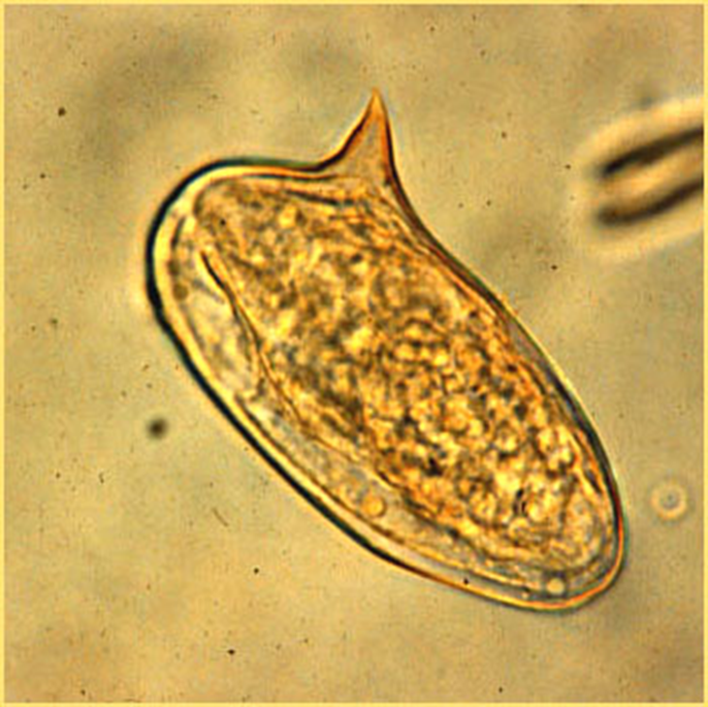
11- mention the name of intermediate host?

Slide 13
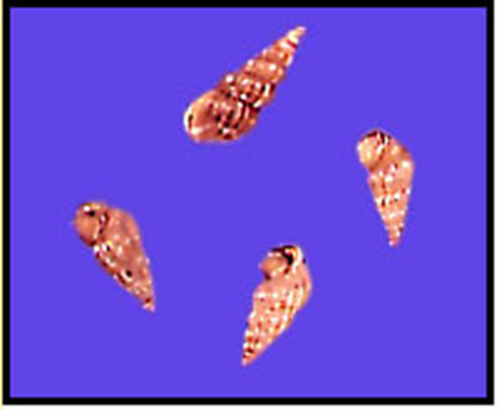
12- identify?

Slide 14
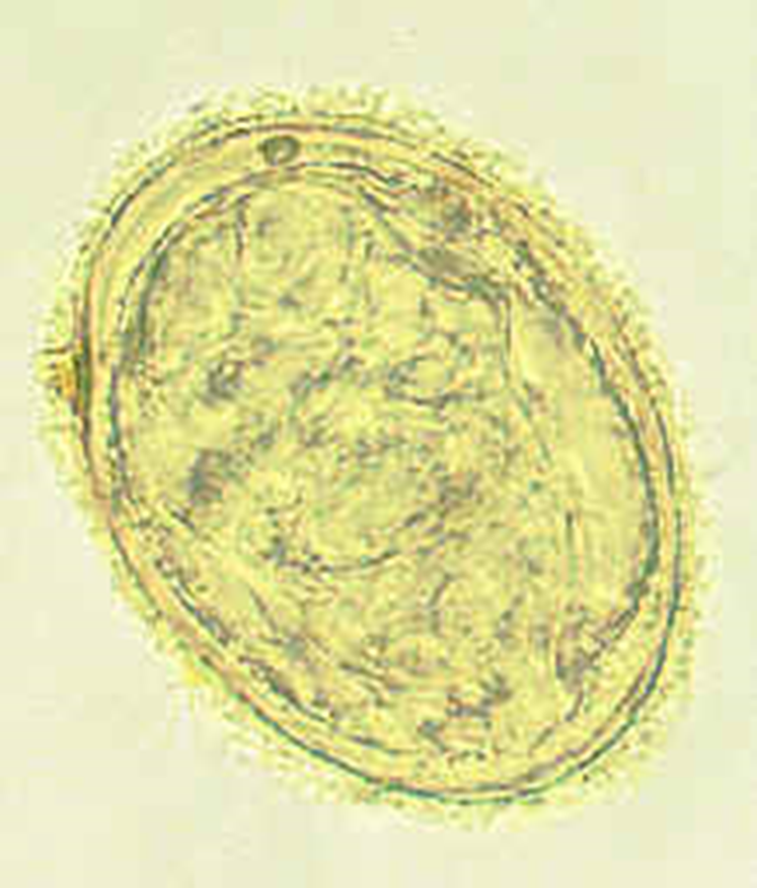
13- mention the habitat of adult stage?

Slide 15
14- define liver rot?

Slide 16
15- mention the differences between S.haematobium and S. japonicum?

Slide 17
16- mention the developmental stages of Fasciolopscis buski?

Slide 18
17- mention the complications of s.mansoni?

Slide 19
18- define the term schistosomulae?

Slide 20
19- draw the ova of schistosoma species?

Slide 21
20- draw the cerceria of schistosoma and Fasciola species?

