Slide 1
Nematology quiz
22.4.2017

Slide 2
ANSWER ALL QUESTIONS
YOU HAVE 2 MINUTES FOR EACH QUESTION

Slide 3
1
Classify nematodes according to egg/ larvae production ?

Slide 4
2
Mention the route of transmission of thread worm?

Slide 5
3
Enumerate 3 special test used to diagnose military worm ?

Slide 6
4
Enumerate 5 parasites inhabit the large bowel

Slide 7
5
Mention anthropontic parasite which cause creeping eruption ?

Slide 8
6
Mention 4 parasite species follow heart lung migration ?

Slide 9
7
Enumerate diagnostic techniques used to diagnose thread worm ?

Slide 10
8
Draw and describe whip worm ova ?

Slide 11
9
Draw and describe family worm egg

Slide 12
10
Mention the advantage of Stoll technique?

Slide 13
11
Mention the parasite that cause Insomnia? And mention the suitable clinical specimens to diagnose that parasite ?

Slide 14
12
The species of hook worm possess cutting plate is …………………………………………………………………………………………………………………………………………………………………………

Slide 15
13
Define the followings:
Internal autoinfection?
Geohelminthes?

Slide 16
14
Differentiate between fertile and non fertile egg of giant round worm?

Slide 17
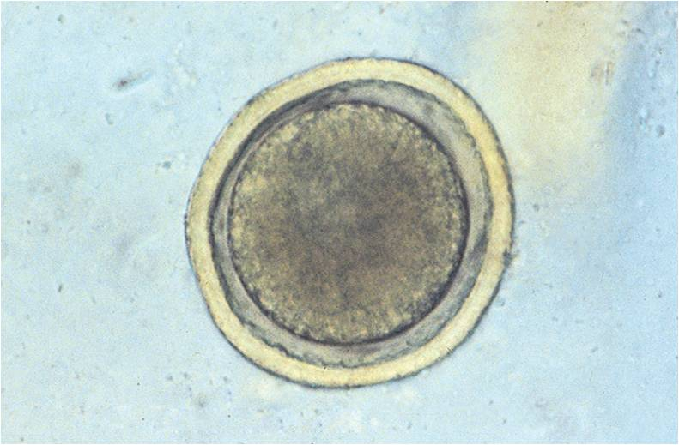
15
Identify

Slide 18
16
Enumerate parasitic species which give positive fecal occult blood test

Slide 19
17
Enumerate advantages of wet mount techniques

Slide 20
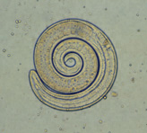
18
Identify

Slide 21
19
Mention the parasitic species that can be transmitted through mammary ( transmammary)

Slide 22
19
Define the term night soil and mention it is importance in medical parasitology

Slide 23
20
Mention the use of baermanns techniques ?

Slide 24

Good luck

